Slide 1


Ensuring Fiscal Prudence while making provision for partially/fully subsidized Public Goods & Services
Technical Presentation
A research Study proposed to NITI Aayog, Government of India
August 2026

Slide 2
Contents
(DMEO Proposal)
-

Slide 3

Why Deloitte
Our experience
We have undertaken similar projects in India and abroad
Deloitte has a dedicated team of professionals supporting governments and public sector institutions in public finance, fiscal policy, public financial management, debt management, FMIS, policy, expenditure and subsidy assessment, fiscal sustainability, revenue augmentation research, impact assessment, institutional strengthening and evidence-based policy formulation, with extensive experience in strengthening governance, improving public resource allocation and enabling sustainable and inclusive development in India as well as globally.
Familiar with Local context
Strong regional presence with established network
Deloitte has familiarity with the Indian public finance and policy landscape, having supported NITI Aayog, government institutions, multilateral agencies and key policy stakeholders on assignments covering subsidy assessment, fiscal policy, public finance, scheme evaluation and economic reforms. This provides strong contextual understanding of government priorities, institutional frameworks, public expenditure dynamics and subsidy-related challenges, enabling the team to deliver evidence-based and context-specific recommendations.
Our team
Experienced team with requisite expertise and skill sets
Deloitte has proven experience in assignments related to government and public sector transformation, public finance and fiscal governance in India and abroad, with dedicated teams working across areas such as fiscal policy and strategy, public financial management, expenditure and subsidy reforms, revenue and debt management, policy research and evaluation, institutional strengthening, digital transformation, capacity building, and evidence-based governance reforms.
We Know you
Our firm has served the NITI Aayog. We know your people, priorities and purpose
We know that NITI Aayog plays a pivotal role in shaping India’s development priorities, policy frameworks and evidence-based reforms. Deloitte has served as a trusted advisor to NITI Aayog across assignments on public finance, subsidy assessment, scheme evaluation and strategic policy research. We understand NITI Aayog’s focus on evidence-driven policymaking and fiscal efficiency and have proposed a team with the relevant expertise and experience to provide high-quality advisory support for this study.

Slide 4

Contents
Sl. No | Section | Slide
1. | Organization Profile | 5
2. | Information on consultant’s core Business and years in business | 11
3. | Approach & Methodology | 18
4. | Profile of Key Personnel | 31
5. | Our Experience in the field of Assignment | 39
6. | Letter of Association | 94
7. | Financial Turnover | 96
8. | Relevant documents | 99

Slide 5

Organization Profile

Slide 6
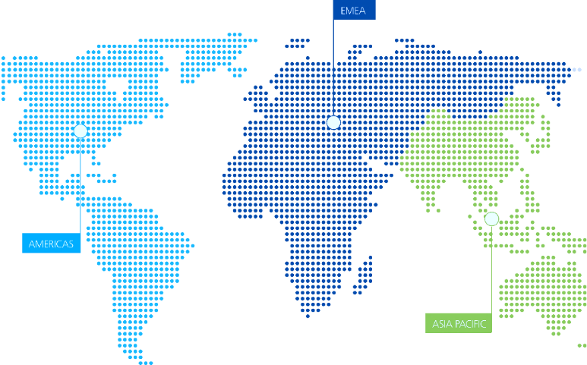
About Deloitte - A global vision and differential approach
Deloitte is a world character organization that advises and supports clients to reach success from any location in which they operate, offering Audit, Tax, Consulting, Financial Advisory, Risk Advisory and Legal Advisory services to all types of clients across multiple sectors.
Deloitte, the first choice for clients drawn by its world quality service in every segment of the market.
Presence
+150
Countries
Headcount
+4,10,000
Professionals

Slide 7
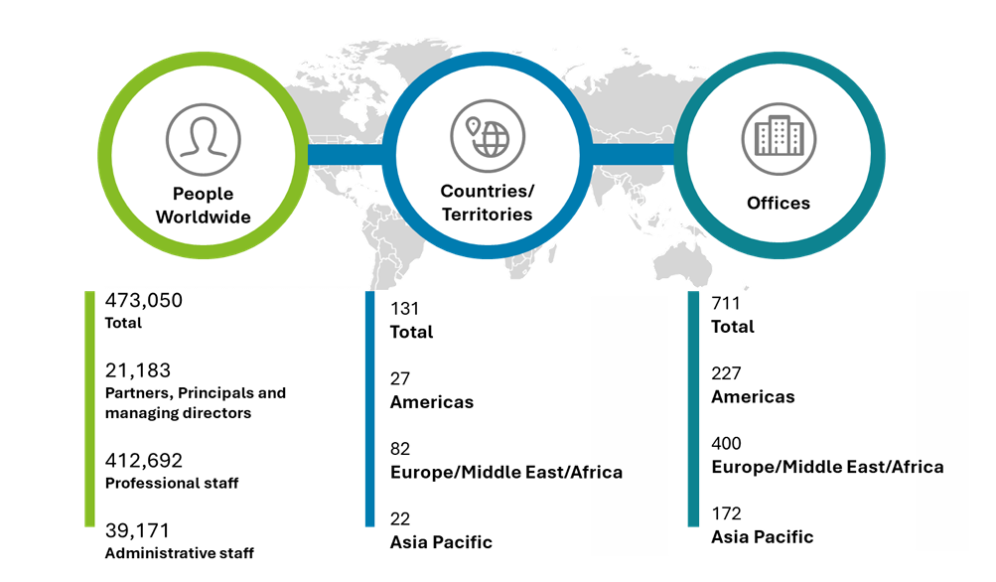
Deloitte Advantage
Deloitte is the world’s largest professional services organization with presence across 150+ countries and territories
North America
131 offices 2 countries
Key offices: New York, San Francisco, Los Angeles, Denver, Toronto, Montreal
Ranked #1 globally in Consulting by Kennedy
Named global leader in Business Analytics Services by Gartner
Named leader in Business Technology Transformation by Forrester Inc.
Named global leader in Cyber Security Consulting by Kennedy
Ranked #1 globally in Life Sciences Sector Consulting by Kennedy
Named leader in Global Risk Management Consulting Services by Gartner
Ranked #1 globally in Forensics & Dispute Advisory Services by Kennedy
Recognized for innovative client work by the International Tax Review
South America
69 offices in 28 countries
Key offices: Sao Paulo, Mexico City, Buenos Aires, Santiago, Caracas
Europe
297 offices in 47 countries
Key offices: London, Frankfurt, Paris, Rome, Dusseldorf, Madrid, Moscow, Prague
Africa & Middle East
46 offices in 35 countries
Key offices: Johannesburg, Cape Town, Kenya, Tel Aviv
Asia Pacific
113 offices in 26 countries
Key offices: India, Pakistan, Singapore, Thailand, Vietnam, Indonesia
India
30,000+ professionals
14 offices
Key offices: Mumbai, Delhi, Hyderabad, Bengaluru
Deloitte member firms serve 82% of the 2020 Fortune 500 companies

Slide 8
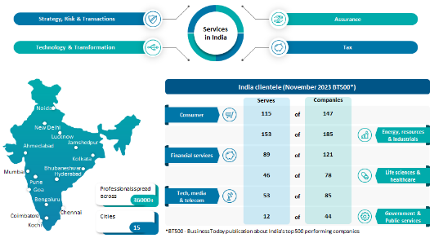
Technical and Managerial Capabilities of the firm
Deloitte India is one of the leading professional services firms with a rich heritage of serving the best-in-class clients in India
Deloitte in India
Deloitte has been present in the Indian sub-continent since 1893 through its network firm A.F. Ferguson and constitutes a large and important part of the global Deloitte network. Deloitte Touche Tohmatsu India LLP (DTTILLP) provides Research, Strategy & Consulting, Risk Advisory, Assurance, Tax and Financial Advisory services, supported by more than 36,000 professionals across 15 cities in India.
Deloitte’s PF practice has more than 30 years of experience supporting national, sub-national and local governments, international funding agencies and government organizations across public finance, state finances, fiscal policy and public financial management. Our experience includes expenditure management, subsidy assessment, fiscal sustainability, revenue augmentation, debt management and FMIS, as well as policy research, fiscal and economic assessments, stakeholder consultations, benchmarking, analytical frameworks and evidence-based policy recommendations.
Our global client experience includes the World Bank, Asian Development Bank, United Nations, USAID, European Union, EBRD, African Development Bank, Austrian Development Agency and Inter-American Development Bank, providing a strong combination of global insights and local expertise.
We deliver high-quality, evidence-based and implementation-oriented solutions for complex public finance, policy research and government reform assignments.

Slide 9
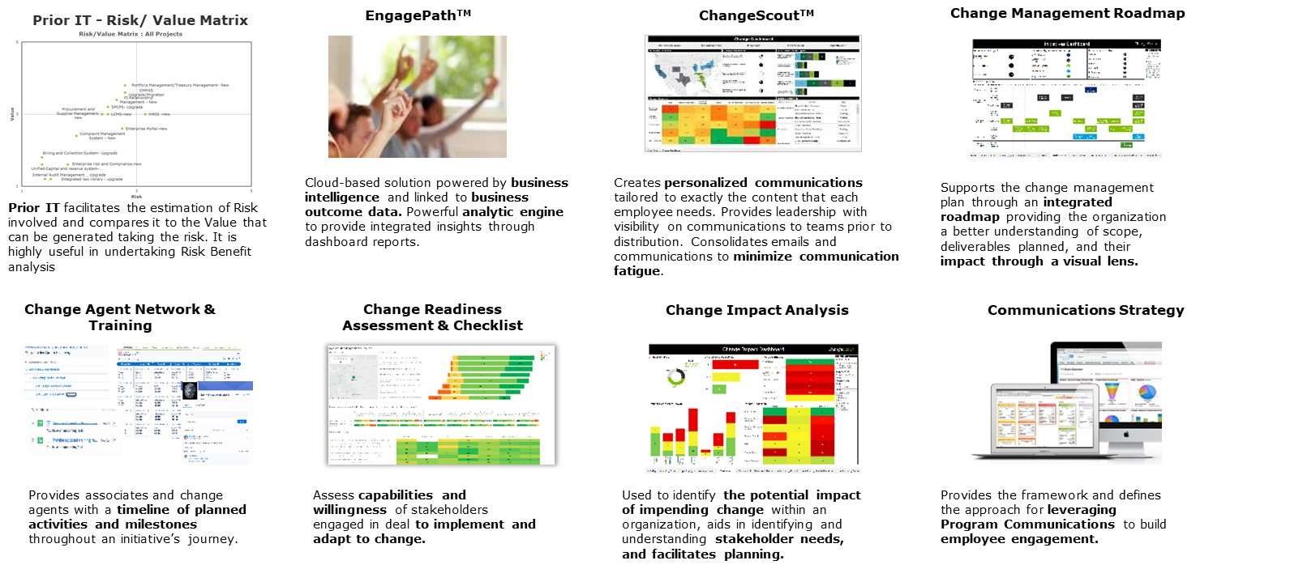
Selected thought leadership on Public Finance : Deloitte India

Slide 10
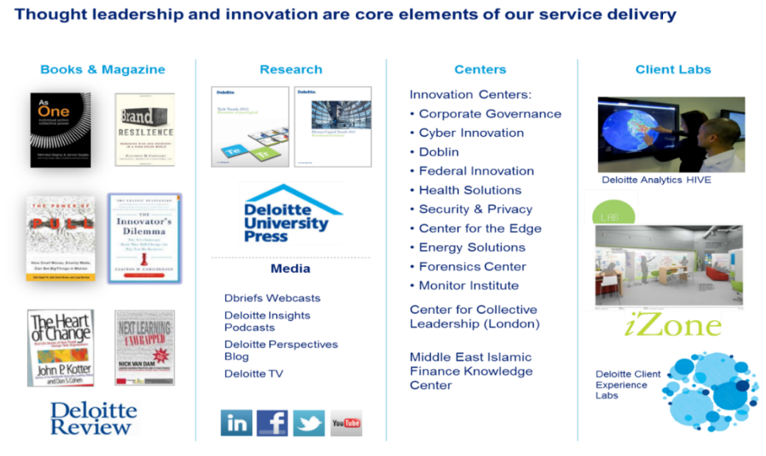
Selected thought leadership on Public Finance : Deloitte India

Slide 11
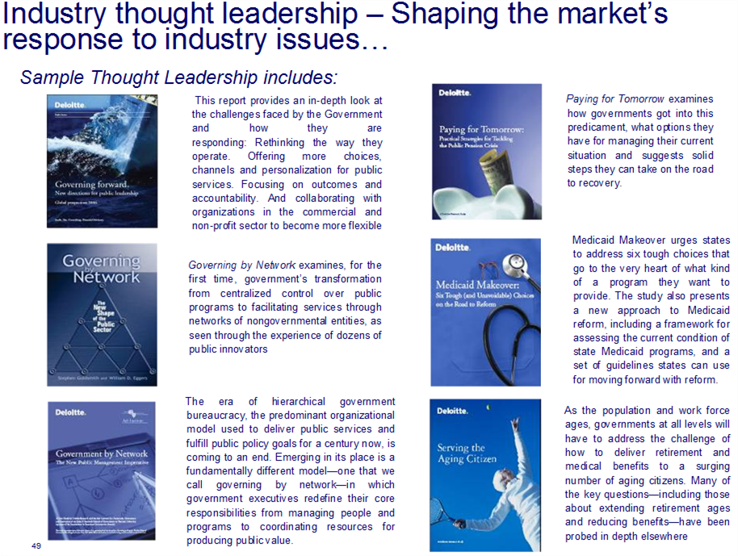
Selected thought leadership on Public Finance : Deloitte India

Slide 12
Information on the consultant’s core business and years in business

Slide 13
Information on the consultant’s core business and years in business
Deloitte Service Lines
Risk Advisory
Assurance
Tax
Financial Advisory
Consulting
Strategic & Reputation Risk
Regulatory Risk
Financial Risk
Operational Risk
Cyber Risk
A Comprehensive Audit Process
Assurance Services
Specialized Audit Services Including Detailed Investigations
Business Process Solutions
Global Business Tax
Global Employer Services
Indirect Tax
Mergers and Acquisitions (M&A) – Tax
Tax Analytics
Transfer Pricing
Corporate Finance & Restructuring
Forensic Services
M&A Transaction Services
Valuation & Modelling
Strategy and Operations
Human Capital
Technology
Government Public Sector
Energy & Resources
Financial Services
Life Sciences & Healthcare
Public Sector
Consumer Business & Transportation
Manufacturing
Technology, Media & Telecommunications
Note:
All of the services listed here may not be available from every Deloitte member firm. In addition, there may be local regulations restricting the provision of certain services to attest clients

Slide 14
Information on the consultant’s core business and years in business
Deloitte focuses on 7 core industries and 27 sectors in the global marketplace, and serves a range of sectors within each industry
Collaboration, innovation, industry insight, advice & implementation
Deloitte is…
A LEADING GLOBAL PROFESSIONAL SERVICES ORGANIZATION
Committed to being the best, raising the bar higher and setting the pace for others to follow
Delivers against a broad and deep multidisciplinary portfolio of business capabilities that is distinctive in our profession
Recognized as a leader by independent experts across most capabilities and industries of any professional services provider
Redefining how our profession serves the PIF and the public interest by making an impact that matters
Bringing global, integrated, and cross-/micro- industry perspectives to solve the PIF’s most complex problems
Unmatched breadth and depth of skills and capabilities
Assurance and
Compliance
Consulting, Advisory
& Implementation
Strategy
Human
Capital
Finance
Legal
Tax
Outsourcing
Assurance
Operations
Risk
Tech

Slide 15
Information on the consultant’s core business and years in business
Public Sector Consulting & Strategy
Deloitte member forms serve Public Sector clients, including national, provincial, regional, and/or local governments; international and non-profit organizations; and education institutional institutions in North and South America, Europe, the Middle East, Africa, Latin America, and Asia Pacific.
Deloitte Member Firms work with:
All the members of the G20
World’s largest global, multilateral, and bilateral donor institutions, including the World Bank Group
Most competitive nations as ranked by World Economic Forum
Most effective governments according to the World Bank
Largest economics as measured by GDP
World’s leading nations in innovation performance according to the Global Innovation Index produced by INSEAD and the World Intellectual Property Organization
Top countries leading in national achievement of health, education, and income according to the Human Development Report produced by the United Nations Development Programme (UNDP)

Slide 16
Information on the consultant’s core business and years in business
Public Sector
The Public Sector group in India team consists of industry specialists in government policies; regulations and governance; transport and infrastructure; and service delivery
Strong Industry Focus
Energy & Resources (E&R)
The vertical covers Oil and Gas, Power, Mining Renewal and nuclear Energy
Manufacturing
Life sciences and Healthcare
The sector includes automotive, aero-space and defense, capital goods, chemical process, metals and consumer product manufacturing
Consumer Business
Focus areas include health reforms, global markets and competitors, regulatory requirements, talent issues, healthcare transformation, reducing product costs, innovation and product value
Our specialist teams provide industry specific solutions in the Consumer Products, Retail, THL and Transportation sub-sectors
Financial services
Technology, Media and Telecommunications
The segments include banking and securities, insurance, investment management and real estate
The Technology, Media & Telecommunications Industry (TMT) group consists of the practices organized in the various member firms of DTTL and includes member firm partners, directors and senior managers, supported by many other professionals

Slide 17
Information on the consultant’s core business and years in business
Deloitte India Legacy
A series of mergers involving established brand names and strong internal growth has created critical mass
2004
AFF Merger
1999
SBB Merger
2013
Monitor India
1990
TR& Co. DHS Merger
1997
PCH Merger
Milestones
1940
CCC formed
1983
CCC and F&R= TR &Co.
1928
PCH formed
AFF: AF Ferguson
SBB: SB Billimoria
PCH: P.C. Hansotia
TR & Co: Touch Ross & Co.
CCC: CC Choksi
F&R: Fraser & Ross
1907
F&R formed
1902
SBB formed
1893
AFF formed
Note:
Deloitte Touche Tohmatsu India Private Limited (DTTIPL), the consulting arm of Deloitte in India was incorporated in 1995 (around 20 years). DTTIPL has been converted into a Limited Liability Partnership (LLP) with the name Deloitte Touche Tohmatsu India LLP (DTTILLP) under Section 58 of the Limited Liability Partnership Act, 2008 (LLP Act) read with provisions of the Third Schedule of the LLP Act with effect from 1 October 2015 (Effective Date).

Slide 18
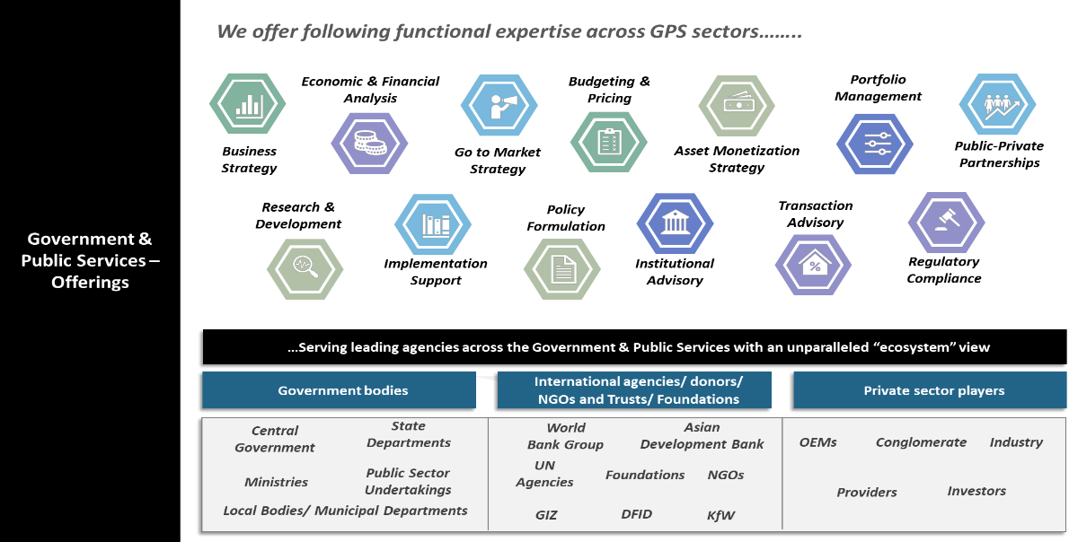
Our Clientele

Slide 19
Understanding the Scope

Slide 20
State of State Finances
Rising fiscal deficits and subsidy burdens are weakening expenditure quality, while fragmented documentation obscures the underlying drivers.
₹37.93 lakh cr: Combined revenue expenditure of 21 States in 2023-24, up 53.5% from ₹24.71 lakh cr in 2018-19
20.0%: Share of that revenue expenditure absorbed by subsidies and transfers - ₹7.59 lakh crore in 2023-24
2.2% → 2.7%: Subsidies and beneficiary-oriented schemes as a share of GSDP, 2018-19 to 2023-24 (16th Finance Commission)
WHY THIS MATTERS FOR FISCAL PRUDENCE
3% FRBM ceiling breached in 2024-25 and 2025-26
Source: RBI, State Finances: A Study of Budgets (GFD); Report of the 16th Finance Commission, 2026-31 (subsidies and transfers, capital expenditure), 21-State dataset.
Rising subsidy commitments is leading to higher pressure on fiscal space and persistent fiscal deficits therefore, is potential crowding-out of capital expenditure leading to weaker quality of public spending.
Also, Inter-State comparison is currently unclear: the same intervention is booked under different heads in different States, so ranking or benchmarking States on published subsidy data would mislead.

Slide 21
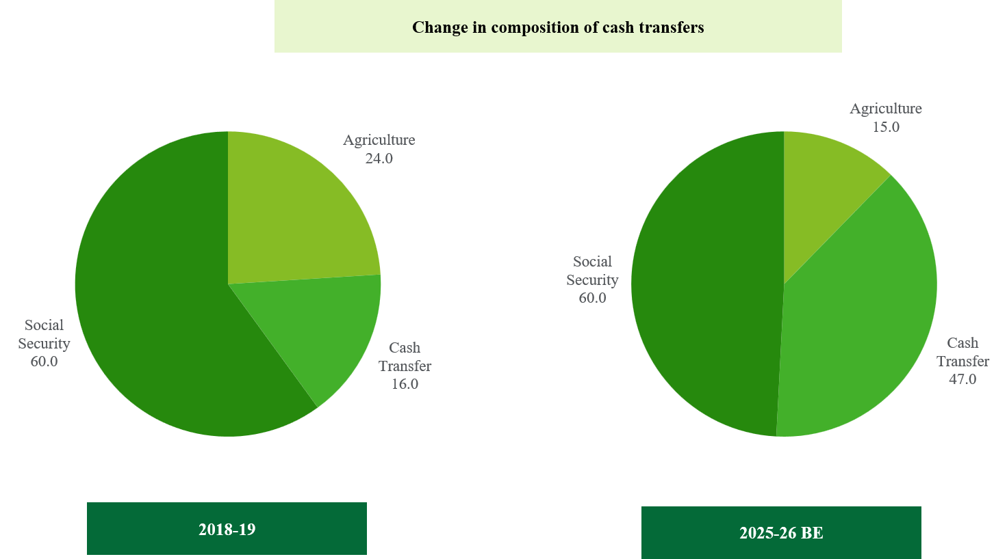
Changing composition of subsidies
The composition of subsidy spending has shifted decisively towards recurring, weak-conditioned transfers
Three conceptual Challenges compounded by three structural gaps in reporting
Audits found ineligible beneficiaries and duplication.
.
Definitional ambiguity: No single definition captures every use of the term. International standards focus on transfers to producers; Indian welfare programmes also transfer to consumers and households
Fragmented reporting: The same functional item is classified differently across States, departments and object heads. Payments routed through public enterprises may never reach the subsidy statement
.
Expenditure quality: A State with high committed expenditure and persistent deficits has less room for new commitments — yet a well-targeted provision cannot be judged on budget cost alone.
Source: 16th Finance Commission
Incompleteness
Cash transfers, PLI, tax expenditures and off-budget financing are excluded from official statements.
WHY THIS MATTERS FOR FISCAL PRUDENCE
₹73,099 cr → ₹2.63 lakh cr: Cash transfers by States, 2018-19 to 2025-26 BE — a rise from roughly 3% to about 20% of total subsidies
₹Transfers were largely financed through borrowing or capex cuts.
Inconsistency
Accounting heads shift — urea moved from Agriculture to Industry in 2010 — and bills are deferred irregularly.
₹9 states spent >5% of revenue on cash transfers; 6 ran revenue deficits.
85.0%:Share of consumption subsidies and unconditional transfers in the 2023-24 aggregate; above 90% in Punjab, Karnataka, Chhattisgarh and Rajasthan
Incomparability
Power subsidies alone appear under Agriculture, Power or Industry depending on the State.
34.2% / 15.5%: Power sector and social-security pensions as shares of the ~₹6 lakh crore spent in 2023-24 (16th FC)

Slide 22
Changing composition of subsidies
The composition of subsidy spending has shifted decisively towards recurring, weak-conditioned transfers
Three conceptual Challenges compounded by three structural gaps in reporting
Audits found ineligible beneficiaries and duplication.
.
Definitional ambiguity: No single definition captures every use of the term. International standards focus on transfers to producers; Indian welfare programmes also transfer to consumers and households
Fragmented reporting: The same functional item is classified differently across States, departments and object heads. Payments routed through public enterprises may never reach the subsidy statement
.
Expenditure quality: A State with high committed expenditure and persistent deficits has less room for new commitments — yet a well-targeted provision cannot be judged on budget cost alone.
Source: 16th Finance Commission
Incompleteness
Cash transfers, PLI, tax expenditures and off-budget financing are excluded from official statements.
₹73,099 cr → ₹2.63 lakh cr: Cash transfers by States, 2018-19 to 2025-26 BE — a rise from roughly 3% to about 20% of total subsidies
Inconsistency
Accounting heads shift — urea moved from Agriculture to Industry in 2010 — and bills are deferred irregularly.
85.0%:Share of consumption subsidies and unconditional transfers in the 2023-24 aggregate; above 90% in Punjab, Karnataka, Chhattisgarh and Rajasthan
Incomparability
Power subsidies alone appear under Agriculture, Power or Industry depending on the State.
34.2% / 15.5%: Power sector and social-security pensions as shares of the ~₹6 lakh crore spent in 2023-24 (16th FC)

Slide 23
Consequences of Definitional ambiguities on subsidies
Some Key Observations
16th Finance Commission
It noted a lack of standardization in defining and accounting for subsidies and transfers across States, which observed that subsidies and transfers are being misclassified as assistance, grants or other expenditure.
15th Finance Commission
Delayed subsidy payments create a cycle of utility debt, deteriorating service quality and increased State contingent liabilities.
Example: In Punjab, unpaid power subsidies accumulated to Rs 7,930 crore by 2020-21, effectively converting an explicit subsidy into public debt.
CAG Report (2022)
For FY2021-22, out of total subsidies of 32,998 cr., 34.3% were implicit in nature and got booked elsewhere (i.e not as subsidies).
ADB Report (2026) submitted to 16th Finance Commission
For FY2023-24, a total of INR 3 lakh crores were distributed as subsidies by States which were not classified as subsidies. Some examples below-
Purpose | Amount not classified as subsidy (2023-24) | Illustrative schemes
Pension and subsistence allowance | Rs 77,109 cr | Cheyutha Pension, Telangana (Rs 7,335 cr.); NTR Bharosa Pension, Andhra Pradesh (Rs 5,680 cr.); Old Age Samman Pension, Haryana (Rs 5,008 cr.)
Electricity | Rs 66,471 cr | TANGEDCO losses under UDAY, Tamil Nadu (Rs 17,117 cr); discom loss funding under revamp schemes, Uttar Pradesh (Rs 9,700 cr)
Financial assistance | Rs 57,182 cr | Gruha Lakshmi, Karnataka (Rs 16,964 cr); Rajiv Gandhi Farmer Justice Scheme, Chhattisgarh (Rs 4,926 cr); Orunodoi, Assam (Rs 3,202 cr)
Loan waiver | Rs 25,315 cr | Debt relief to farmers, Telangana (Rs 11,021 cr); waiver of agriculture loans, Tamil Nadu (Rs 2,478 cr)
Price support | Rs 17,416 cr | Krishak Unnati, Chhattisgarh (Rs 13,320 cr)
Housing | Rs 15,112 cr | PMAY Housing for All, Uttar Pradesh (Rs 2,380 cr); Shabari Tribal Housing, Maharashtra (Rs 1,250 cr)
Investment promotion | Rs 14,898 cr | Rythu Bharosa, Telangana (Rs 13,576 cr); assistance to textile mills, Uttar Pradesh (Rs 423 cr)
Food | Rs 14,577 cr | MSP Scheme, Maharashtra (Rs 4,771 cr); supplementary nutrition under ICDS, Uttar Pradesh (Rs 1,027 cr)
Healthcare | Rs 14,340 cr | National Rural Health Mission, Uttar Pradesh (Rs 2,945 cr); Biju Swasthya Kalyana Yojana, Odisha (Rs 1,452 cr)

Slide 24
Deloitte’s Point of View-Need for clarity of definition/framework on fully/partially subsidized goods
Steps we believe the study must take - and which shape everything in our methodology
The value of this engagement is not in estimating current spending. It is in building a classification architecture robust enough to survive changes in administration and shifting terminology: freebies, incentives, merit goods.
On the problem statement
Comprehensive framework capturing multiple dimensions
A credible framework must triangulate three dimensions at once
  nature of the good
  financing mechanism
  intent/targeting
  Existing frameworks apply only one lens. That is the gap this study closes
Framework needs to capture State level complexities
Primary research must deliberately weight State heterogeneity.
Major States, NE/Hill States and UTs
Not only Fiscal scale but in administrative and data-reporting capacity — so sampling and consultation should stratify accordingly
Benefits under SSA
Deloitte’s POV
PF provisions in case of IW
Need for a practical framework which can be used by States
The framework must be usable prospectively - designed so NITI Aayog and States can classify new schemes as they are proposed, not only categorise existing ones retrospectively.
This registers definitions decay over time within the same department
Focus beyond budgetary transactions
Improved classification is not a data-hygiene exercise.
Off-budget exposure and contingent liabilities arising from unclassified subsidies are already a focus for rating agencies and FRBM-linked review,
Labour Code

Slide 25
Our Understanding of the Scope
i
Assess the status of State finances across key fiscal parameters and highlight challenges
ii
Review existing literature and document efforts made towards defining the various forms of subsidies around public goods/services
iii
Explore the possibility of formalising a definition for partially/fully subsidised public goods/services rolled out by governments
The core problem is not the presence of the subsidies; it is that no consistent framework exist tell legitimate welfare apart from fiscally high-risk provision
Subsidies expand
and change shape
: Cash transfers move from ~3% to ~20% of total subsidies; ₹73,099 cr becomes ₹2.63 lakh crore.
.
Financing moves
off the books
Off-budget borrowing, PD-account routing, deferred reimbursement and discom arrears.
Committed
expenditure locks in: Salaries, pensions and interest absorb a large share of receipts -~9% of GSDP, compounding 7-10% a year
Capital spending
is crowded out
: Capex compressed to 1-3% of GSDP for most States — the adjustment of least resistance.
Narrowing tax
Autonomy: GST removed residual State tax powers; the Compensation Cess has been phased out.
Debt breaches
prudential limits
: Debt-to-GSDP past FRBM targets in several States; the cost shifts to future budgets
Shrinking fiscal space further, and the loop tightens
Where this study intervenes
Define: A common taxonomy that survives changes in administration and technology
Detect: Surface the subsidy like spend that never reaches the subsidy statement
Classify: Separate essential welfare from conditional and distortionary provisions
Decide: A toolkit apply to schemes not yet designed, not just those exist

Slide 26
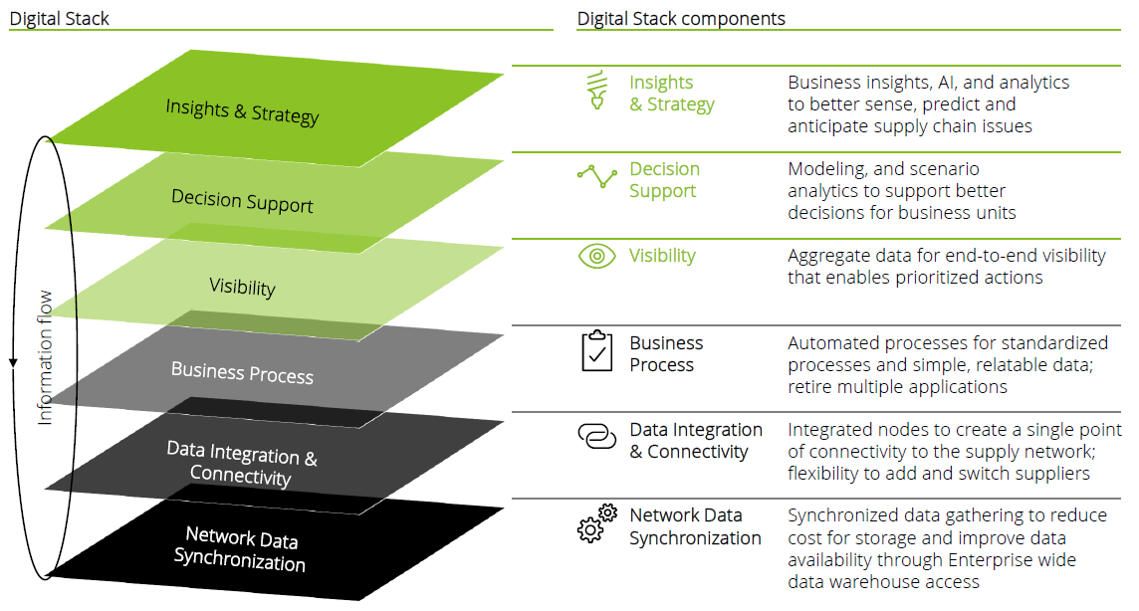
Objectives of the Study
A comprehensive, evidence-based guideline for Central and State Governments to identify, assess and review partially or fully subsidised public goods and services - safeguarding both fiscal sustainability and legitimate welfare objectives.
 | Assessment of State finances | Trends across revenue receipts, revenue and capital expenditure, deficits, committed expenditure, debt and interest payments.
 | Review of concepts & definitions | National and international literature on subsidies, welfare expenditure, merit goods and provisions described as freebies.
 | Development of a classification framework | Criteria separating essential welfare and capability-enhancing support from provisions that may be distortionary.
 | Estimation of explicit subsidies | DDGs and related statements reviewed to capture subsidy-like spend booked as grants, assistance, transfers or agency payments.
 | Assessment of fiscal implications | The burden subsidy commitments place on revenue expenditure, fiscal space and room for capital investment.
 | Benchmarking | Domestic and international practice in targeting, DBT, tariff design, metering, sunset clauses and transition support.
 | Guideline & framework / toolkit | A practical instrument testing provisions against welfare, affordability, targeting, transparency and sustainability criteria.
THE OVERLAP THIS STUDY WILL EXPLAIN Several States running the largest subsidy programmes also rank among the lower-scoring States on NITI Aayog's own Fiscal Health Index (2026). Whether that is cause, consequence or coincidence is precisely what a consistent classification framework would let us test — rather than assume.

Slide 27




Relevance and need of the Study
Four reasons this study is critical now - and one uncomfortable overlap that motivates all of them
Definitional &
accounting clarity
Strengthening
targeting & equity
Unifies fragmented subsidy definitions across Union and State budgets, addressing under-reporting from off-budget liabilities, special securities and misclassified heads.
Restoring
fiscal prudence
HCES 2023-24 micro-data shows how untargeted universal subsidies disproportionately benefit affluent quantiles, supporting a shift to Aadhaar-enabled DBT.
Institutionalising
PFM reform
Empirical evidence on how escalating discretionary giveaways widen revenue deficits, elevate debt and crowd out high-multiplier capital investment.
A permanent toolkit, standardised reporting formats and actionable guidelines for NITI Aayog to guide sub-national PFM and support Vision 2047.
THE OVERLAP THIS STUDY WILL EXPLAIN Several States running the largest subsidy programmes also rank among the lower-scoring States on NITI Aayog's own Fiscal Health Index (2026). Whether that is cause, consequence or coincidence is precisely what a consistent classification framework would let us test — rather than assume.

Slide 28
Approach and Methodology

Slide 29
Six Principles that govern out approach
Each one is a design decision that changes how the study is executed, not a statement of intent
01
Definitional clarity is foundational, not preliminary
02
State heterogeneity demands a differentiated approach
03
Visibility into off-budget spending is critical
Given the absence of a standardised definition, we treat definition-building as the core deliverable that shapes all subsequent data collection, classification and framework design — not a first step to move past.
Major States, NE/Hill States and UTs vary in fiscal scale, administrative capacity and reporting maturity. Sampling, consultation and data collection are calibrated to those differences to preserve like-for-like comparability.
A significant share of subsidy expenditure is deferred or routed through off-budget borrowings and special securities. Our methodology goes beyond published budget documents into CAG audit reviews, State PSU financials and contingent-liability disclosures.
04
Empirical rigour balanced with contextual judgment
05
The output must be usable, not merely descriptive
06
Comparability is designed in from the outset
Quantitative classification is systematised, but borderline cases require judgment informed by consultation — so the framework reflects real administrative practice, not theoretical categorisation.
Beyond classifying current spending, the toolkit is designed for prospective use — enabling NITI Aayog and States to apply it to new schemes as they are proposed.
Normalisation for fiscal capacity, population and reporting maturity is built into the method, so the study does not reproduce the very inconsistencies it seeks to resolve.

Slide 30
Phase-wise Approach & Methodology
A definition, an estimate and a working toolkit in 120 days
PHASE I
T to T+30 days
PHASE II
T+30 to T+90 days
PHASE III
T+90 to T+120 days
INCEPTION & PLANNING
ASSESS & DESIGN
CONSOLIDATION & VALIDATION
Finalise approach, coverage and expectations with NITI Aayog
Identify primary and secondary stakeholders and consultation plan
Confirm data sources, templates and study area / State sample
Preliminary secondary research and meta-analysis of literature
Agree final table of contents, work plan and governance
Ten-year fiscal panel for 21 States and the Centre
Object-head review of Detailed Demands for Grants
Implicit subsidy, off-budget and contingent-liability probe
Fiscal-space assessment and crowding-out analysis
Key informant interviews and focus group discussions
Four-dimension classification matrix and draft framework
Validation workshop on the draft framework
Incorporation of NITI Aayog and stakeholder comments
Build and test the Excel-based four-module toolkit
Executive synopsis and policy recommendations
Dissemination workshop and handover of raw data repository
D1 · Inception Report and presentation
D2 · Draft Final Report with draft framework/toolkit
D3 · Final Report, synopsis and data repository
RUNNING THROUGHOUT · Fortnightly progress review with NITI Aayog's Monitoring and Advisory Committee · Monthly sub-reports on data collection, data quality checks, secondary research, toolkit and analysis

Slide 31
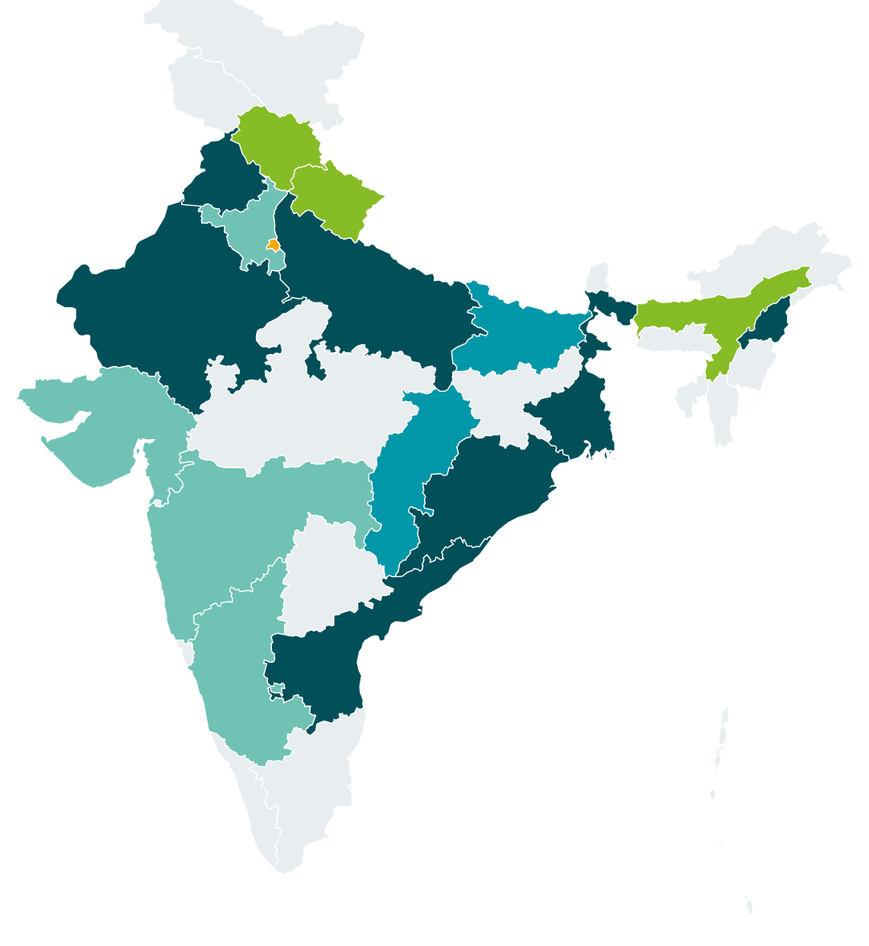
Phase -1: Selection of the study areas
A three-tier sample that reflects fiscal scale, administrative capacity and reporting maturity — not just geography
TIER 1 · MACRO PANEL
TIER II · Stratification of the States
Macro-fiscal analysis and trend mapping across 21 large States (~95% of India's GDP) and the Central Government, over FY 2016-17 to FY 2025-26.
Major general category States — high-subsidy/high-deficit 2) Fiscally prudent comparators 3) NE/Hill States for cost disabilities, and UTs with legislature for urban utility subsidy structures.
TIER 3 · DEEP-DIVE STATES AND THE PARAMETERS THAT SELECT THEM
Deep-dive States (7)
Reference set: Andhra Pradesh, Punjab, Rajasthan, West Bengal, Uttar Pradesh, Odisha and Nagaland — the seven States examined in the NITI Aayog-sponsored study, chosen because they span substantial variation in fiscal profile, subsidy dependence, regional characteristics and reliance on central transfers. The final shortlist will be confirmed against the eight parameters below and through consultation with NITI Aayog.
High-subsidy / high-deficit
Fiscally prudent comparators
NE & Hill States
TIER 2 · STRATIFICATION
UT with legislature
Macro panel only
Fiscal and revenue deficit as % of GSDP
Share of subsidies in total revenue expenditure
Composition of subsidies
Growth in subsidies over the last five years
Committed expenditure as % of revenue receipts
Revenue and capital expenditure as % of GSDP
Debt to GSDP ratio
Interest payment to revenue receipts ratio
High Risk
Moderate Risk
Low Risk

Slide 32
Phase -II: Assess & Design Four Dimesion Evaluation Matrix
Measuring what the budget books do not show — four steps from published statement to defensible estimate
01 Compile the Fiscal Panel
02 Review Detailed Demands for Grants at object-head level
03: Probe Beyond the Budget
04: Access the Fiscal space
Ten years of annual data across RBI State Finances, CAG Finance Accounts and audit reports, State Budgets, Indian Public Finance Statistics
Journal literature and audit findings on mis-accounting of subsidy expenditure and spending on non-merit goods
Reconciliation of the same item across sources before any analysis
Reorganise expenditure by major, sub-major, minor, sub-minor, detailed and object head — the primary unit of account
Identify expenditure explicitly classified as subsidy; scholarships, pensions and direct transfers meeting the adopted definition; non-salary grants providing concessions or private goods
Assistance to PSUs, boards, corporations and cooperatives financing explicit benefits or compensating mandated price concessions
Interest subvention, insurance premium support, fee waivers and loan-related assistance; subsidy-like spend routed through implementing agencies
Implicit subsidies from under-priced tariffs in power, transport and comparable sectors
Off-budget financing and funds transferred through Personal Deposit accounts
Contingent liability statements, guarantees and PSU-level data where off-budget borrowing has occurred
Key informant interviews to surface scheme-level spend that is distortionary but not labelled as subsidy
Revenue resources remaining after committed expenditure — salaries and wages, pensions, interest payments
Statutory transfers to local bodies and other rigid obligations where the State has limited discretion
No universal numerical ceiling is prescribed: the analysis shows how much revenue is pre-empted and how subsidy obligations interact with revenue balance, debt servicing and capital expenditure
Every identified scheme is tested against four dimensions on documented evidence, never on its name or its sector
Universal vs. Targeted
Consumption vs. Investment
Progressive vs. Regressive
Positive vs. Negative externalities
1
2
3
4
Universal or restricted to identified groups · clarity of eligibility · exclusion and deduplication arrangements
Supports immediate household consumption, or builds human capital, agricultural productivity and durable infrastructure
Benefits flow to lower MPCE quantiles reducing inequality, or are captured by affluent quantiles consuming higher volumes
Creates uncompensated societal benefit in health, literacy or clean energy, or distorts pricing, depletes resources and erodes credit discipline

Slide 33
Classification: how a scheme resolves to Policy Response
Composite scores place each scheme in one of three assessment categories
Essential welfare or capability-enhancing expenditure
Conditional or reformable subsidy
Distortionary or high-risk provision
Targeted, or justified by strong welfare, distributive or externality considerations, and supported by a sustainable delivery design.
Addresses a legitimate objective but requires improved targeting, redesign, time limits, metering, DBT conversion, periodic review or transition arrangements.
Weakly targeted, open-ended, fiscally unaffordable, associated with adverse resource or market effects, or financed through repeated arrears and liabilities.
Policy consequence: Retain and protect. Report separately so that welfare spending is not conflated with distortionary provision in fiscal commentary.
Policy consequence: Reform with a defined instrument and a defined date. This is where most of the fiscal opportunity sits.
Policy consequence: Phase out or restructure, with exit clauses and transition support, consistent with the 16th Finance Commission's recommendations.
ILLUSTRATIVE OUTPUT OF THE CLASSIFICATION MATRIX
Scheme / provision of public good | Essential welfare or capability-enhancing | Conditional or reformable | Distortionary or high-risk | Resulting classification
Scheme 1 | ✓ | — | — | Welfare expenditure
Scheme 2 | — | ✓ | ✓ | Distortionary partially/fully subsidised public good
Scheme 3 | ✓ | ✓ | — | Welfare expenditure, flagged for redesign
The draft framework is tabled for discussion at the close of Phase 2, so that NITI Aayog and consulted States shape the classification rules before they are applied at scale.

Slide 34
Phase III: The Framework / Toolkit Governments Can Actually Operate
Self-contained MS Excel instrument with a user guide, in four modules
01
Scheme Intake Sheet
A structured template for any State or Ministry to enter a scheme's basic parameters — objective, budget head, beneficiary base, financing source and duration.
Standardised, comparable scheme-level data across States
02
Classification Engine
Applies the 4-Dimension Evaluation Matrix with pre-set weights, computing a composite score automatically from the intake data.
Auto-generated verdict across the three assessment categories
03
Fiscal Space Dashboard
Pulls the six fiscal-space indicators for the relevant State alongside the scheme being assessed.
A one-page fiscal-context view sitting beside each classification
04
State / National Roll-up
Aggregates scheme-level classifications into a State-level and All-India summary.
Ready benchmarking — e.g. % of a State's subsidy budget that is high-risk
Validation and benchmarking anchors
International
Domestic
Validation route
IMF GFSM 2014 and COFOG · OECD Producer and Consumer Support Estimate · World Bank quasi-fiscal-deficit and hidden-cost methodology
NIPFP merit / non-merit taxonomy · Odisha's implicit-subsidy reporting · NITI Aayog's Fiscal Health Index
Periodic reviews with NITI Aayog · workshop on the draft framework · dissemination workshop on the final toolkit
© 2026 Deloitte Touche Tohmatsu India LLP.
Ensuring Fiscal Prudence in Subsidised Public Goods & Services | Technical Presentation to NITI Aayog
20

Slide 35
Benchmarking
Tested international building blocks, adapted for a federal structure they were not designed for
INTERNATIONAL FRAMEWORKS
DOMESTIC PRECEDENTS
IMF · GFSM 2014 and COFOG
NIPFP · merit and non-merit taxonomy
Subsidy classification and functional classification of expenditure. Treats subsidies as current unrequited transfers to producers, with direct transfers to households classified separately as social benefits.
The unrecovered-cost concept (Mundle and Rao, 1991; Srivastava et al., 1997, 2003) defines budgetary subsidies as the difference between the cost of delivering a non-public good and the recoveries realised.
OECD · Producer and Consumer Support Estimates
Odisha · implicit subsidy reporting
Inventory-based measurement that captures support delivered through price mechanisms as well as budget transfers — directly relevant to India's under-priced tariffs.
A working State-level precedent for surfacing implicit subsidy in published fiscal documents rather than leaving it undisclosed.
World Bank · Quasi-fiscal deficit and hidden cost
NITI Aayog · Fiscal Health Index
Methodology for measuring implicit subsidies, developed most fully in the power sector, where India's largest implicit exposure sits.
Ranks States on quality of expenditure, revenue mobilisation, fiscal prudence, debt level and debt sustainability — providing a ready normalisation layer for cross-State comparison.
How comparator countries will be selected
Scale of welfare expenditure
In absolute and per capita terms, benchmarked against population size
Nature of the instrument
Weighting countries with a history of budgetary subsidies and cash transfers
Demonstrated impact
Effect of that expenditure on economic development outcomes
Domestic benchmarking cases will be drawn from States identified in the literature review as exhibiting the relevant patterns.
Ensuring Fiscal Prudence in Subsidised Public Goods & Services | Technical Presentation to NITI Aayog
20

Slide 36
Work Plan
Timeline
T
M1
M2
M3
M4
Cadence
Schedule Output/Deliverables
Schedule Output/Deliverables
Schedule Output/Deliverables
Schedule reviews
Schedule reviews
Schedule reviews
Phase 1
Inception & Planning
Kick-off and stakeholder identification
State selection and stratification
Run-Scale
Secondary research and meta-analysis; scope, methodology and report structure finalised
Fiscal-space assessment; KIIs and FGDs with States; benchmarking
Phase II
Assess & Design
Ten-year fiscal dataset: RBI, CAG Finance Accounts, State budgets
Activities
DDG review, major head to object head; implicit, off-budget and EBR exposure
Scheme shortlisting and evaluation matrix
Classification framework: welfare, reformable, distortionary
Excel framework build & recommendations
NITI Aayog comments and feedback
Phase III
Validate & Report
Validation workshop on draft report
Final report, synopsis & data repository; dissemination workshop
Programme management . Quality & Risk Assurance
Project charter and governance mechanism | Fortnightly progress reporting | Data-quality assurance and independent technical review | Plagiarism and IPR compliance | Risk identification and mitigation
Key Output/ Deliverables:
D1 — Inception Report and presentation (T+20), finalised after NITI Aayog comments (T+30): confirmed scope, methodology, State sample, secondary-research findings and report structure; D2 — Draft Final Report (T+90): recalculated subsidy estimates, Econometric model output, NSSO quantile targeting analysis, case studies and draft framework/toolkit; D3 — Final Report and sign-off (T+120): executive synopsis, 10 book-bound hard copies and soft copy, verifiable raw data in MS Excel/CSV and consultation transcripts
Drafts of all output prepared will be presented to the officials for review. Discussions/meeting will be undertaken with the relevant officials and recommended changes will be incorporated in the final output. All final outputs/reports will then be submitted
Legend:
Assess — research and analysis
Run
Deliverable to NITI Aayog
Stakeholder workshop
Fortnightly progress review
Design & Deliver — framework, reporting
Advocacy Content, material

Slide 37
Profile of the key personnel

Slide 38



Proposed team structure and staffing
A three-tier structure — leadership and quality assurance, key experts, and project
PROJECT LEADERSHIP & QUALITY ASSURANCE
KEY ROLES AND CONTRIBUTION
Report status, escalate issues and risks
Cascade direction, decisions and approvals
NITI Aayog - Governance
Deloitte Leadership & QA
Partner, Public Finance Practice — Project Sponsor
Independent Quality & Risk Reviewer
Sets strategic direction, resolves policy-level and stuck issues, and owns the relationship with NITI Aayog
Independent quality and risk review of the Inception, Draft Final and Final Reports before submission
Guarantees continuity of the PI for the full study period, as undertaken in Form 1
10%
KEY EXPERTS — CORE TECHNICAL TEAM
State Finance Departments & Line Ministries
Finance Secretaries, Budget Directors, DISCOM and implementing-agency officials
Academia, think tanks and multilateral experts facilitated by NITI Aayog
Principal Investigator — Tapas Kumar Sen
45+ years | Public finance, subsidy incidence, fiscal federalism
Co-Principal Investigator — Rishav Singh
23+ years | PFM, expenditure management, fiscal sustainability
PI owns the definition, the classification framework and the final policy recommendations, and signs off every deliverable
Co-PI co-leads the four-dimension evaluation matrix, fiscal-space assessment and national/international benchmarking
Lead the KIIs, FGDs and validation workshops with States, ministries and domain experts
% of issues resolved at each tier
15%
PROJECT SUPPORT TEAM
NITI Aayog nodal support
Facilitation of stakeholder connections, datasets, parameters and report structure
Data custodians — RBI, CAG, State Finance Departments
Research Staff cum Project Manager — Kartik Agarwal
13+ years | State fiscal analysis, outcome budgeting, econometrics
Field Staff (2 members) — Purvi Chaturvedi (6+ yrs), Aanchal Karnani (2+ yrs)
Budget analysis, KII/FGD administration, welfare-scheme research
Compiles the ten-year dataset from RBI State Finances, CAG Finance Accounts, DDGs and State budgets, with data-quality checks
Builds and tests the MS Excel framework/toolkit and assembles the verifiable raw-data repository for NITI Aayog
Owns the workplan, fortnightly progress reporting and coordination with the NITI Aayog nodal officer
Administers the State questionnaire and prepares consultation transcripts and field notes
75%

Slide 39
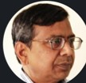

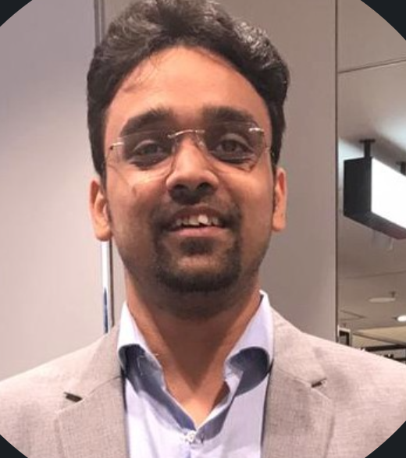

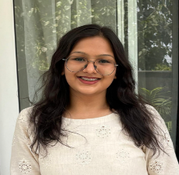
Information on the qualification of key staff
A five-member core team, with the engagement partner carrying dual responsibility for delivery and for governance
Dr. Tapas Kumar Sen
Principal Investigator · Public Finance Specialist · 45+ years
Rishav Singh
Co-Principal Investigator · Engagement Partner · 23+ years
Kartik Agarwal
Research Staff-1 · Project Manager · 13+ years
Purvi Chaturvedi
Aanchal Karnani
Field Staff-1 · 6+ years
Field Staff-2 · 2+ years

Slide 40
Information on the qualification of key staff
Deloitte Touche Tohmatsu India LLP
Education
Subject Matter Expertise
  Ph.D. — University of Pune
  M.A. (Economics) — Sambalpur University
  B.A. (Hons. in Economics) — Sambalpur University
Public Finance & Fiscal Policy
Sectoral Strategy Preparation
Subsidy Policy & Rationalisation
Revenue Mobilization and Fiscal Risk Assessment
Program Management
Public Expenditure & Budget Analysis
Welfare Expenditure & Merit Goods
Tapas Kumar Sen
Professional Highlights
Public Finance Specialist with extensive experience in fiscal policy, public expenditure management, welfare financing and fiscal sustainability, with a strong focus on assessing the fiscal burden of government support programmes and public service commitments. Experienced in expenditure rationalization, fiscal risk assessment, intergovernmental transfers and evidence-based resource allocation for Central and State Governments
Relevant experience
Fiscal Impact & Expenditure Assessment: Assessed the fiscal implications of government support programmes, welfare commitments and public expenditure, including their impact on State fiscal balances and sustainability.
Expenditure Rationalisation: Analysed expenditure composition, prioritisation and efficiency of government interventions, including measures to rationalise non-merit and low-impact expenditure.
Welfare & Public Service Financing: Evaluated welfare-sector financing, merit goods and subsidised public services, considering coverage, fiscal affordability and competing development priorities.
Fiscal Risk Analysis: Assessed endogenous fiscal risks arising from government support commitments, pensions, public debt and other liabilities, including under the ADB-supported Jharkhand assignment.
Fiscal Forecasting & Policy Analysis: Undertook estimation and forecasting of major government support expenditures and analysed their medium-term implications for fiscal management.
Centre–State Fiscal Framework: Examined welfare expenditure requirements, expenditure commitments and resource-sharing arrangements in the preparation of Madhya Pradesh and Odisha memoranda for the 15th Finance Commission.
Public Finance Research: Co-authored key studies on Government Subsidies in India, Subsidies of the Government of India and Forecasting Major Subsidies of the Central Government, covering the scale, incidence and fiscal implications of government support.
Resource Allocation & Fiscal Prudence: Provided policy inputs on resource allocation, expenditure prioritisation and fiscal consolidation, balancing social-sector commitments with available fiscal space.

Slide 41
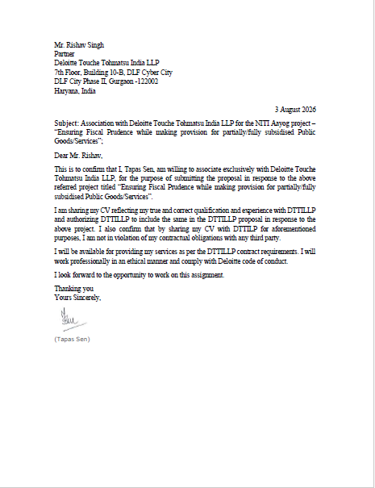
LoA of the qualification of key staff
Deloitte Touche Tohmatsu India LLP

Slide 42
Information on the qualification of key staff
Deloitte Touche Tohmatsu India LLP
Rishav Singh
Executive Director, Deloitte Touche Tohmatsu India LLP
Education
Subject Matter Expertise
    PGDM from Indian Institute of Management (Premier B school of India), Calcutta
    MA Economics
    BA Economics
  Macro-fiscal Analysis
  Policy Analysis, Data Analysis
  Public Finance Reforms
  Risk & Compliance Management
  Project Management
  Tax Policy, Tax Administration
  Debt Management
Professional Highlights
Rishav is an Executive Director with the Public Finance Practice of Deloitte India with more than 15 years of professional experience in Government Consulting. He has worked for bilateral/ multilateral funded projects for DFID, World Bank and ADB especially in the area of economic development, gender budgeting, Macro fiscal modelling, assessing correlation between sectors and GDP, outcome budgeting, debt management reforms, procurement reforms and Fundamental Rules and Pension Rules management. Rishav is currently working on an economic growth and transformation project with the Government of Uttar Pradesh, India. Rishav is leading the module on macro fiscal analysis and revenue augmentation. This includes analysis of the macroeconomic profile of the state, fiscal analysis and assessment of the impact of female labour force participation on the economic growth.
Relevant experience
  Guiding the team in implementation of large-scale reform project of boosting up the size of Gross State Domestic Product (GSDP) of Uttar Pradesh to One Trillion Dollar in five years. Performed critical analysis of macro and micro economic sectoral data around GSDP, trade, investment, expenditure, saving, workforce participation, inflation, import and export in the State. Analyzed the status and recent trends to determine multipliers between sectoral growth and impact on the GSDP; and assign targets and how to achieve them for each sector. Designed robust methodologies on potential social impact of each proposed intervention. Currently providing continuous technical handholding support to implementing departments/ agencies to ensure seamless coordination and delivery in a time bound manner.
  Guided the team in analyzing the feasibility and methodology for estimating Green GSDP for Uttar Pradesh (one of the large state in India)
  Build and implementation of Financial Consolidation System for Department of Finance, Abu Dhabi
  Supporting the Second West Bengal Development Finance Program, West Bengal - led the fiscal policy and expenditure reforms for comprehensive fiscal consolidation program that aims to generate fiscal savings. Required to provide assistance to West Bengal to augment growth enhancing development financing and improve delivery of public services.
  Strengthening Decentralized Participative Planning in Rajasthan under Strengthening Public Financial Management, Rajasthan
  Preparation of Memorandum for Fifteenth Finance Commission (FFC) for Government of West Bengal - Led the team to analyze the state finances, deficit, and debt levels of Government of West Bengal; Studied the distribution of previous Finance Commissions between the Union and the states and recommended a criterion/parameter for inter-se distribution on behalf of the government which included social sector including education and health; Performed analysis of revenue performance of the State.
  Preparing Memorandum to Thirteenth Finance Commission for Government of Madhya Pradesh
  Prepared a Medium-term fiscal framework for Government of Madhya Pradesh - Undertook sectorial reviews, review of past expenditure, identification of performance indicators and costing of programmes and policies. Undertook fiscal projections for the Government over next five years based on proposed strategy and intervention; Carried Capacity Building workshops of stakeholders on budget preparation and management and MTFF Macroeconomic analysis and forecast of resources based on socio economic objectives of the state.
  Prepared a vision framework for Government of Andhra Pradesh encompassing current trends in public finance and reforms in expenditure management - Mapped key revenue processes and suggested process improvements for RAMIS.
  Supported Government of Sri Lanka to achieve the modernization of revenue administration and the strengthening of the system of financial management in order to help contain the size of fiscal deficit.

Slide 43
Information on the qualification of key staff
Deloitte Touche Tohmatsu India LLP
Education
Subject Matter Expertise
Kartik Agarwal
Director, Deloitte Touche Tohmatsu India LLP
  M.A. Economics, Delhi School of Economics, University of Delhi (2013)
  B.A. (Hons.) Economics, Sri Venkateswara College, University of Delhi (2011)
  Economic and Fiscal Analysis
  Sustainable Development Goals (SDGs) Financing
  Public Financial Management (PFM)
  Fiscal Policy and Resource Mobilization
  Statistical Systems Strengthening
  Data Analytics and Survey Methodologies
  Government Advisory and Public Sector Reforms
Professional Highlights
kartik is a Director with Deloitte India with over 13 years of professional experience in economic policy, fiscal management, SDG financing, public sector reforms, economic forecasting, monitoring and evaluation, and government advisory services. He has led and supported assignments for national and state governments, multilateral agencies, and development partners including ADB, GIZ, World Bank, DfID, Government of India, and multiple State Governments. His expertise includes macroeconomic and fiscal analysis, growth diagnostics, public expenditure management, outcome budgeting, medium-term fiscal frameworks, SDG financing strategies, statistical strengthening, survey design, and evidence-based policymaking. He has extensive experience in stakeholder consultations, government coordination, policy formulation, economic assessments, development planning, and data-driven decision making.Kartik is proficient in advanced analytical techniques and statistical tools including Excel and STATA, and has successfully delivered projects across India and Bhutan.
Relevant experience
Led preparation of SDG-linked Outcome Budgets and Output-Outcome Monitoring Frameworks for government departments, strengthening alignment of public expenditure with SDG targets.
Conducted SDG financing and funding gap assessments and developed resource mobilization strategies for sustainable development and climate action.
Developed economic growth strategies, GSDP projections, monitoring frameworks, and medium-term fiscal plans to support long-term state development.
Designed economic and fiscal intelligence frameworks using advanced analytics, forecasting models, survey methodologies, and statistical strengthening approaches.
Undertook economic, fiscal, and public finance analyses to support policy reforms, expenditure prioritization, debt sustainability, and revenue enhancement.
Assessed the economic impact of public financial management reforms through macroeconomic modelling and cost-benefit analysis.
Developed scientific valuation frameworks using econometric techniques and statistical models for immovable property valuation.
Designed and operationalized Monitoring & Evaluation systems, dashboards, and performance measurement frameworks across government departments.
Formulated intergovernmental fiscal transfer frameworks through extensive fiscal analysis, stakeholder consultations, and scenario modelling.
Supported Finance Commission submissions through macroeconomic, fiscal, revenue, expenditure, and socio-economic assessments.
Conducted fiscal, expenditure, and governance analyses to strengthen decentralized planning and local government systems.
Supported institutional strengthening, tax administration reforms, GST transition planning, and large-scale capacity-building initiatives.
Undertook sectoral policy, regulatory, and economic impact assessments using evidence-based and data-driven analytical approaches.

Slide 44
Information on the qualification of key staff
Deloitte Touche Tohmatsu India LLP
Purvi Chaturvedi
Senior Consultant, Deloitte Touche Tohmatsu India LLP
Education
Subject Matter Expertise
  Master's in International Affairs, Geneva
  Graduate Institute of International and Development Studies, Switzerland
  B.A. (Hons.) Economics, University of Delhi
  Policy Research & Analysis
  KPI & Indicator Framework Design
  Public Policy & Governance
  Gender & Social Inclusion
  Sustainable Development & SDGs
  Stakeholder Consultation & Coordination
  Data Analytics & Evidence-Based Policymaking
  Public Expenditure & Welfare Assessment
Professional Highlights
Purvi Chaturvedi is a policy and development professional with experience across government advisory, public policy, monitoring and evaluation, gender-responsive governance, stakeholder engagement, and international development. She has a prior experience with, UN agencies (UNCTAD, UNDP), OECD, ICRC, and the International Trade Centre (ITC) in India, Switzerland, and France. Her experience spans policy research, indicator framework development, programme monitoring, public expenditure analysis, capacity building, and coordination with government departments, development partners, and multilateral institutions..
Relevant experience
Supported design and implementation of KPI, indicator, monitoring and evaluation frameworks for flagship government programmes and long-term development visions.
Conducted policy research, comparative assessments, data analytics, and preparation of policy documents, guidelines, concept notes, and briefing materials.
Coordinated with state and district government departments, facilitating stakeholder consultations, review meetings, and interdepartmental collaboration.
Developed indicator architectures, milestone frameworks, and analytical tools for long-term government planning and vision-setting exercises.
Delivered technical assistance on gender-responsive policy reforms and produced evidence-based policy briefs using trade, gender, and development indicators.
Supported programme implementation, monitoring, donor reporting, and performance assessment against results frameworks and KPIs.
Designed and facilitated capacity-building workshops, training programmes, and stakeholder engagement initiatives across multiple geographies.
Conducted public expenditure, welfare subsidy, and socio-economic assessments using qualitative and quantitative research methodologies.
Developed monitoring and evaluation reports, theories of change, and evidence-based recommendations for programme improvement.
Led stakeholder consultations, validation workshops, roundtables, and high-level events involving governments, development partners, and international organisations.
Undertook economic, environmental, and sustainability-focused research to support policy formulation and evidence-based decision making.
Contributed to development of indicator frameworks and comparative policy analyses for assessing policy effectiveness and developmental outcomes

Slide 45
Information on the qualification of key staff
Deloitte Touche Tohmatsu India LLP
Education
Subject Matter Expertise
Anchal Karnani
Consultant, Deloitte Touche Tohmatsu India LLP
  M.A. Economics, University of Manchester, United Kingdom
  Data Analytics & Business Intelligence Certification, Shaheed Sukhdev College of Business Studies
  B.Sc. (Hons.) Economics, Symbiosis School of Economics
  Economic Research & Analysis
  Public Finance & Fiscal Policy
  SDG Financing
  Data Analytics & Econometrics
  Sustainable Development
  Quantitative & Qualitative Research
  Statistical Analysis (STATA, R, Excel)
  Economic Modelling & Forecasting
Professional Highlights
Aanchal Karnani is an economist and research professional with experience in public finance, sustainable development, economic research, policy analysis, and data analytics. She has supported engagements related to SDG financing, fiscal sustainability, stakeholder consultations, and policy research, and possesses strong analytical skills with expertise in STATA, R, Excel, and econometric analysis. Her experience spans government advisory assignments, policy research, academic research, and evidence-based economic analysis.
Relevant experience
Supported SDG financing assessments and development of resource mobilization strategies across multiple states, focusing on sustainable development and climate action.
Conducted extensive research on public finance, fiscal sustainability, innovative financing mechanisms, and SDG-related expenditure trends.
Undertook stakeholder mapping, consultations, and engagement with government departments, multilateral agencies, NGOs, and sector experts.
Developed concept notes, analytical reports, and policy recommendations to support financing strategies and development priorities.
Prepared policy briefs and research outputs on municipal governance, MSME development, gender budgeting, and public policy issues.
Conducted macroeconomic research using panel datasets and advanced econometric techniques to assess drivers of economic growth in emerging economies.
Applied quantitative methods, statistical modelling, and robustness testing using STATA and R to generate evidence-based policy insights.
Designed and executed primary research studies involving data collection, survey analysis, and evaluation of financial inclusion and enterprise performance.
Analysed public expenditure, financing patterns, and institutional constraints affecting access to finance and development outcomes.
Performed sectoral, financial, and market analysis using economic, statistical, and business intelligence tools to support research and decision-making.
Produced research reports, literature reviews, analytical frameworks, and policy recommendations based on quantitative and qualitative evidence.
Facilitated knowledge-sharing initiatives, expert consultations, and policy discussions to support research dissemination and stakeholder engagement.

Slide 46
Our Experience with NITI Aayog

Slide 47
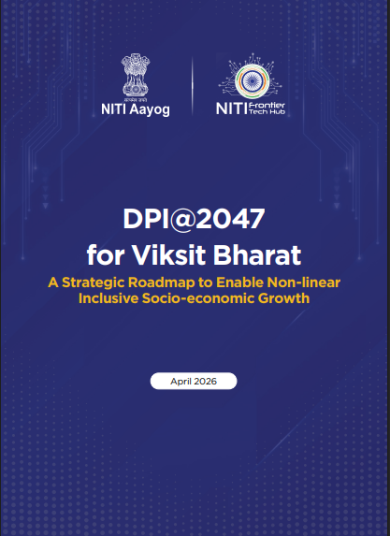

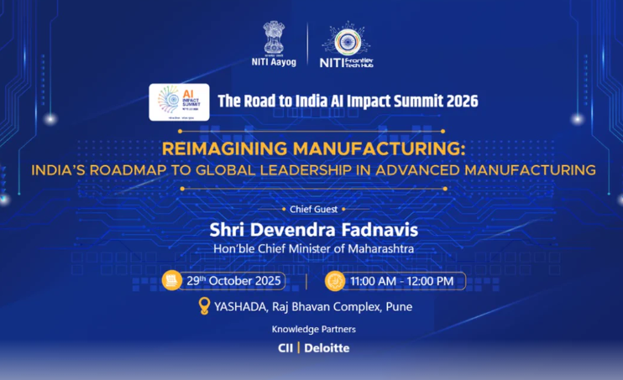
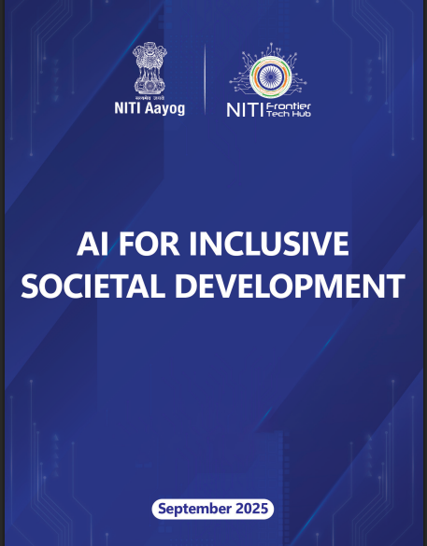
Deloitte’s contribution with NITI AYOG in shaping National Strategies
  DPI@2047 for Viksit Bharat: Deloitte supported NITI Aayog’s Frontier Tech Hub in developing a strategic roadmap for next-generation DPI to drive inclusive socio-economic growth beyond financial inclusion and welfare delivery.
  The roadmap identified eight priority sectors and proposed a district-led, AI-enabled digital ecosystem to enhance livelihoods, productivity, service delivery, and economic growth.
  Attracting AI Data Centre Infrastructure Investment in India: Deloitte assessed India’s readiness to emerge as a global AI infrastructure hub across six key pillars, including power, connectivity, computing, talent, real estate, and policy.
  The study recommended targeted reforms and investment incentives to attract large-scale AI data centre investments and strengthen India’s AI ecosystem
  Reimagining Manufacturing: Deloitte, in collaboration with CII and NITI Aayog’s Frontier Tech Hub, developed a roadmap to position India as a global leader in advanced manufacturing by 2035, covering 13 high-impact sectors.
  The roadmap recommends frontier technology adoption, workforce development, industrial infrastructure, innovation ecosystems, and enhanced manufacturing competitiveness through a phased implementation strategy.
  AI for Inclusive Societal Development: Deloitte supported NITI Aayog’s Frontier Tech Hub in developing a roadmap to leverage AI and frontier technologies to improve livelihoods, productivity, and social protection for India’s 490 million informal workers.
  The roadmap proposes AI-enabled digital identities, skilling, voice assistants, robotics, and IoT solutions to expand access to jobs, markets, finance, welfare, and safer working conditions.

Slide 48

Deloitte’s contribution with NITI AAYOG in shaping Global/National Strategies
  DPI@2047 for Viksit Bharat: Deloitte supported NITI Aayog’s Frontier Tech Hub in developing a strategic roadmap for next-generation DPI to drive inclusive socio-economic growth beyond financial inclusion and welfare delivery.
  The roadmap identified eight priority sectors and proposed a district-led, AI-enabled digital ecosystem to enhance livelihoods, productivity, service delivery, and economic growth.
  Evaluation of Centrally Sponsored Schemes in Agriculture and Allied Sectors : The report assessed the effectiveness and efficiency of flagship agriculture and allied-sector schemes, with a focus on resource utilization, implementation, beneficiary coverage, productivity, market efficiency and farmer outcomes. It identified key implementation gaps and bottlenecks and provided recommendations to improve scheme delivery, convergence, resource efficiency and overall sectoral impact.
  Reimagining Manufacturing: Deloitte, in collaboration with CII and NITI Aayog’s Frontier Tech Hub, developed a roadmap to position India as a global leader in advanced manufacturing by 2035, covering 13 high-impact sectors.
  The roadmap recommends frontier technology adoption, workforce development, industrial infrastructure, innovation ecosystems, and enhanced manufacturing competitiveness through a phased implementation strategy.
  AI for Inclusive Societal Development: Deloitte supported NITI Aayog’s Frontier Tech Hub in developing a roadmap to leverage AI and frontier technologies to improve livelihoods, productivity, and social protection for India’s 490 million informal workers.
  The roadmap proposes AI-enabled digital identities, skilling, voice assistants, robotics, and IoT solutions to expand access to jobs, markets, finance, welfare, and safer working conditions.

Slide 49
Our Experience in the field of Assignment

Slide 50
Our Experience – Summary Table (1/7)
S. No. | Study Title | Name of the Organisation | Month/Year | Amount/Budget | Publications in Journals | Subject and Themes
Experience of the Organization in conducting research Projects/Reports in the areas of this subject/theme for Reputed institutes and publications in the last 10 years.
1. | Evaluation of Centrally Sponsored Schemes in Agriculture and Allied Sectors | NITI Ayog, Government of India | September 2019 - September 2020 | INR 0.98 Crore | https://www.nfsm.gov.in/WriteReadData/UploadDOC/NITIAayogEvaluationreport.pdf | Public Finance & Fiscal Policy Analysis; Research Studies & Policy Advisory
2. | Economic Intelligence Unit, West Bengal | Finance Department, Government of West Bengal | December 2018- Ongoing | INR 4.50 Crore | https://finance.wb.gov.in/writereaddata/Budget_Publication/BP_30.pdf | Public Finance & Fiscal Policy Analysis; Public Financial Management (PFM); Research Studies & Policy Advisory; State Finance & Fiscal Sustainability Assessment
3. | Consultancy Services for Capacity Development on Rajasthan Transparency in Public Procurement Act and Rules- Strengthening India’s Intergovernmental Fiscal Transfers: | World Bank Nodal Department: Finance Department, Government of Rajasthan (World Bank Funded) | July 2022- June 2024 | INR 57 Crore | https://finance.rajasthan.gov.in/PDFDOCS/EAD/12420.pdf | Public Finance & Fiscal Policy Analysis; Public Financial Management (PFM); Research Studies & Policy Advisory; Public Procurement Diagnostics & Procurement Reform; Multilateral Development Project
4. | Response to an invitation by the Chair of the Fifteenth Finance Commission (15th FC) of the Government of India to the Asian Development Bank (ADB) | Asian Development Bank | July 2018-October 2018 |  | https://www.adb.org/sites/default/files/publication/662116/strengthening-indias-intergovernmental-fiscal-transfers.pdf | Public Finance & Fiscal Policy Analysis; Public Financial Management (PFM); Research Studies & Policy Advisory; State Finance & Fiscal Sustainability Assessment; Multilateral Development Project
5. | Second West Bengal Development Finance Program (WBDFP2) – Asian Development Bank (ADB)- Technical Assistance Consultant’s Report | Asian Development Bank | February 2018- November 2019 | INR 1.93 Crores | https://www.adb.org/projects/documents/ind-49209-001-tacr | Public Finance & Fiscal Policy Analysis; Public Financial Management (PFM); Research Studies & Policy Advisory; State Finance & Fiscal Sustainability Assessment; Multilateral Development Project
6. | Market Study & Entry Strategy for Istituto Marangoni | Istituto Marangoni S.r.l. | May 2022- August 2022 | INR 37 Lakhs | https://www.qaa.ac.uk/docs/qaa/reports/istituto-marangoni-her-ap-16.pdf?sfvrsn=cbfef581_4 | Research Studies & Policy Advisory

Slide 51
Our Experience – Summary Table (2/7)
S. No. | Study Title | Name of the Organisation | Month/Year | Amount/Budget | Publications in Journals | Subject and Themes
Experience of the Organization in conducting research Projects/Reports in the areas of this subject/theme for Reputed institutes and publications in the last 10 years.
7. | Strengthening Financing Strategies for SDG in three states of HP, Meghalaya and MP and developing transformative concept notes for finance mobilisation for SDGs localisation and Climate Action | Govt. of Meghalaya, Govt. of Himachal Pradesh, Govt. of Madhya Pradesh, GIZ (Deutsche Gesellschaft für Internationale Zusammenarbeit) | December 2025-June 2026 | INR 64.83 Lakhs | - | Public Finance & Fiscal Policy Analysis; Public Financial Management (PFM); Research Studies & Policy Advisory; State Finance & Fiscal Sustainability Assessment; Multilateral Development Project
8. | To Boost the size of the Gross State Domestic Product (GSDP) of Uttar Pradesh to One Trillion Dollar Economy in five years | Government of Uttar Pradesh | August -2022-Ongoing | INR 120 Crores | https://nipfp.org.in/media/documents/State_Forum_2023_-_A_Compendium_fWY24V2.pdf https://nipfp.org.in/media/documents/State_Forum__2024_-__A_Compendium_1.pdf https://nipfp.org.in/media/documents/State_Forum__2024_-__A_Compendium_1.pdfhttps://nipfp.org.in/media/documents/State_Forum_2025_A_Compendium.pdf | Public Finance & Fiscal Policy Analysis; Research Studies & Policy Advisory; State Finance & Fiscal Sustainability Assessment
9. | Jharkhand Domestic Resource Mobilization | Asian Development Bank (ABD); Nodal Department: Department of Finance, Government of Jharkhand | August 2024- March 2025 | INR 1.86 Crore |  | Public Finance & Fiscal Policy Analysis; Public Financial Management (PFM); Research Studies & Policy Advisory; State Finance & Fiscal Sustainability Assessment; Multilateral Development Project

Slide 52
Our Experience – Summary Table (3/7)
S. No. | Study Title | Name of the Organisation | Month/Year | Amount/Budget | Publications in Journals | Subject and Themes
Experience of the Organization in conducting research Projects/Reports in the areas of this subject/theme for Reputed institutes and publications in the last 10 years.
10. | Strengthening Economic and Fiscal Intelligence, Gujarat State Financial Services Ltd., Department of Finance, Government of Gujarat (GoG) – Phase 1 | Gujarat State Financial Services Ltd., Finance Dept, GoG | April 2025-July 2025 | INR 98 Lakhs |  | Public Finance & Fiscal Policy Analysis; Public Financial Management (PFM); Research Studies & Policy Advisory; State Finance & Fiscal Sustainability Assessment
11. | Project Management Consultant (PMC) for managing Project Management Unit (PMU) of National Data and Analytics Platform (NDAP) Project | NITI Ayog | August 2022- Ongoing | INR 82 Lakhs |  | Public Financial Management (PFM); Research Studies & Policy Advisory
12. | Preparation of Memorandum for 16th Finance Commission (FC) for Government of West Bengal | Government of West Bengal | January 2025- July 2025 | INR 60 Lakhs |  | Public Finance & Fiscal Policy Analysis; Research Studies & Policy Advisory; State Finance & Fiscal Sustainability Assessment
13. | Preparation of Memorandum for 15th Finance Commission (FC) for Government of Gujarat | Government of Gujarat | March 2018-July 2018 | INR 60 Lakhs |  | Public Finance & Fiscal Policy Analysis; Research Studies & Policy Advisory; State Finance & Fiscal Sustainability Assessment
14. | Project Management Unit (PMU) at Vapi Municipal Corporation | Vapi Municipal Corporation | March 2026-Ongoing | INR 2 Crore |  | Public Financial Management (PFM); State Finance & Fiscal Sustainability Assessment
15. | Facilitation of Transition to GST in Commercial Tax Department, West Bengal | Government of West Bengal | September 2016-October 2017 | INR 6.72 Crore |  | Public Finance & Fiscal Policy Analysis; Public Financial Management (PFM); Research Studies & Policy Advisory

Slide 53
Our Experience – Summary Table (4/7)
S. No. | Study Title | Name of the Organisation | Month/Year | Amount/Budget | Publications in Journals | Subject and Themes
Experience of the Organization in conducting research Projects/Reports in the areas of this subject/theme for Reputed institutes and publications in the last 10 years.
16. | East Coast Economic Corridor Development in the State of Andhra Pradesh | Asian Development Bank | January 2016- May 2018 | INR 59.13 Lakhs |  | Research Studies & Policy Advisory; Multilateral Development Project
.7 | Project Management Support to the Logistics Division | Asian Development Bank and Government of India | November 2020-June 2021 | INR 78.2 Lakhs |  | Research Studies & Policy Advisory; Multilateral Development Project
18. | Ranking States on the Basis of Their Logistics Efficiency – LEADS 2019 | Department of Commerce, Ministry of Commerce and Industry (MoCI), Government of India | August 2018- March 2019 | INR 79 Lakhs |  | Research Studies & Policy Advisory
19 | Project Management Unit for Finance Department, Government of Rajasthan | Finance Department, Government of Rajasthan | March 2024-September 2025 | INR 4.47 Crore | https://finance.rajasthan.gov.in/PDFDOCS/TAX/CCT/14791.pdf Rajasthan Legislative Assembly | Public Finance & Fiscal Policy Analysis; Public Financial Management (PFM); State Finance & Fiscal Sustainability Assessment
20. | Strengthening Decentralized Participative Planning in Government of Rajasthan | Finance Department, Government of Rajasthan | June 2018-May 2021 | INR 6.93 Crore |  | Public Finance & Fiscal Policy Analysis; Public Financial Management (PFM); Research Studies & Policy Advisory; State Finance & Fiscal Sustainability Assessment

Slide 54
Our Experience – Summary Table (5/7)
S. No. | Study Title | Name of the Organisation | Month/Year | Amount/Budget | Publications in Journals | Subject and Themes
Experience of the Organization in conducting research Projects/Reports in similar areas of this subject/theme for Reputed institutes and publications in the last 10 years.
1. | Research study on Professional Scientific and other business services (PSBS) | NITI Aayog, Government of India | October 2025- July 2026 | INR 49.97 Lakhs |  | Research Studies & Policy Advisory; Public Finance & Fiscal Policy Analysis
2. | Facilitation of Transition to GST in Commercial Tax Department | Government of West Bengal | September 2016- October 2017 | INR 1.26 Crores |  | Public Finance & Fiscal Policy Analysis; Public Financial Management (PFM); Research Studies & Policy Advisory
3. | Institutional Assessment of the Commercial Taxes Department (CTD) including GST Readiness Assessment and Developing a Road Map | Government of Rajasthan | April 2017-April 2019 | INR 6.72 Crores |  | Public Finance & Fiscal Policy Analysis; Public Financial Management (PFM); Research Studies & Policy Advisory
4. | Consulting Services for GST Rate Validation for Works Contract in Water Supply & Kalpasar Department, Government of Gujarat | Government of Gujarat | June 2019-March 2020 | INR 78.65 Lakhs |  | Public Finance & Fiscal Policy Analysis; Research Studies & Policy Advisory
5. | Preparation of Memorandum for 16th Finance Commission (FC) for Government of Gujarat | Government of Gujarat | July 2024-Ongoing | INR 80 Lakhs |  | Public Finance & Fiscal Policy Analysis; Research Studies & Policy Advisory; State Finance & Fiscal Sustainability Assessment

Slide 55
Our Experience – Summary Table (6/7)
S. No. | Study Title | Name of the Organisation | Month/Year | Amount/Budget | Publications in Journals | Subject and Themes
Experience of the Organization in conducting research Projects/Reports in similar areas of this subject/theme for Reputed institutes and publications in the last 10 years.
6. | Strengthening Public Investment Management in Rajasthan | World Bank; Nodal: Government of Rajasthan | December 2021-January 2025 | INR 23.85 Lakhs |  | Public Financial Management (PFM); Public Finance & Fiscal Policy Analysis; Multilateral Development Project
7. | Program management/ PMU for Financial sustainability, Revenue enhancement and Process Improvement for NOIDA | New Okhla Industrial Development Authority | October 2020- April 2023 | INR 1.5 Crore |  | Public Finance & Fiscal Policy Analysis; Public Financial Management (PFM); State Finance & Fiscal Sustainability Assessment
8. | Preparation of Memorandum for 15th Finance Commission (FC) for Government of West Bengal | Finance Department, Government of West Bengal | February 2018-July 2018 | INR 25 Lakhs |  | Public Finance & Fiscal Policy Analysis; Research Studies & Policy Advisory; State Finance & Fiscal Sustainability Assessment
9. | Development of an Index based on State Level Logistics Performance Indicators - Logistics Ease Across Different States (LEADS) Index 2018 | Department of Commerce, Ministry of Commerce and Industry (MoCI) | July 2017- January 2018 | INR 69.62 Lakhs |  | Research Studies & Policy Advisory
10. | Strengthening MSME cluster ecosystem in India through institutional network of Enterprise Development Centres (EDCs) | Asian Development Bank/ Ministry of MSME, Government of India | March 2020- June 2021 | INR 55.23 Lakhs |  | Research Studies & Policy Advisory; Multilateral Development Project

Slide 56
Our Experience – Summary Table (7/7)
S. No. | Study Title | Name of the Organisation | Month/Year | Amount/Budget | Publications in Journals | Subject and Themes
Experience of the Organization in conducting research Projects/Reports in similar areas of this subject/theme for Reputed institutes and publications in the last 10 years.
11. | Impact of Global Recession on India's Trade | NITI Aayog, Government of India | May 2023-September 2023 | INR 25 Lakhs |  | Research Studies & Policy Advisory; Public Finance & Fiscal Policy Analysis
12. | Drafting of National Logistics Policy | Asian Development Bank and Government of Nepal | November 2020-June 2021 | INR 24.60 Lakhs |  | Research Studies & Policy Advisory; Multilateral Development Project
13. | Market Assessment of “ICCC as a Service” - NEC Corporation India, Smart Cities | NEC Corporation India Pvt. Ltd. | May 2022- October 2022 | INR 30 Lakhs |  | Research Studies & Policy Advisory
14. | Strategic Support for Mann Deshi Foundation's Women's Empowerment through Entrepreneurship Development - Mumbai Expansion (Need Assessment) | Mann Deshi Foundation | November 2022-January 2023 | INR 54 Lakhs |  | Research Studies & Policy Advisory
15. | Ranking of States/UTs on the basis of their logistics efficiency – Development of an Index titled ‘Logistics Ease Across Different States (LEADS 2024-2026) | Ministry of Commerce and Industry, Government of India | July 2017-Jan 2025 | INR 5.87 Crore |  | Research Studies & Policy Advisory
16. | East Coast Economic Corridor Development in West Bengal ( Ref: ADB-Niti Creds) | Asian Development Bank / Government of West Bengal | April 2023-September 2024 | INR 59.13 Lakhs |  | Research Studies & Policy Advisory; Multilateral Development Project

Slide 57
Relevant Experience
1
Evaluation of Centrally Sponsored Schemes in Agriculture and Allied Sectors Client: NITI Aayog
Description of Key Activities: The assignment included conducting a comprehensive study and survey in eleven states (including Uttar Pradesh) and one Union Territory for evaluation of flagship schemes including Blue Revolution (fisheries), Green Revolution (agriculture) and White Revolution (animal husbandry) encompassing the agriculture and allied sector with specific focus on efficient resource utilization including central and state resources, production & productivity/yield, cost-benefit ratio, quality, reduction in postharvest/storage losses, price realization, stabilization & market efficiency, sector‘s social obligations, increase in farmers‘ income through the Umbrella CSS schemes. This intended to capture broader canvas of effectiveness, efficiency, employment generation, scope for skill developments, value additions, opportunities to bring innovation and sustainability to assess the overall sectoral impact in national economy. The activities executed by the Team were: Analysed Input use efficiency of Green Revolution, White Revolution, Blue Revolution and PMKSY (Per Drop More Crop) in terms of i.e. institutional mechanism, fund flow (adequacy & timeliness) & utilization through public expenditure tracking, planning process (top-down and bottom-up), policy guidelines and human resources allocated for the implementation of the schemes at central, state, district, block, and village, mechanisms to identify and reward best practices within the scheme design as well as Monitoring & Evaluation systems Conducted more than 150 Focus Group Discussions (FGDs), over 700 Key Informant Interviews (KIIs) and more than 1,800 Household (HH) Surveys across eleven states (including Uttar Pradesh) and one union territory Explored the coverage of the Green Revolution, White Revolution, Blue Revolution and PMKSY (Per Drop More Crop) in terms of eligible beneficiaries, geographies etc. and analyse the reasons for non-coverage, if applicable. Analyse the coverage of landless and small & marginal farmers in case of Green Revolution and small dairy farmers and fishers based on household survey and KIIs Identified key bottlenecks/issues & challenges in the implementation like capacity constraints at state, district & block level, supporting stakeholder engagement, timely availability of quality inputs, non-adoption of best practices, issues in the bottom-up district-level planning and non-integrated nature of advisories, issues in collective/cooperative model, harvest & post-harvest losses and absence of efficient price realization mechanisms Designed the discussions guides for focus group discussions, interview guides for in-depth interviews and structured questionnaires/schedules for household surveys Putting in place appropriate IT hardware and application software for data collection and management Evaluated quality of assets created in Green Revolution, White Revolution, Blue Revolution and PMKSY (Per Drop More Crop) and services provided therein Assessed extent of convergence within and across Green Revolution, White Revolution, Blue Revolution and PMKSY (Per Drop More Crop) as well as with other central/state government schemes and private sector, CSR, Civil society efforts, multilaterals, etc.
Country: India
Start Date : September 2019; End Date: September 2020
Service Provider: DTTILLP

Slide 58
Relevant Experience
2
Economic Intelligence Unit, West Bengal Client: Finance Department, Government of West Bengal
Description of Key Activities: Assist authority under their instructions and supervision in various areas related to public finance The activities executed by the Team were: GST Potential Analysis and GST Data Analytics: Assessment of GST revenue trends, taxpayer compliance, sector-wise performance, revenue buoyancy, and identification of untapped GST potential. Non-Tax Revenue Potential Analysis: Evaluation of existing non-tax revenue sources, including fees, charges, royalties, and asset-based revenues, to identify opportunities for revenue augmentation and improved resource mobilization by the State. Impact Assessment of FRBM and Fiscal Consolidation Targets: Analysis of the implications of FRBM compliance and fiscal consolidation measures on developmental and social sector expenditure, with a focus on balancing fiscal discipline and growth-oriented public spending. Debt Sustainability and Econometric Analysis: Examination of debt indicators, debt servicing capacity, fiscal risks, and long-term sustainability through statistical and econometric techniques to assess the State's fiscal resilience and borrowing capacity Secondary Research on Public Finance and Fiscal Reforms: Review and analysis of policies, budget documents, fiscal reports, academic literature, and best practices related to revenue mobilization, public expenditure management, subsidies, and fiscal reforms at national and state levels. Research Support to Finance Department: Provision of continuous analytical and research support to the Finance Department on emerging fiscal issues, policy matters, budget analysis, reform initiatives, and other assignments as required from time to time
Country: India
Start Date : November 2019; End Date: Ongoing
Contract Value : INR 0.47 Crores
Service Provider: DTTILLP

Slide 59
Relevant Experience
3
Consultancy Services for Capacity Development on Rajasthan Transparency in Public Procurement Act and Rules Client: Economic Affairs Division (Govt. of Rajasthan)/World Bank
Description of Key Activities: The GoR faces the following issues with respect to implementation of the RTPP Acts and Rules- There was weak execution of the RTPP Act and Rules due to limited awareness of the same among Government of Rajasthan (GoR) officials. Limited understanding of the RTPP Act and Rules led to fallacies in the procurement procedures undertaken by GoR departments. This resulted in sub-optimal utilization of public resources. The primary objective of this consultancy assignment was the capacity development of public and private sector officials on the implementation of the Rajasthan Transparency in Public Procurement (RTPP) Act and Rules, including the implementation of a comprehensive training strategy based on the specified curriculum map, training strategy, and implementation plan across the State of Rajasthan, covering a target of 7,000 certifications (i.e., officials to be trained). This consultancy assignment for the implementation of the training strategy was expected to improve the implementation of the RTPP Act and Rules in the State, thereby promoting transparency and accountability in public procurement. The activities executed by Deloitte were: Training and Capacity Development of Government Officials: The assignment involved the design and delivery of a comprehensive capacity-building programme for more than 7,000 Government of Rajasthan (GoR) officials engaged in procurement-related activities across State, district, and sub-district levels. Officials were trained through structured Foundation and Specialty Courses aligned with the Government's approved training strategy, contributing to enhanced understanding and implementation of public procurement processes. Development of Training Planning and Management System (TPMS): The assignment facilitated the development of a Training Planning and Management System (TPMS) to institutionalize and sustain procurement-related capacity development across the State. The platform was established to maintain training records, monitor learning outcomes, and enable continued access to training programmes for government officials. Identification and Capacity Building of Master Trainers: The assignment included the identification, selection, and capacity development of a pool of Master Trainers to support long-term institutional strengthening. The selected trainers were trained on procurement regulations, training methodologies, and knowledge dissemination approaches, enabling them to further cascade training across departments and field-level institutions. Development of Training Content and Digital Learning Modules: The assignment involved the preparation of comprehensive training material on public procurement, including manuals, facilitator guides, participant handbooks, case studies, and digital learning resources. Additionally, content for Massive Open Online Courses (MOOCs) was developed to facilitate large-scale and sustainable dissemination of procurement-related knowledge. Strengthening Public Procurement Systems through Workforce Upskilling: The assignment successfully supported the large-scale upskilling of personnel engaged in public procurement functions across Rajasthan. Given the significant contribution of public procurement to the State economy, the intervention strengthened institutional capacities and promoted more efficient, transparent, and accountable utilization of public resources, thereby contributing to improved service delivery and governance outcomes.
Country: India
Start Date : July 2022; End Date: June 2024
Contract Value : INR 0.29 Crores
Service Provider: DTTILLP

Slide 60
Relevant Experience
4
Response to an invitation by the Chair of the Fifteenth Finance Commission (15th FC) of the Government of India to the Asian Development Bank (ADB) Client: Asian Development Bank (ADB)
Description of Key Activities: The 15th Finance Commission of India has been tasked recently to develop recommendations for designing the new framework for the intergovernmental fiscal transfer system between the center and the subnational governments in India. One of the objectives of the recommendations is to help develop a robust fiscal transfer mechanism that will incentivize the delivery of high quality and equitable social services, especially in the education sector by the subnational governments. The activities executed by Deloitte were: Prepared and submitted the Inception Report, detailing the research methodology, analytical framework, literature review, data requirements, stakeholder engagement approach, and comprehensive work plan covering all study objectives and scope items. Conducted an extensive desk review and policy analysis of the education sector in India, including assessment of fiscal transfer mechanisms, expenditure trends, governance arrangements, and key sectoral challenges. Undertaken a comparative evaluation of inter-state education performance, utilizing quantitative indicators related to access, equity, infrastructure, learning outcomes, and educational service delivery. Carried out a detailed diagnostic assessment of existing fiscal transfer mechanisms, including Finance Commission grants, Centrally Sponsored Schemes (CSS), and education sector funding arrangements. Performed international benchmarking and comparative research on education financing models and performance-based transfer systems across multiple countries to identify global good practices and replicable lessons for India Analyzed data and evidence to identify key gaps, inefficiencies, and opportunities for strengthening outcome-based and performance-linked fiscal transfers in the education sector. [ Developed a robust evaluation framework and policy recommendations for performance-based transfers, including equalization approaches, incentive mechanisms, monitoring arrangements, and outcome measurement methodologies. Prepared and submitted the Draft Final Report, presenting research findings, analytical assessments, international case studies, policy options, and recommendations for the Fifteenth Finance Commission. Designed and delivered a high-level presentation of key findings and recommendations for deliberations with the Fifteenth Finance Commission and other stakeholders in New Delhi. Facilitated stakeholder consultations and incorporated feedback received from the Asian Development Bank (ADB) and the Fifteenth Finance Commission through iterative review and validation processes. Refined the analytical outputs and recommendations based on stakeholder inputs and finalized the study deliverables to ensure policy relevance, technical rigor, and alignment with the objectives of the assignment. Submitted the Final Report, incorporating all agreed revisions and providing actionable recommendations to support the design of a more equitable, outcome-oriented, and performance-driven fiscal transfer framework for the education sector
Country: India
Start Date : July 2018; End Date: October 2018
Contract Value : INR 0.50 Crores
Service Provider: DTTILLP

Slide 61
Relevant Experience
5
Second West Bengal Development Finance Program (WBDFP2) – Asian Development Bank (ADB)- Technical Assistance Consultant’s Report Client: Asian Development Bank/ Finance Department, Government of West Bengal
Description of Key Activities: The ADB funded Second West Bengal Development Finance Program (WBDFP2) sought to facilitate the continuation of a comprehensive fiscal consolidation program in West Bengal initiated in 2012. The program had three output areas: (i) expenditure rationalization efforts were accelerated, (ii) facilitation of private investment was improved, and (iii) revenue administration was strengthened. • Developed a Medium-Term Expenditure Framework (MTEF) to support fiscal planning, expenditure prioritization, and effective resource allocation. • Developed an analytical model to analyse the VAT and GST potential for West Bengal, enabling evidence-based assessment of revenue mobilisation opportunities. i. Identified best practices in VAT fraud detection through a detailed review and analysis of returns data. ii. Prepared rules for validation of Input Tax Rebate (ITR) claims to strengthen tax administration and improve compliance monitoring. • Estimated VAT potential and VAT gap using the Input-Output approach, facilitating the identification of revenue leakages and opportunities for enhancing tax collections. • Estimated service tax potential for the State through economic data analysis and advanced analytics, providing inputs for revenue forecasting and policy decision-making The activities executed by the Team were: Conducted technical studies across major tax types, including VAT, Excise, Stamp Duty, Electricity Duty, Motor Vehicle Tax and Mining Royalty. Reviewed tax laws, institutional structures and revenue administration processes; analysed revenue and buoyancy trends against SOTR and GSDP. Supported GoWB in strengthening revenue administration through tax monitoring, QR code-based liquor hologram tagging and digitisation of legacy land/property data. Assessed liquor supply chain processes, conducted process verification, and identified gaps and recommendations to reduce revenue leakage. Prepared MTEFs for School Education and Health & Family Welfare Departments and trained officials on expenditure planning and fiscal management. Built FPMU capacity for identification and development of PPP projects eligible for viability gap funding under WBDFP II. Supported Internal Audit reforms through training manuals and implementation of a Risk-Based Internal Audit Manual and practices.
Country: India
Start Date : February 2018; End Date: November 2019
Contract Value : INR 1.33 Crores
Service Provider: DTTILLP

Slide 62
Relevant Experience
6
Market Study & Entry Strategy for Istituto Marangoni Client: Istituto Marangoni S.r.l.
Description of Key Activities: Istituto Marangoni, a leading international institution in fashion, art and design education, sought to expand its operations in India beyond its existing Mumbai campus. Having conducted an initial market entry study in 2016, the institution required a refreshed market study and entry strategy to reassess the Indian Fashion, Art and Design (FAD) education market and to inform the establishment of an additional campus in the country. The Indian higher-education market for niche design disciplines had evolved considerably, driven by rising demand for globally benchmarked design education, an expanding aspirational student base, and increased competitive intensity among premium institutions. Against this backdrop, the assignment aimed to provide an evidence-based assessment of market size, demand-supply dynamics, the competitive landscape and the applicable policy environment, and to translate these findings into a robust, de-risked entry strategy for a new campus. The strategic objectives of the engagement were to refresh the market study and entry strategy for India, identify a suitable location for the new campus, and define mitigation measures to manage cannibalization risk with the existing Mumbai operation — enabling informed investment and site-selection decisions by the institution's leadership. The activities executed by the Team were: Developed a structured framework for the market assessment study and a framework for the competitor assessment covering up to 10 institutes. Designed the primary-research approach, including finalized survey questionnaire templates and a sample size of up to 500 respondents. Analysed the National Education Policy to determine its implications for foreign-institution entry and FAD education in India. Assessed the fashion, art and design education market, with location assessment focused on Delhi, Bengaluru and Mumbai. Undertook the fashion market size through secondary research and a demand-supply study of up to 3 institutes. Evaluated the current fashion education landscape across up to 10 institutes within the same category as Istituto Marangoni, including a review of institute portfolios of shortlisted institutions. Structured an entry strategy for the establishment of Istituto Marangoni's new campus in India. Recommended mitigation strategies to address potential cannibalization with the existing Mumbai setup. Prepared the Draft Market Assessment Report (Phase 1) and the Final Market Assessment Report & Entry Strategy Report reflecting the findings of the study
Country: India
Start Date : May 2022 ; End Date: August 2022
Contract Value : INR 2.18 Crores
Service Provider: DTTILLP

Slide 63
Relevant Experience
7
Strengthening Financing Strategies for SDG in three states of HP, Meghalaya and MP and developing transformative concept notes for finance mobilization for SDGs localization and Climate Action Client: Govt. of Meghalaya, Govt. of Himachal Pradesh, Govt. of Madhya Pradesh, GIZ (Deutsche Gesellschaft für Internationale Zusammenarbeit).
Description of Key Activities: Deloitte was appointed for the implementation of Institutional Development Action Plan The activities executed by the Team were: Task 1: Study of Proposed ‘Advanced Seminars & workshops Program : Determined the feasibility and defined the concept, aims, contents, delivery modes and management framework for a new knowledge transfer program of advanced seminars and workshops on contemporary and climate resilient roads sector topics and issues, delivered collaboratively between leading technical, professional and industry entities in Gujarat and R&BD Task 2: Implementation of pilot program of advanced seminars and workshops: Implemented pilot program of four advanced seminars, each of a duration of 2 to 3 days, covering the themes: Sustainable and disaster resilient Development of Road Infrastructure Emerging trends in Planning, Design, Construction, Maintenance of roads and bridges Innovative Implementation Strategies Use of Instrumentation & Big data Management in Road Sector Task 3: Study for road sector centre of excellence Undertook a study to determine feasibility aspects and a general framework and ‘Business model’ for possible R&BD linked Centre of excellence Task 4:Implementation of centre of excellence Assisted R&BD in finalization and activation of Implementation Plans for the establishment and inaugural operations of the new Centre of Excellence, through workshops and consultations with concerned R&BD areas and with participating entities and help the R&BD in providing support for up to eighteen months from inception
Country: India
Start Date : May 2016; End Date: March 2021
Contract Value : INR 8.97 Crores
Service Provider: DTTILLP

Slide 64
Relevant Experience
7
Strengthening Financing Strategies for SDG in three states of HP, Meghalaya and MP and developing transformative concept notes for finance mobilization for SDGs localization and Climate Action Client: Govt. of Meghalaya, Govt. of Himachal Pradesh, Govt. of Madhya Pradesh, GIZ (Deutsche Gesellschaft für Internationale Zusammenarbeit).
Description of Key Activities: Deloitte was appointed for the implementation of Institutional Development Action Plan The activities executed by the Team were: Task 1: Study of Proposed ‘Advanced Seminars & workshops Program : Determined the feasibility and defined the concept, aims, contents, delivery modes and management framework for a new knowledge transfer program of advanced seminars and workshops on contemporary and climate resilient roads sector topics and issues, delivered collaboratively between leading technical, professional and industry entities in Gujarat and R&BD Task 2: Implementation of pilot program of advanced seminars and workshops: Implemented pilot program of four advanced seminars, each of a duration of 2 to 3 days, covering the themes: Sustainable and disaster resilient Development of Road Infrastructure Emerging trends in Planning, Design, Construction, Maintenance of roads and bridges Innovative Implementation Strategies Use of Instrumentation & Big data Management in Road Sector Task 3: Study for road sector centre of excellence Undertook a study to determine feasibility aspects and a general framework and ‘Business model’ for possible R&BD linked Centre of excellence Task 4:Implementation of centre of excellence Assisted R&BD in finalization and activation of Implementation Plans for the establishment and inaugural operations of the new Centre of Excellence, through workshops and consultations with concerned R&BD areas and with participating entities and help the R&BD in providing support for up to eighteen months from inception
Country: India
Start Date : May 2016; End Date: March 2021
Contract Value : INR 8.97 Crores
Service Provider: DTTILLP

Slide 65
Relevant Experience
8
Strengthening Financing Strategies for SDG in three states of HP, Meghalaya and MP and developing transformative concept notes for finance mobilization for SDGs localization and Climate Action Client: Govt. of Meghalaya, Govt. of Himachal Pradesh, Govt. of Madhya Pradesh, GIZ (Deutsche Gesellschaft für Internationale Zusammenarbeit).
Description of Key Activities: Deloitte was appointed for the implementation of Institutional Development Action Plan The activities executed by the Team were: Task 1: Study of Proposed ‘Advanced Seminars & workshops Program : Determined the feasibility and defined the concept, aims, contents, delivery modes and management framework for a new knowledge transfer program of advanced seminars and workshops on contemporary and climate resilient roads sector topics and issues, delivered collaboratively between leading technical, professional and industry entities in Gujarat and R&BD Task 2: Implementation of pilot program of advanced seminars and workshops: Implemented pilot program of four advanced seminars, each of a duration of 2 to 3 days, covering the themes: Sustainable and disaster resilient Development of Road Infrastructure Emerging trends in Planning, Design, Construction, Maintenance of roads and bridges Innovative Implementation Strategies Use of Instrumentation & Big data Management in Road Sector Task 3: Study for road sector centre of excellence Undertook a study to determine feasibility aspects and a general framework and ‘Business model’ for possible R&BD linked Centre of excellence Task 4:Implementation of centre of excellence Assisted R&BD in finalization and activation of Implementation Plans for the establishment and inaugural operations of the new Centre of Excellence, through workshops and consultations with concerned R&BD areas and with participating entities and help the R&BD in providing support for up to eighteen months from inception
Country: India
Start Date : May 2016; End Date: March 2021
Contract Value : INR 8.97 Crores
Service Provider: DTTILLP

Slide 66
Relevant Experience
9
Strengthening Financing Strategies for SDG in three states of HP, Meghalaya and MP and developing transformative concept notes for finance mobilization for SDGs localization and Climate Action Client: Govt. of Meghalaya, Govt. of Himachal Pradesh, Govt. of Madhya Pradesh, GIZ (Deutsche Gesellschaft für Internationale Zusammenarbeit).
Description of Key Activities: Deloitte was appointed for the implementation of Institutional Development Action Plan The activities executed by the Team were: Task 1: Study of Proposed ‘Advanced Seminars & workshops Program : Determined the feasibility and defined the concept, aims, contents, delivery modes and management framework for a new knowledge transfer program of advanced seminars and workshops on contemporary and climate resilient roads sector topics and issues, delivered collaboratively between leading technical, professional and industry entities in Gujarat and R&BD Task 2: Implementation of pilot program of advanced seminars and workshops: Implemented pilot program of four advanced seminars, each of a duration of 2 to 3 days, covering the themes: Sustainable and disaster resilient Development of Road Infrastructure Emerging trends in Planning, Design, Construction, Maintenance of roads and bridges Innovative Implementation Strategies Use of Instrumentation & Big data Management in Road Sector Task 3: Study for road sector centre of excellence Undertook a study to determine feasibility aspects and a general framework and ‘Business model’ for possible R&BD linked Centre of excellence Task 4:Implementation of centre of excellence Assisted R&BD in finalization and activation of Implementation Plans for the establishment and inaugural operations of the new Centre of Excellence, through workshops and consultations with concerned R&BD areas and with participating entities and help the R&BD in providing support for up to eighteen months from inception
Country: India
Start Date : May 2016; End Date: March 2021
Contract Value : INR 8.97 Crores
Service Provider: DTTILLP

Slide 67
Relevant Experience
10
Strengthening Financing Strategies for SDG in three states of HP, Meghalaya and MP and developing transformative concept notes for finance mobilization for SDGs localization and Climate Action Client: Govt. of Meghalaya, Govt. of Himachal Pradesh, Govt. of Madhya Pradesh, GIZ (Deutsche Gesellschaft für Internationale Zusammenarbeit).
Description of Key Activities: Deloitte was appointed for the implementation of Institutional Development Action Plan The activities executed by the Team were: Task 1: Study of Proposed ‘Advanced Seminars & workshops Program : Determined the feasibility and defined the concept, aims, contents, delivery modes and management framework for a new knowledge transfer program of advanced seminars and workshops on contemporary and climate resilient roads sector topics and issues, delivered collaboratively between leading technical, professional and industry entities in Gujarat and R&BD Task 2: Implementation of pilot program of advanced seminars and workshops: Implemented pilot program of four advanced seminars, each of a duration of 2 to 3 days, covering the themes: Sustainable and disaster resilient Development of Road Infrastructure Emerging trends in Planning, Design, Construction, Maintenance of roads and bridges Innovative Implementation Strategies Use of Instrumentation & Big data Management in Road Sector Task 3: Study for road sector centre of excellence Undertook a study to determine feasibility aspects and a general framework and ‘Business model’ for possible R&BD linked Centre of excellence Task 4:Implementation of centre of excellence Assisted R&BD in finalization and activation of Implementation Plans for the establishment and inaugural operations of the new Centre of Excellence, through workshops and consultations with concerned R&BD areas and with participating entities and help the R&BD in providing support for up to eighteen months from inception
Country: India
Start Date : May 2016; End Date: March 2021
Contract Value : INR 8.97 Crores
Service Provider: DTTILLP

Slide 68
Relevant Experience
7
Strengthening Financing Strategies for SDG in three states of HP, Meghalaya and MP and developing transformative concept notes for finance mobilization for SDGs localization and Climate Action Client: Govt. of Meghalaya, Govt. of Himachal Pradesh, Govt. of Madhya Pradesh, GIZ (Deutsche Gesellschaft für Internationale Zusammenarbeit).
Description of Key Activities: Deloitte was appointed for the implementation of Institutional Development Action Plan The activities executed by the Team were: Task 1: Study of Proposed ‘Advanced Seminars & workshops Program : Determined the feasibility and defined the concept, aims, contents, delivery modes and management framework for a new knowledge transfer program of advanced seminars and workshops on contemporary and climate resilient roads sector topics and issues, delivered collaboratively between leading technical, professional and industry entities in Gujarat and R&BD Task 2: Implementation of pilot program of advanced seminars and workshops: Implemented pilot program of four advanced seminars, each of a duration of 2 to 3 days, covering the themes: Sustainable and disaster resilient Development of Road Infrastructure Emerging trends in Planning, Design, Construction, Maintenance of roads and bridges Innovative Implementation Strategies Use of Instrumentation & Big data Management in Road Sector Task 3: Study for road sector centre of excellence Undertook a study to determine feasibility aspects and a general framework and ‘Business model’ for possible R&BD linked Centre of excellence Task 4:Implementation of centre of excellence Assisted R&BD in finalization and activation of Implementation Plans for the establishment and inaugural operations of the new Centre of Excellence, through workshops and consultations with concerned R&BD areas and with participating entities and help the R&BD in providing support for up to eighteen months from inception
Country: India
Start Date : May 2016; End Date: March 2021
Contract Value : INR 8.97 Crores
Service Provider: DTTILLP

Slide 69
Relevant Experience
7
Strengthening Financing Strategies for SDG in three states of HP, Meghalaya and MP and developing transformative concept notes for finance mobilization for SDGs localization and Climate Action Client: Govt. of Meghalaya, Govt. of Himachal Pradesh, Govt. of Madhya Pradesh, GIZ (Deutsche Gesellschaft für Internationale Zusammenarbeit).
Description of Key Activities: Deloitte was appointed for the implementation of Institutional Development Action Plan The activities executed by the Team were: Task 1: Study of Proposed ‘Advanced Seminars & workshops Program : Determined the feasibility and defined the concept, aims, contents, delivery modes and management framework for a new knowledge transfer program of advanced seminars and workshops on contemporary and climate resilient roads sector topics and issues, delivered collaboratively between leading technical, professional and industry entities in Gujarat and R&BD Task 2: Implementation of pilot program of advanced seminars and workshops: Implemented pilot program of four advanced seminars, each of a duration of 2 to 3 days, covering the themes: Sustainable and disaster resilient Development of Road Infrastructure Emerging trends in Planning, Design, Construction, Maintenance of roads and bridges Innovative Implementation Strategies Use of Instrumentation & Big data Management in Road Sector Task 3: Study for road sector centre of excellence Undertook a study to determine feasibility aspects and a general framework and ‘Business model’ for possible R&BD linked Centre of excellence Task 4:Implementation of centre of excellence Assisted R&BD in finalization and activation of Implementation Plans for the establishment and inaugural operations of the new Centre of Excellence, through workshops and consultations with concerned R&BD areas and with participating entities and help the R&BD in providing support for up to eighteen months from inception
Country: India
Start Date : May 2016; End Date: March 2021
Contract Value : INR 8.97 Crores
Service Provider: DTTILLP

Slide 70
Relevant Experience
7
Strengthening Financing Strategies for SDG in three states of HP, Meghalaya and MP and developing transformative concept notes for finance mobilization for SDGs localization and Climate Action Client: Govt. of Meghalaya, Govt. of Himachal Pradesh, Govt. of Madhya Pradesh, GIZ (Deutsche Gesellschaft für Internationale Zusammenarbeit).
Description of Key Activities: Deloitte was appointed for the implementation of Institutional Development Action Plan The activities executed by the Team were: Task 1: Study of Proposed ‘Advanced Seminars & workshops Program : Determined the feasibility and defined the concept, aims, contents, delivery modes and management framework for a new knowledge transfer program of advanced seminars and workshops on contemporary and climate resilient roads sector topics and issues, delivered collaboratively between leading technical, professional and industry entities in Gujarat and R&BD Task 2: Implementation of pilot program of advanced seminars and workshops: Implemented pilot program of four advanced seminars, each of a duration of 2 to 3 days, covering the themes: Sustainable and disaster resilient Development of Road Infrastructure Emerging trends in Planning, Design, Construction, Maintenance of roads and bridges Innovative Implementation Strategies Use of Instrumentation & Big data Management in Road Sector Task 3: Study for road sector centre of excellence Undertook a study to determine feasibility aspects and a general framework and ‘Business model’ for possible R&BD linked Centre of excellence Task 4:Implementation of centre of excellence Assisted R&BD in finalization and activation of Implementation Plans for the establishment and inaugural operations of the new Centre of Excellence, through workshops and consultations with concerned R&BD areas and with participating entities and help the R&BD in providing support for up to eighteen months from inception
Country: India
Start Date : May 2016; End Date: March 2021
Contract Value : INR 8.97 Crores
Service Provider: DTTILLP

Slide 71
Relevant Experience
7
Strengthening Financing Strategies for SDG in three states of HP, Meghalaya and MP and developing transformative concept notes for finance mobilization for SDGs localization and Climate Action Client: Govt. of Meghalaya, Govt. of Himachal Pradesh, Govt. of Madhya Pradesh, GIZ (Deutsche Gesellschaft für Internationale Zusammenarbeit).
Description of Key Activities: Deloitte was appointed for the implementation of Institutional Development Action Plan The activities executed by the Team were: Task 1: Study of Proposed ‘Advanced Seminars & workshops Program : Determined the feasibility and defined the concept, aims, contents, delivery modes and management framework for a new knowledge transfer program of advanced seminars and workshops on contemporary and climate resilient roads sector topics and issues, delivered collaboratively between leading technical, professional and industry entities in Gujarat and R&BD Task 2: Implementation of pilot program of advanced seminars and workshops: Implemented pilot program of four advanced seminars, each of a duration of 2 to 3 days, covering the themes: Sustainable and disaster resilient Development of Road Infrastructure Emerging trends in Planning, Design, Construction, Maintenance of roads and bridges Innovative Implementation Strategies Use of Instrumentation & Big data Management in Road Sector Task 3: Study for road sector centre of excellence Undertook a study to determine feasibility aspects and a general framework and ‘Business model’ for possible R&BD linked Centre of excellence Task 4:Implementation of centre of excellence Assisted R&BD in finalization and activation of Implementation Plans for the establishment and inaugural operations of the new Centre of Excellence, through workshops and consultations with concerned R&BD areas and with participating entities and help the R&BD in providing support for up to eighteen months from inception
Country: India
Start Date : May 2016; End Date: March 2021
Contract Value : INR 8.97 Crores
Service Provider: DTTILLP

Slide 72
Relevant Experience
7
Strengthening Financing Strategies for SDG in three states of HP, Meghalaya and MP and developing transformative concept notes for finance mobilization for SDGs localization and Climate Action Client: Govt. of Meghalaya, Govt. of Himachal Pradesh, Govt. of Madhya Pradesh, GIZ (Deutsche Gesellschaft für Internationale Zusammenarbeit).
Description of Key Activities: Deloitte was appointed for the implementation of Institutional Development Action Plan The activities executed by the Team were: Task 1: Study of Proposed ‘Advanced Seminars & workshops Program : Determined the feasibility and defined the concept, aims, contents, delivery modes and management framework for a new knowledge transfer program of advanced seminars and workshops on contemporary and climate resilient roads sector topics and issues, delivered collaboratively between leading technical, professional and industry entities in Gujarat and R&BD Task 2: Implementation of pilot program of advanced seminars and workshops: Implemented pilot program of four advanced seminars, each of a duration of 2 to 3 days, covering the themes: Sustainable and disaster resilient Development of Road Infrastructure Emerging trends in Planning, Design, Construction, Maintenance of roads and bridges Innovative Implementation Strategies Use of Instrumentation & Big data Management in Road Sector Task 3: Study for road sector centre of excellence Undertook a study to determine feasibility aspects and a general framework and ‘Business model’ for possible R&BD linked Centre of excellence Task 4:Implementation of centre of excellence Assisted R&BD in finalization and activation of Implementation Plans for the establishment and inaugural operations of the new Centre of Excellence, through workshops and consultations with concerned R&BD areas and with participating entities and help the R&BD in providing support for up to eighteen months from inception
Country: India
Start Date : May 2016; End Date: March 2021
Contract Value : INR 8.97 Crores
Service Provider: DTTILLP

Slide 73
Relevant Experience
7
Strengthening Financing Strategies for SDG in three states of HP, Meghalaya and MP and developing transformative concept notes for finance mobilization for SDGs localization and Climate Action Client: Govt. of Meghalaya, Govt. of Himachal Pradesh, Govt. of Madhya Pradesh, GIZ (Deutsche Gesellschaft für Internationale Zusammenarbeit).
Description of Key Activities: Deloitte was appointed for the implementation of Institutional Development Action Plan The activities executed by the Team were: Task 1: Study of Proposed ‘Advanced Seminars & workshops Program : Determined the feasibility and defined the concept, aims, contents, delivery modes and management framework for a new knowledge transfer program of advanced seminars and workshops on contemporary and climate resilient roads sector topics and issues, delivered collaboratively between leading technical, professional and industry entities in Gujarat and R&BD Task 2: Implementation of pilot program of advanced seminars and workshops: Implemented pilot program of four advanced seminars, each of a duration of 2 to 3 days, covering the themes: Sustainable and disaster resilient Development of Road Infrastructure Emerging trends in Planning, Design, Construction, Maintenance of roads and bridges Innovative Implementation Strategies Use of Instrumentation & Big data Management in Road Sector Task 3: Study for road sector centre of excellence Undertook a study to determine feasibility aspects and a general framework and ‘Business model’ for possible R&BD linked Centre of excellence Task 4:Implementation of centre of excellence Assisted R&BD in finalization and activation of Implementation Plans for the establishment and inaugural operations of the new Centre of Excellence, through workshops and consultations with concerned R&BD areas and with participating entities and help the R&BD in providing support for up to eighteen months from inception
Country: India
Start Date : May 2016; End Date: March 2021
Contract Value : INR 8.97 Crores
Service Provider: DTTILLP

Slide 74
Relevant Experience
7
Strengthening Financing Strategies for SDG in three states of HP, Meghalaya and MP and developing transformative concept notes for finance mobilization for SDGs localization and Climate Action Client: Govt. of Meghalaya, Govt. of Himachal Pradesh, Govt. of Madhya Pradesh, GIZ (Deutsche Gesellschaft für Internationale Zusammenarbeit).
Description of Key Activities: Deloitte was appointed for the implementation of Institutional Development Action Plan The activities executed by the Team were: Task 1: Study of Proposed ‘Advanced Seminars & workshops Program : Determined the feasibility and defined the concept, aims, contents, delivery modes and management framework for a new knowledge transfer program of advanced seminars and workshops on contemporary and climate resilient roads sector topics and issues, delivered collaboratively between leading technical, professional and industry entities in Gujarat and R&BD Task 2: Implementation of pilot program of advanced seminars and workshops: Implemented pilot program of four advanced seminars, each of a duration of 2 to 3 days, covering the themes: Sustainable and disaster resilient Development of Road Infrastructure Emerging trends in Planning, Design, Construction, Maintenance of roads and bridges Innovative Implementation Strategies Use of Instrumentation & Big data Management in Road Sector Task 3: Study for road sector centre of excellence Undertook a study to determine feasibility aspects and a general framework and ‘Business model’ for possible R&BD linked Centre of excellence Task 4:Implementation of centre of excellence Assisted R&BD in finalization and activation of Implementation Plans for the establishment and inaugural operations of the new Centre of Excellence, through workshops and consultations with concerned R&BD areas and with participating entities and help the R&BD in providing support for up to eighteen months from inception
Country: India
Start Date : May 2016; End Date: March 2021
Contract Value : INR 8.97 Crores
Service Provider: DTTILLP

Slide 75
Relevant Experience
7
Strengthening Financing Strategies for SDG in three states of HP, Meghalaya and MP and developing transformative concept notes for finance mobilization for SDGs localization and Climate Action Client: Govt. of Meghalaya, Govt. of Himachal Pradesh, Govt. of Madhya Pradesh, GIZ (Deutsche Gesellschaft für Internationale Zusammenarbeit).
Description of Key Activities: Deloitte was appointed for the implementation of Institutional Development Action Plan The activities executed by the Team were: Task 1: Study of Proposed ‘Advanced Seminars & workshops Program : Determined the feasibility and defined the concept, aims, contents, delivery modes and management framework for a new knowledge transfer program of advanced seminars and workshops on contemporary and climate resilient roads sector topics and issues, delivered collaboratively between leading technical, professional and industry entities in Gujarat and R&BD Task 2: Implementation of pilot program of advanced seminars and workshops: Implemented pilot program of four advanced seminars, each of a duration of 2 to 3 days, covering the themes: Sustainable and disaster resilient Development of Road Infrastructure Emerging trends in Planning, Design, Construction, Maintenance of roads and bridges Innovative Implementation Strategies Use of Instrumentation & Big data Management in Road Sector Task 3: Study for road sector centre of excellence Undertook a study to determine feasibility aspects and a general framework and ‘Business model’ for possible R&BD linked Centre of excellence Task 4:Implementation of centre of excellence Assisted R&BD in finalization and activation of Implementation Plans for the establishment and inaugural operations of the new Centre of Excellence, through workshops and consultations with concerned R&BD areas and with participating entities and help the R&BD in providing support for up to eighteen months from inception
Country: India
Start Date : May 2016; End Date: March 2021
Contract Value : INR 8.97 Crores
Service Provider: DTTILLP

Slide 76
Relevant Experience
7
Strengthening Financing Strategies for SDG in three states of HP, Meghalaya and MP and developing transformative concept notes for finance mobilization for SDGs localization and Climate Action Client: Govt. of Meghalaya, Govt. of Himachal Pradesh, Govt. of Madhya Pradesh, GIZ (Deutsche Gesellschaft für Internationale Zusammenarbeit).
Description of Key Activities: Deloitte was appointed for the implementation of Institutional Development Action Plan The activities executed by the Team were: Task 1: Study of Proposed ‘Advanced Seminars & workshops Program : Determined the feasibility and defined the concept, aims, contents, delivery modes and management framework for a new knowledge transfer program of advanced seminars and workshops on contemporary and climate resilient roads sector topics and issues, delivered collaboratively between leading technical, professional and industry entities in Gujarat and R&BD Task 2: Implementation of pilot program of advanced seminars and workshops: Implemented pilot program of four advanced seminars, each of a duration of 2 to 3 days, covering the themes: Sustainable and disaster resilient Development of Road Infrastructure Emerging trends in Planning, Design, Construction, Maintenance of roads and bridges Innovative Implementation Strategies Use of Instrumentation & Big data Management in Road Sector Task 3: Study for road sector centre of excellence Undertook a study to determine feasibility aspects and a general framework and ‘Business model’ for possible R&BD linked Centre of excellence Task 4:Implementation of centre of excellence Assisted R&BD in finalization and activation of Implementation Plans for the establishment and inaugural operations of the new Centre of Excellence, through workshops and consultations with concerned R&BD areas and with participating entities and help the R&BD in providing support for up to eighteen months from inception
Country: India
Start Date : May 2016; End Date: March 2021
Contract Value : INR 8.97 Crores
Service Provider: DTTILLP

Slide 77
Relevant Experience
7
Strengthening Financing Strategies for SDG in three states of HP, Meghalaya and MP and developing transformative concept notes for finance mobilization for SDGs localization and Climate Action Client: Govt. of Meghalaya, Govt. of Himachal Pradesh, Govt. of Madhya Pradesh, GIZ (Deutsche Gesellschaft für Internationale Zusammenarbeit).
Description of Key Activities: Deloitte was appointed for the implementation of Institutional Development Action Plan The activities executed by the Team were: Task 1: Study of Proposed ‘Advanced Seminars & workshops Program : Determined the feasibility and defined the concept, aims, contents, delivery modes and management framework for a new knowledge transfer program of advanced seminars and workshops on contemporary and climate resilient roads sector topics and issues, delivered collaboratively between leading technical, professional and industry entities in Gujarat and R&BD Task 2: Implementation of pilot program of advanced seminars and workshops: Implemented pilot program of four advanced seminars, each of a duration of 2 to 3 days, covering the themes: Sustainable and disaster resilient Development of Road Infrastructure Emerging trends in Planning, Design, Construction, Maintenance of roads and bridges Innovative Implementation Strategies Use of Instrumentation & Big data Management in Road Sector Task 3: Study for road sector centre of excellence Undertook a study to determine feasibility aspects and a general framework and ‘Business model’ for possible R&BD linked Centre of excellence Task 4:Implementation of centre of excellence Assisted R&BD in finalization and activation of Implementation Plans for the establishment and inaugural operations of the new Centre of Excellence, through workshops and consultations with concerned R&BD areas and with participating entities and help the R&BD in providing support for up to eighteen months from inception
Country: India
Start Date : May 2016; End Date: March 2021
Contract Value : INR 8.97 Crores
Service Provider: DTTILLP

Slide 78
Relevant Experience
7
Strengthening Financing Strategies for SDG in three states of HP, Meghalaya and MP and developing transformative concept notes for finance mobilization for SDGs localization and Climate Action Client: Govt. of Meghalaya, Govt. of Himachal Pradesh, Govt. of Madhya Pradesh, GIZ (Deutsche Gesellschaft für Internationale Zusammenarbeit).
Description of Key Activities: Deloitte was appointed for the implementation of Institutional Development Action Plan The activities executed by the Team were: Task 1: Study of Proposed ‘Advanced Seminars & workshops Program : Determined the feasibility and defined the concept, aims, contents, delivery modes and management framework for a new knowledge transfer program of advanced seminars and workshops on contemporary and climate resilient roads sector topics and issues, delivered collaboratively between leading technical, professional and industry entities in Gujarat and R&BD Task 2: Implementation of pilot program of advanced seminars and workshops: Implemented pilot program of four advanced seminars, each of a duration of 2 to 3 days, covering the themes: Sustainable and disaster resilient Development of Road Infrastructure Emerging trends in Planning, Design, Construction, Maintenance of roads and bridges Innovative Implementation Strategies Use of Instrumentation & Big data Management in Road Sector Task 3: Study for road sector centre of excellence Undertook a study to determine feasibility aspects and a general framework and ‘Business model’ for possible R&BD linked Centre of excellence Task 4:Implementation of centre of excellence Assisted R&BD in finalization and activation of Implementation Plans for the establishment and inaugural operations of the new Centre of Excellence, through workshops and consultations with concerned R&BD areas and with participating entities and help the R&BD in providing support for up to eighteen months from inception
Country: India
Start Date : May 2016; End Date: March 2021
Contract Value : INR 8.97 Crores
Service Provider: DTTILLP

Slide 79
Relevant Experience
7
Strengthening Financing Strategies for SDG in three states of HP, Meghalaya and MP and developing transformative concept notes for finance mobilization for SDGs localization and Climate Action Client: Govt. of Meghalaya, Govt. of Himachal Pradesh, Govt. of Madhya Pradesh, GIZ (Deutsche Gesellschaft für Internationale Zusammenarbeit).
Description of Key Activities: Deloitte was appointed for the implementation of Institutional Development Action Plan The activities executed by the Team were: Task 1: Study of Proposed ‘Advanced Seminars & workshops Program : Determined the feasibility and defined the concept, aims, contents, delivery modes and management framework for a new knowledge transfer program of advanced seminars and workshops on contemporary and climate resilient roads sector topics and issues, delivered collaboratively between leading technical, professional and industry entities in Gujarat and R&BD Task 2: Implementation of pilot program of advanced seminars and workshops: Implemented pilot program of four advanced seminars, each of a duration of 2 to 3 days, covering the themes: Sustainable and disaster resilient Development of Road Infrastructure Emerging trends in Planning, Design, Construction, Maintenance of roads and bridges Innovative Implementation Strategies Use of Instrumentation & Big data Management in Road Sector Task 3: Study for road sector centre of excellence Undertook a study to determine feasibility aspects and a general framework and ‘Business model’ for possible R&BD linked Centre of excellence Task 4:Implementation of centre of excellence Assisted R&BD in finalization and activation of Implementation Plans for the establishment and inaugural operations of the new Centre of Excellence, through workshops and consultations with concerned R&BD areas and with participating entities and help the R&BD in providing support for up to eighteen months from inception
Country: India
Start Date : May 2016; End Date: March 2021
Contract Value : INR 8.97 Crores
Service Provider: DTTILLP

Slide 80
Relevant Experience
7
Strengthening Financing Strategies for SDG in three states of HP, Meghalaya and MP and developing transformative concept notes for finance mobilization for SDGs localization and Climate Action Client: Govt. of Meghalaya, Govt. of Himachal Pradesh, Govt. of Madhya Pradesh, GIZ (Deutsche Gesellschaft für Internationale Zusammenarbeit).
Description of Key Activities: Deloitte was appointed for the implementation of Institutional Development Action Plan The activities executed by the Team were: Task 1: Study of Proposed ‘Advanced Seminars & workshops Program : Determined the feasibility and defined the concept, aims, contents, delivery modes and management framework for a new knowledge transfer program of advanced seminars and workshops on contemporary and climate resilient roads sector topics and issues, delivered collaboratively between leading technical, professional and industry entities in Gujarat and R&BD Task 2: Implementation of pilot program of advanced seminars and workshops: Implemented pilot program of four advanced seminars, each of a duration of 2 to 3 days, covering the themes: Sustainable and disaster resilient Development of Road Infrastructure Emerging trends in Planning, Design, Construction, Maintenance of roads and bridges Innovative Implementation Strategies Use of Instrumentation & Big data Management in Road Sector Task 3: Study for road sector centre of excellence Undertook a study to determine feasibility aspects and a general framework and ‘Business model’ for possible R&BD linked Centre of excellence Task 4:Implementation of centre of excellence Assisted R&BD in finalization and activation of Implementation Plans for the establishment and inaugural operations of the new Centre of Excellence, through workshops and consultations with concerned R&BD areas and with participating entities and help the R&BD in providing support for up to eighteen months from inception
Country: India
Start Date : May 2016; End Date: March 2021
Contract Value : INR 8.97 Crores
Service Provider: DTTILLP

Slide 81
Relevant Experience
7
Strengthening Financing Strategies for SDG in three states of HP, Meghalaya and MP and developing transformative concept notes for finance mobilization for SDGs localization and Climate Action Client: Govt. of Meghalaya, Govt. of Himachal Pradesh, Govt. of Madhya Pradesh, GIZ (Deutsche Gesellschaft für Internationale Zusammenarbeit).
Description of Key Activities: Deloitte was appointed for the implementation of Institutional Development Action Plan The activities executed by the Team were: Task 1: Study of Proposed ‘Advanced Seminars & workshops Program : Determined the feasibility and defined the concept, aims, contents, delivery modes and management framework for a new knowledge transfer program of advanced seminars and workshops on contemporary and climate resilient roads sector topics and issues, delivered collaboratively between leading technical, professional and industry entities in Gujarat and R&BD Task 2: Implementation of pilot program of advanced seminars and workshops: Implemented pilot program of four advanced seminars, each of a duration of 2 to 3 days, covering the themes: Sustainable and disaster resilient Development of Road Infrastructure Emerging trends in Planning, Design, Construction, Maintenance of roads and bridges Innovative Implementation Strategies Use of Instrumentation & Big data Management in Road Sector Task 3: Study for road sector centre of excellence Undertook a study to determine feasibility aspects and a general framework and ‘Business model’ for possible R&BD linked Centre of excellence Task 4:Implementation of centre of excellence Assisted R&BD in finalization and activation of Implementation Plans for the establishment and inaugural operations of the new Centre of Excellence, through workshops and consultations with concerned R&BD areas and with participating entities and help the R&BD in providing support for up to eighteen months from inception
Country: India
Start Date : May 2016; End Date: March 2021
Contract Value : INR 8.97 Crores
Service Provider: DTTILLP

Slide 82
Relevant Experience
7
Strengthening Financing Strategies for SDG in three states of HP, Meghalaya and MP and developing transformative concept notes for finance mobilization for SDGs localization and Climate Action Client: Govt. of Meghalaya, Govt. of Himachal Pradesh, Govt. of Madhya Pradesh, GIZ (Deutsche Gesellschaft für Internationale Zusammenarbeit).
Description of Key Activities: Deloitte was appointed for the implementation of Institutional Development Action Plan The activities executed by the Team were: Task 1: Study of Proposed ‘Advanced Seminars & workshops Program : Determined the feasibility and defined the concept, aims, contents, delivery modes and management framework for a new knowledge transfer program of advanced seminars and workshops on contemporary and climate resilient roads sector topics and issues, delivered collaboratively between leading technical, professional and industry entities in Gujarat and R&BD Task 2: Implementation of pilot program of advanced seminars and workshops: Implemented pilot program of four advanced seminars, each of a duration of 2 to 3 days, covering the themes: Sustainable and disaster resilient Development of Road Infrastructure Emerging trends in Planning, Design, Construction, Maintenance of roads and bridges Innovative Implementation Strategies Use of Instrumentation & Big data Management in Road Sector Task 3: Study for road sector centre of excellence Undertook a study to determine feasibility aspects and a general framework and ‘Business model’ for possible R&BD linked Centre of excellence Task 4:Implementation of centre of excellence Assisted R&BD in finalization and activation of Implementation Plans for the establishment and inaugural operations of the new Centre of Excellence, through workshops and consultations with concerned R&BD areas and with participating entities and help the R&BD in providing support for up to eighteen months from inception
Country: India
Start Date : May 2016; End Date: March 2021
Contract Value : INR 8.97 Crores
Service Provider: DTTILLP

Slide 83
Relevant Experience
7
Strengthening Financing Strategies for SDG in three states of HP, Meghalaya and MP and developing transformative concept notes for finance mobilization for SDGs localization and Climate Action Client: Govt. of Meghalaya, Govt. of Himachal Pradesh, Govt. of Madhya Pradesh, GIZ (Deutsche Gesellschaft für Internationale Zusammenarbeit).
Description of Key Activities: Deloitte was appointed for the implementation of Institutional Development Action Plan The activities executed by the Team were: Task 1: Study of Proposed ‘Advanced Seminars & workshops Program : Determined the feasibility and defined the concept, aims, contents, delivery modes and management framework for a new knowledge transfer program of advanced seminars and workshops on contemporary and climate resilient roads sector topics and issues, delivered collaboratively between leading technical, professional and industry entities in Gujarat and R&BD Task 2: Implementation of pilot program of advanced seminars and workshops: Implemented pilot program of four advanced seminars, each of a duration of 2 to 3 days, covering the themes: Sustainable and disaster resilient Development of Road Infrastructure Emerging trends in Planning, Design, Construction, Maintenance of roads and bridges Innovative Implementation Strategies Use of Instrumentation & Big data Management in Road Sector Task 3: Study for road sector centre of excellence Undertook a study to determine feasibility aspects and a general framework and ‘Business model’ for possible R&BD linked Centre of excellence Task 4:Implementation of centre of excellence Assisted R&BD in finalization and activation of Implementation Plans for the establishment and inaugural operations of the new Centre of Excellence, through workshops and consultations with concerned R&BD areas and with participating entities and help the R&BD in providing support for up to eighteen months from inception
Country: India
Start Date : May 2016; End Date: March 2021
Contract Value : INR 8.97 Crores
Service Provider: DTTILLP

Slide 84
Relevant Experience
7
Strengthening Financing Strategies for SDG in three states of HP, Meghalaya and MP and developing transformative concept notes for finance mobilization for SDGs localization and Climate Action Client: Govt. of Meghalaya, Govt. of Himachal Pradesh, Govt. of Madhya Pradesh, GIZ (Deutsche Gesellschaft für Internationale Zusammenarbeit).
Description of Key Activities: Deloitte was appointed for the implementation of Institutional Development Action Plan The activities executed by the Team were: Task 1: Study of Proposed ‘Advanced Seminars & workshops Program : Determined the feasibility and defined the concept, aims, contents, delivery modes and management framework for a new knowledge transfer program of advanced seminars and workshops on contemporary and climate resilient roads sector topics and issues, delivered collaboratively between leading technical, professional and industry entities in Gujarat and R&BD Task 2: Implementation of pilot program of advanced seminars and workshops: Implemented pilot program of four advanced seminars, each of a duration of 2 to 3 days, covering the themes: Sustainable and disaster resilient Development of Road Infrastructure Emerging trends in Planning, Design, Construction, Maintenance of roads and bridges Innovative Implementation Strategies Use of Instrumentation & Big data Management in Road Sector Task 3: Study for road sector centre of excellence Undertook a study to determine feasibility aspects and a general framework and ‘Business model’ for possible R&BD linked Centre of excellence Task 4:Implementation of centre of excellence Assisted R&BD in finalization and activation of Implementation Plans for the establishment and inaugural operations of the new Centre of Excellence, through workshops and consultations with concerned R&BD areas and with participating entities and help the R&BD in providing support for up to eighteen months from inception
Country: India
Start Date : May 2016; End Date: March 2021
Contract Value : INR 8.97 Crores
Service Provider: DTTILLP

Slide 85
Relevant Experience
8
Haryana State CSR Trust project- crop residue management Client: Internal
Description of Key Activities: Deloitte is providing support to the Government of Haryana in the preparation of an effective and sustainable strategy for Stubble Waste Management and afforestation in the view of reducing the instances of stubble burning and its associated impact on air pollution and environment risk The activities executed by the Team were: As-Is-Assessment: a) Conduct analysis of the policies, regulations, incentive schemes, etc. implemented by the Govt. of Haryana, b) Identify the regional, state and central level stakeholders and c) Identify the issues and challenges around stubble waste management in the state Develop a road map for stubble management Policy: Suggest and augment policy solutions inclusive of the on-field and off-field methods of stubble management, cropping patterns, incentives for machineries and technology, penalty system and monitoring system. Process: Simplification of processes of subsidy payments, penalty collection, monitoring processes and query handling processes via mobile application or stubble management web platform. Institution: Design an effective legal institutional mechanism at the local level for stubble management through collaboration via PPP with private sectors and mechanism to leverage CSR funds for stubble waste management. Advocacy and Communication: Playbook for awareness and communication strategy including Information, Education and Communication (IEC) activities for sensitisation of farmers in the targeted geographies and focus on role of women and SHGs in the awareness process. Conducted Focus Group discussion and interviews for data and information validation by the preparation of structured questionnaires
Country: India
Start Date : September 2021; End Date: Ongoing (March 2024)
Contract Value : Pro Bono
Service Provider: DTTILLP

Slide 86
Relevant Experience
9
Providing Technical Assistance Support for Implementation of Odisha Urban Infrastructure Programme (OSUIP) Client: Housing and Urban Development Department, Government of Odisha/ Foreign and Commonwealth Development Office (FCDO)
Description of Key Activities: As part of the project, Deloitte provided Technical Assistance (TA) support to (i) build capacity of HUDD towards creating a policy and regulatory environment to facilitate investment promotion and green and climate resilient infrastructure development (ii) build capacity of target ULBs and para-statal agencies towards building their credit worthiness through improved financial management, better cost recovery of urban services, enhanced resource mobilization by ULBs, creating better quality of life in urban areas and (iii) improve urban administration and build institutional and regulatory capacity in areas of PPP, climate resilient planning, green buildings certifications, sustainable infrastructure, green energy, etc. The key values delivered by Deloitte included: Providing technical and administrative support to the client in identifying and implementing necessary regulatory, policy and institutional changes & interventions regarding aspects which improved of resilience to disaster and climate risk, ease of doing business e.g., Issue of online trade license, automated building plan approval through provision of Common Application form under the Odisha Development Authorities Act (Common Application Form) Rules, (ODA, CAF Rules) 2016. > 80% reduction in time to grant building permissions expected through Online Single Window Approval mechanism. Introduction of common form for applying for climate resilient building plan approval across all development authorities for low risk buildings and buildings other than low risk. Strengthen urban administration in Odisha and institutional capacity of Directorate of Town Planning, Development Authorities and other parastatals Providing support for preparation and notification of Planning and Building Standard Regulations for 8 Development Authorities of Odisha- including the coastal towns of Puri, Konark, Berhampur and Balasore for disaster resilient roads and health care facilities Detailed As Is assessment of existing policy structure and recommendation of reforms (disaster management, Solid Waste Management Byelaws, land rights to slum dwellers, performance-based grant mechanism, etc..) and identified areas of required investment needs Provided Support for preparation and notification of Common Planning and Building Standard Rules for 67 special planning authorities and regional improvement trusts in the State to standardize planning and construction of different categories of buildings in the urban areas and integrate climate change adaptation for infrastructure development Developed online tool to facilitate budget preparation for all ULBs in the state, with monitoring dashboards to track status of data update by respective ULBs to facilitate timely closure of budgeting process; extensive capacity development support was provided to guide ULBs in using the online tool for budget preparation Developed the Smart Water Information Management System for monitoring the water supply performance of all urban local bodies Assisted in strengthening governance and enforcement mechanisms through the establishment of a dedicated e-governance cell, conducting monthly and quarterly reviews and formation of data collection squads
Country: India
Start Date : January 2015; End Date: December 2018
Contract Value : INR 40 Crores
Service Provider: DTTILLP

Slide 87
Relevant Experience
10
Project Management Consultant for New Town Kolkata Green Smart City Corporation Limited Client: New Town Kolkata Green Smart City Corporation Limited
Description of Key Activities: Deloitte has been engaged by the New Town Kolkata Green Smart City Corporation Limited, SPV, to provide technical assistance and project management support for implementation of smart solutions with the underlying premise of (i) improved quality of living, (ii) enhanced mobility and connectivity, (iii) increased safety & security, (iv) creating economic opportunities and (v) formulation and support in implementation of enabling policies. As a Project Management Consultant, Deloitte is supporting the Client to implement the SCP which includes area-based development and selected pan-city components covering a wide range of sectors like Sustainable Energy Usage, Environment Management, Emergency Services, Command Control Centre, e-Governance, Solid Waste Management ND Telemedicine etc. The key activities undertaken by the team include: Facilitating the development of New Town as a climate responsive Urban Environment in compliance with the parameters of the “Climate Smart Cities Assessment Framework” Design & develop initiatives to enhance the green cover of the city and partnering with local farmers, universities and research institutions for the implementation of the same. Coordinating with different government departments like Pollution Control Board, local development and urban authorities, public health and engineering departments etc. to provide insights on Climate related benchmarks and formulating a plan for the improvement of ranking and score for New Town along with improving the disaster resilience of the city infrastructures like roads, hospitals, etc, Encouraging the development of Green Buildings that at IGBC or LEEDS accredited and Vertical City along with disaster resilient roads, Non Motorized Transport, Solar Power, increasing Green Cover, using technology for enhanced energy saving and enabling carbon offset, to in order to ensure a better and sustainable quality of life for its citizens. Prepared DPRs for implementation of environmentally sustainable public places, seismic resilient hospital buildings and initiatives. Conceptualized interventions to rejuvenate and revitalize the water resources of the city such as canals and ensure that they become a hub of economic activity and recreation. Developed of integrated sustainable projects such as retrofitting buildings with solar panels, greenwalls and rainwater harvesting and recycling Facilitated the development of sustainable urban infrastructure such as roads, public bicycle sharing, electric buses, solar stud lights, barrier free pedestrian and cycling footpath, LoRaWAN based streetlights etc. Developed plan for the recycling of compost from community markets and partnering with local businesses for the usage of the same in local climate friendly initiatives Assessed the existing baseline/ as-is analysis for the identified project modules and prioritized the investment needs Gap assessment for the identified project modules and defining ICT projects/ smart solutions for addressing the same The project also included building the capacity of the SPV through development of Standard Operating Procedures, Training Plans and impart of training for officials
Country: India
Start Date : July 2019; End Date: Ongoing (June 2024)
Contract Value : INR 22 Crores
Service Provider: DTTILLP

Slide 88
Relevant Experience
11
Planning plantations: Past learning, toward triple wins in carbon, biodiversity and livelihoods Client: National Academy of Sciences, (USAID) Project Partners: University of Minessota, U.S
Description of Key Activities: This project addressed an important research gap by assessing the success of afforestation projects against the three intended goals of forest carbon storage, ecosystem health and ecosystem services for rural livelihoods. It provided important data on carbon and biodiversity in plantations of multiple age cohorts in diverse ecological types, and developed methodological innovations for analysis of carbon storage, biodiversity, and the relationships to land cover and livelihoods. These sites were mostly pine dominated and witnesses fire incidents during summers (April-May) of every year. Policy recommendations to manage such areas has been an outcome of the projects along with addressing the project objectives The activities executed by CEDAR were: Estimation of the standing tree and soil carbon status of forest plantations established between 1985 and 2015 in different altitudinal and ecological zones in Kangra district in the Indian Himalayan state of Himachal Pradesh. We selected a stratified random sample of the plantations identified by Dr. Fleischman’s team, and to measure soil and tree carbon status in plots. In addition to measuring carbon storage, we also measured the availability of biomass for firewood and fodder, the two most important forest products used by local people. We measured biodiversity of mushrooms and trees in the selected plots. We also examined the relationship between carbon storage, biodiversity, rural livelihoods, and land cover change. Stakeholder engagement and workshop was conducted to identify social and policy conditions that can contribute to plantations that most fully realize triple wins: storing carbon, increasing biodiversity, and improving rural livelihoods, and publicize these conditions to organizations that are involved in planning and funding plantations.
Country: India
Start Date : 2019; End Date: 2022
Contract Value : INR 0.56 Crores
Service Provider: CEDAR

Slide 89
Relevant Experience
12
Consultancy services for preparation of e-Governance Master Plan for Department of Forest Wildlife & Preservation, Punjab Client: Department of Forest Wildlife & Preservation, Punjab
Description of Key Activities: The Department of Forest Wildlife & Preservation intends to introduce automation and e‐ Governance by leveraging ICT to streamline and improve upon its functioning in order to bring efficiency, transparency and accountability The key values delivered by Deloitte included: Study organization structure, existing technology, policies, laws, functions and services and processes for wildlife and forest management Study the existing IT infrastructure Study of National & International Best Practices Study Existing processes and Design To‐Be processes Document the functions/ services/ processes for improvement, automation/ IT enablement and Government Process Reengineering (GPR) for speedy, efficient, transparent and accountable system Prepare Business model and continuity plan to ensure sustainable implementation, study existing transaction volumes and model for designing PPP options based on user charges Define scope and framework of legal, regulatory and statutory reforms required to be put in place. Prepare Detailed Project Report (DPR) for e‐Governance implementation in the department Prepare RFP & related documents required for selecting Implementing Agency
Country: India
Start Date : Decemeber 2009; End Date: December 2015
Contract Value : INR 0.52 Crores
Service Provider: DTTILLP

Slide 90
Relevant Experience
13
Smart Cities Mission Management Unit (MMU) for assisting the Ministry of Housing & Urban Affairs (MoHUA) to support the roll-out, execution, oversee, monitor and build capacities of Mission Client: Ministry of Housing & Urban Affairs, Government of India
Description of Key Activities: Deloitte is the Mission Management Unit for the Smart Cities Mission being implemented by the Ministry of Housing & Urban Affairs, Government of India covering 100 cities. It involves working closely with the Smart City Mission Directorate, Ministry of Housing & Urban Affairs (MoHUA) for providing technical assistance to them for effective implementation, monitoring and evaluation of technical activities. It also includes providing technical advice to the cities so that the Smart Cities Mission objectives are accomplished, projects are executed, and capacities are institutionalized. The activities executed by Deloitte were: Supporting the national mission directorate of Smart Cities Mission in periodic monitoring of the implementation of smart city projects across 100 cities in India Review and assessment of Area Based Development and Pan City initiatives from Smart City Plans Review of Pune urban street design guidelines with emphasis on the development of disaster resilient city roads and associated infrastructure Develop list of projects relating to provision of core infrastructure under Smart Cities Mission under convergence that can catalyze financing from various national and central government schemes Developing effective financing strategies; identifying investment needs, bankable projects and innovative mechanisms like Value Capture Financing, Climate financing, Green Bonds, Municipal Bonds etc. Preparation of environmentally sustainable guidelines for developing PPP framework for taking up green projects in different sectors; and Formulating case studies for undertaking projects in PPP Technical support in the field of Project Management, Finance, Institutional Development, Climate resilience, seismic resilient Infrastructure Development like healthcare facilities, roads, water supply, sewerage, drainage, procurement processes, solid waste management, urban transportation, sustainable infrastructure, environment and social development, etc. Undertake capacity assessment at all levels and assist in filling the capacity gaps through training, knowledge dissemination and fostering best practices. Training and Capacity Building initiatives of Smart Cities Mission Directorate for Smart City SPVs and Project Management Consultants. Launched National Urban Learning Platform (NULP) for digitization of all learning resources available to staff of ULBs and Smart City SPV. MMU has been instrumental in filling capacity gaps within the SPVs of 100 Smart Cities by providing support in deployment of interns – TULIP program Facilitating MoHUA in guidelines, primer, toolkits including (a) Climate Smart Cities Assessment Framework, (b) Complete Streets, (c) Form Based codes, (d) Policy on Infant, Toddler, Caregiver-friendly Neighborhood, (e) Data Maturity Assessment Framework, (f) Transport4All Challenge, (g) Cycles4All and Street4People Challenges, etc. Compilation of best-practice document and conduct of Webinar sessions for capacity building among Municipal authorities on COVID-19 response
Country: India
Start Date : January 2017; End Date: Ongoing (June 2024)
Contract Value : INR 26 Crores
Service Provider: DTTILLP

Slide 91
Relevant Experience
14
Feasibility analysis, project structuring, Strategy Development and implementation of two super specialty hospitals in NCT Delhi on PPP basis Client: Health & Family Welfare Department, GNCTD
Description of Key Activities: Department of Health & Family Welfare, Government of National Capital Territory of Delhi (GNCTD) wished to hire a consultant for conducting a feasibility analysis, project structuring, strategy development and implementation for two super specialty hospitals in NCT Delhi on PPP basis. The project included preparation of feasibility report for two hospital projects (Rajiv Gandhi Super Specialty Hospital – a 650 bed super specialty hospital & Janakpuri Super Specialty Hospital – a 300 bed super specialty hospital) and determination of possible PPP options & recommendations regarding preferred PPP models. The broad scope of work included Techno-economic Feasibility Assessment, Project Structuring & Risk Assessment and Bid Process Management. The activities executed by the Team were: Preparation of a feasibility report, separately for both Hospitals projects, covering the following aspects: As Is assessment of Background & rationale for PPP projects, including benefits and value addition for the government for development of disaster resilient hospital Market assessment to understand demand-supply situation Assessment of financial viability based on detailed cash flow projections, including analysis of scope for cost recovery through user charges, scope for cross subsidization, scope for economies of scale, detailed cost analysis, scope of services in current infrastructure available, disaster resilience and scope for future expansion Detailed analysis of project related risk parameters & risk mitigation strategy, including risk allocation matrix Determination of possible PPP options and recommendations regarding the preferred PPP model Develop a detailed business plan & revenue model for preferred PPP model (for both hospitals), covering the following aspects: Detailed cash flow projections for the project with break-even point analysis & projections for recovery of investment/ IRR Key assumptions: user charges for specified types/categories of super specialty health services & suggested tariff structure Proposed duration of the concession agreement, risk analysis and sensitivity analysis, strategy for ensuring financial viability. Assistance in bid process management for selection of Private Sector Partner Explore/ develop models of alternate funding/ financing mechanisms such as health insurance/ community finance schemes and other innovative financing for super specialty health care for low/middle income groups, on a sustainable basis
Country: India
Start Date : May 2008; End Date: May 2011
Contract Value : INR 11.8 Crores
Service Provider: DTTILLP

Slide 92
Relevant Experience
15
Assessment of contribution of MGNREGA projects towards building climate resilience in the state of Andhra Pradesh and Rajasthan Client: Ministry of Environment Forest and Climate Change (MoEF&CC), Government of India;
Description of Key Activities: In order to support green growth in India, Global Green Growth Institute (GGGI) initiated a program to integrate climate resilience into development programmes and schemes of partner governments with the objective to integrate three pillars of sustainability – environmental sustainability, economic and social development. GGGI along with GIZ intended to have an assessment of Mahatma Gandhi National Rural Employment Guarantee Act (MGNREGA) contribution to climate change. The objective of the assignment was to map MGNREGS contribution to climate resilience in Andhra Pradesh and Rajasthan states of India and identify potential climate change adaptation strategies The objective of the assignment was to map MGNREGS contribution to climate resilience in Andhra Pradesh and Rajasthan states of India and identify potential climate change adaptation strategies. The activities executed by Deloitte were: Review of specific climate phenomenon for the states of Andhra Pradesh and Rajasthan including key vulnerabilities and disaster resilience of logistics and hospitals in the region Review the list of activities undertaken as a part of MGNREGS in the selected blocks (of representative districts) and map the activities against their CCA contributions Conduct stakeholder consultations to capture the views of targeted beneficiaries and state officials in respect of potential of MGNREGS for building climate resilience, its key challenges, and new areas of interface between MGNREGS and CCA in selected districts Identify gaps and recommend specific actionable agenda/ strategy for mainstreaming of climate resilience in MGREGS works in the selected districts
Country: India
Start Date : November 2018; End Date: March 2019
Contract Value : INR 0.18 Crores
Service Provider: DTTILLP

Slide 93
Relevant Experience
16
Evaluation of Central Sector Schemes namely National Coastal Mission, National Adaptation Fund for Climate Change and Climate Change Action Plan Client: Ministry of Environment Forest and Climate Change (MoEF&CC), Government of India;
Description of Key Activities: Central Ministry in Government of India desired to complete an independent third-party evaluation for all Central Sector Schemes implemented during 2017-18 to 2019-20, to determine their effectiveness in achieving the desired outcomes. The approved groupings for the evaluation of Central Sector Schemes are under Environment Conservation which includes National Coastal Mission (including EAP), Eco-Task Force, Climate Change Action Plan, and National Adaptation Fund for Climate Change. The activities executed by Deloitte were: Physical assessment and financial evaluation of schemes under the National Coastal Mission: Review of national and state institutional structure for guiding coordinating and implementation of ICZM approaches in India Assessment of Competency, skillsets, and qualifications / certifications gaps that limit scope of mainstreaming climate change action in central sector schemes Review of completed and ongoing projects such as disaster resilient infrastructure, healthcare facilities under pilot Integrated Coastal Zone Management (ICZM) Plan activities under national component and state components Site visits to project locations and interactions with NPMU and SPMUs Review of National Adaptation Fund including: Assessment of key risks and adverse impacts of climate change in water, agriculture sectors, roads and hospitals Highlighting multi-sectoral, cross-sectoral benefits/co-benefits to meet the challenges of healthcare, water and food security Support in strengthening of institutional & individual capacity through structured capacity building and training resources to reduce risks associated with climate-induced socioeconomic and environmental losses Strengthened awareness and ownership of adaptation and climate risk reduction processes at local level. Increasing involvement of community institutions and identifying key accountabilities and KPIs at the community level. Review of Climate Change Action Plan Submission of Progress Report of the project containing clear roadmap/ strategies to evaluate the scheme in an effective and efficient manner
Country: India
Start Date : December 2019; End Date: December 2020
Contract Value : INR 0.42 crores
Service Provider: DTTILLP

Slide 94
Relevant Experience
17
Establishment of Snayu Tirtha – Neurosciences Institute at Kalyani, West Bengal Client: Institute of Neurosciences Kolkata (INK)
Description of Key Activities: INK proposed to set up an academic and institutional facility at Kalyani – Snayu Tirtha - including a medical college, teaching hospital, nursing college and super speciality disaster resilient hospital providing treatment for neurological disorders. The project was envisaged to be implemented in two phases. Phase 1 incuded a medical college with an annual intake of 150 seats, and a teaching hospital with 650 beds. Phase 2 included a nursing college with 100 seats, post graduate facility for specializing in various streams of neuroscience with 50 seats annually, along with a 350 bedded Superspeciality hospital providing treatment for neurological disorders. The activities executed by Deloitte were: Assist INK in expanding its facilities and services in the area of neurosciences by developing a Detailed Project Report for the establishment of a medical college for MBBS and PG, teaching hospital, nursing college and a disaster and seismic resilient Superspeciality hospital. The scope included justification of the need to establish the above facilities for social benefit in relation to the existing health care scenario in the project area and neighbouring states/ countries, market analysis of the demand for medical education and health sectors, determining project feasibility and investment needs by a detailed analysis of project costs, technology requirement, funding sources, projecting financial statements and models, proposing organisational structure, governance mechanism and ensuring legal and regulatory compliance.
Country: India
Start Date : 2019; End Date: 2020
Contract Value : INR 0.30 Crores
Service Provider: DTTILLP

Slide 95
Relevant Experience
18
Consultancy Support to the C40 Cities Finance Facility Due Diligence Mission to Bangalore Client: Deutsche Gesellschaft für Internationale Zusammenarbeit (GIZ)
Description of Key Activities: The ultimate objective of the CFF is to reduce greenhouse gas emissions and increase resilience in cities by mobilizing finance for city-level climate change action. It aims to achieve the following high-level project outcomes: Enabling sustainable financing of urban climate change investment projects; Developing the capacity of city administrations to mobilize and access a broad range of financing instruments; Sharing knowledge beyond CFF partner cities via peer-to-peer learning and CFF stakeholders; and Developing partnerships between cities and investors / financiers and their representations. The activities executed by Deloitte were: Document existing studies including technical, technological, legal and/or institutional assessments, demand studies, models, cost estimates, environmental and social assessments, financing options, agreements, pledges, frameworks, master plans, etc. Preparation of a capacity assessment report about the managerial and technical capacities in the relevant city administration for executing climate change investment projects such as resilient roads, hospitals, etc. Identifying the institutional structure foreseen to implement the Project. Reviewing the existing documentation and meeting with key stakeholders Updating of existing studies and/or the preparation of new studies by conducting best practice study Support in completing of the mission documents, such as the risk mitigation framework, the CFF stage 2 questionnaire and the CFF mission report
Country: India
Start Date : February 2020; End Date: March 2020
Contract Value : INR 0.20 Crores
Service Provider: DTTILLP

Slide 96
Relevant Experience
19
Climate Risk Screening and Vulnerability Assessment Tool for the International Finance Corporation Client: International Finance Corporation (a part of World Bank Group), United States
Description of Key Activities: In order to support green growth in India, Global Green Growth Institute (GGGI) initiated a program to integrate climate resilience into development programs and schemes of partner governments with the objective to integrate three pillars of sustainability – environmental sustainability, economic and social development. GGGI along with GIZ intended to have an assessment of Mahatma Gandhi National Rural Employment Guarantee Act (MGNREGA) contribution to climate change. The activities executed by the Team were: Review of specific climate phenomenon for the states of Andhra Pradesh and Rajasthan including key vulnerabilities Review the list of activities undertaken as a part of MGNREGS in the selected blocks (of representative districts) and map the activities against their CCA contributions. Conduct stakeholder consultations to capture the views of targeted beneficiaries and state officials in respect of potential of MGNREGS for building climate resilience, its key challenges, and new areas of interface between MGNREGS and CCA in selected districts. Identify gaps and recommend specific actionable agenda/ strategy for mainstreaming of climate resilience in MGREGS works in the selected districts.
Country: India
Start Date : November 2018; End Date: March 2019
Contract Value : INR 0.78 Crores
Service Provider: DTTILLP

Slide 97
Relevant Experience
20
Providing Management Support and Technical Assistance to Change Management Unit (CMU) KUSP (Kolkata Urban Services for Poor) to facilitate, coordinate, administer and execute Rajiv Awas Yojana Client: CMU, Kolkata Urban Services for Poor, FCDO
Description of Key Activities: Rajiv Awas Yojana was aimed at urban poverty alleviation and encourage states to focus on the development and upgradation of slums with basic amenities and affordable housing with a whole-city slum approach. Deloitte was mandated to set up the PMU for providing the technical and management support to Government of West Bengal (GoWB) for implementing RAY. The activities executed by Deloitte were: Review of the building codes to identify appropriate changes required for affordable housing in terms of set offs, higher FAR, mixed use and use of alternative and green building materials and construction technology Addressing gaps in policy for (i) assigning of property rights to slum dwellers (ii) reservation of developed land for LIG and EWS housing (iii) regulatory, policy and strategic changes on land administration, land use, disaster risk, town planning and development control (iv) simplification of procedures for sanctioning building plans (v) creation of funds for urban poor (vi) developing innovative finance mechanisms to fund the slum development and creation of affordable housing Identifying key policy and regulatory reforms by reviewing existing state policies, acts and rules for facilitating preparation of preventive strategy under Slum Free City Plan of Action (SFCPoA). These included Municipal Acts, Land Reforms, Building Codes etc. Assessing key issues in achieving regulatory/ policy reforms together with best practices for recommending policy/ legislative changes impacting land ownership, tenure, reservation etc. of slum dwellers along with building codes governing construction of such houses City/ Draft Development Plan – Preparation of climate resilient guidelines and instructions for sector plans and investment plans including road, water supply, sewerage, drainage, etc. for the ULBs within KMA to develop the first-generation CDP. Conducting orientation workshops for stakeholders at various levels, identification and formation of RAY cells in the ULBs Developing innovative tools for slum prioritization, project cost, etc. Conducting handholding workshops thus enabling the ULBs to prepare their individual SFCPoAs Facilitating GIS enabled slum MIS by assisting and monitoring Geographical Information System (GIS) mapping, socio-economic survey, biometric survey and monitoring the integration of GIS and MIS data for all the ULBs Development of information technology enabled Management Information System (MIS) to track progress of on-ground activities (for slum survey/ household survey/ livelihood survey/ DPR progress etc.) Training and capacity building programs on alternative construction technologies for improving disaster resilience of buildings and healthcare facilities
Country: India
Start Date : September 2012; End Date: June 2015
Contract Value : INR 15.3 Crores
Service Provider: DTTILLP

Slide 98
Relevant Experience
21
Assessment of Master Planning Process & Capacity for the Chennai Metropolitan Area in India Client: The World Bank
Description of Key Activities: The key objective of the assignment was to (a) review the process of master planning preparation, (b) CMDA’s current institutional capacity, (c) make recommendations for improvement and (d) draft a roadmap that supports CMDA in preparing for its Third Master Plan (TMP). The roadmap shall outline strategy for CMDA to address different operational and procedural issues to ensure successful preparation and implementation of the master plan. The activities executed by Deloitte were: Review the development and identify critical issues during the preparation of second master plan in detail Analyze the technical capacity gaps in the existing mandate of CMDA that affect its ability to develop TMP and its implementation plan Assess staff capacity and readiness the SMP may impose to the process of integration of the urban risks and climate priorities into the Third Master Plan (TMP) Review policies, laws and institutions that govern climate impact, the master planning process and their effect on implementation Review the institutional framework that governs master (spatial) planning with full analysis of the different organizations, their roles and structures Conduct thorough analysis of the existing regulations on master planning covering the legal requirements, possibilities and constraints for incorporation of the urban risks in terms of disaster resilient roads, seismic resilient hospitals and climate change priorities in the master planning process Identify gaps in rules and protocols hindering smooth implementation of master plans Recommendations on initiatives to strengthen the existing regulatory system for enhanced implementation Recommendations on the required interventions in the legislation based on the analysis of its current status and the analysis of suitable internationally recognized successful models and best practices for mainstreaming climate / disaster resilience in master planning Assess the GIS capacity and draft roadmap to develop a comprehensive GIS database and capacity to support the preparation of the 3rd Master Plan Benchmarking Master planning capabilities against International best practices Recommend adjustments to the master planning process and tools in use (including digital platforms) to enhance implementation, across agency collaboration, coordination between different units of CMDA, and public participation Lead the process of development of a new methodology for master planning Recommend corresponding amendment to existing rules, and the specifications to implement a modernized process of masterplan preparation and ensuring mainstreaming of climate action and resilience. Suggest internal and external coordination mechanisms to ensure proper engagement among teams and with various stakeholders, at the very minimum focusing on stakeholders involved in decision making on areas of roads, hospitals, housing, water/sanitation, and resilience Recommend plan monitoring parameters as per the Urban and Regional Development Plans Formulation and Implementation (URDPFI) guidelines Draft a roadmap outlining the scope of the master plan and how the CMDA needs to deal with the different operational and procedural issues to ensure successful preparation and implementation of the master plan
Country: India
Start Date : March 2016; End Date: November 2016
Contract Value : INR 0.74 Crores
Service Provider: DTTILLP

Slide 99
Relevant Experience
22
Odisha Technical Assistance Support Unit (TASU) for Smart Urban Governance Client: Housing & Urban Development Department (HUDD), Government of Odisha
Description of Key Activities: HUDD set up the Technical Assistance Support Unit (TASU) in the Department aimed at enhancing the coverage and quality of basic urban services and strengthen urban governance by leveraging Information and Communication Technology (ICT) enabled interventions. The key values delivered by Deloitte included: Provided support for preparation and notification of Common Planning and Building Standard Rules for 67 special planning authorities and regional improvement trusts in the State to standardize planning and construction of different categories of buildings in the urban areas including disaster and seismic resilient buildings and healthcare facilities Formulated a regulatory framework for effective implementation of Comprehensive Development Plans Facilitated roll-out of NIC developed Plan-Plus and Action Soft Software for all ULBs in Odisha- for participative decentralized planning to ensure effective utilization of SFC and CFC grants Provided support in implementation of Online Building Plan Approval System for 112 ULBs of Odisha, along with associated policy / regulatory support and institutional frameworks. Drafted rules and regulations for setting up of Real Estate Regulatory Authority (RERA) in the State Prepared draft rules for regulating development under the jurisdiction of the 67 special planning authorities and regional improvement trusts in the State Defined standards of planning and construction of different categories of buildings in the urban areas and identified areas of investment through prioritization criteria
Country: India
Start Date : February 2018; End Date: October 2020
Contract Value : INR 3.67 Crores
Service Provider: DTTILLP

Slide 100
Relevant Experience
23
Study of State of the Urban Transport in Tamil Nadu Client: Deutsche Gesellschaft für Internationale Zusammenarbeit (GIZ)
Description of Key Activities: The key objective of this assignment is to provide inputs to the State/City Governments in Tamil Nadu to formulate comprehensive measures to strengthen urban transport in Tamil Nadu. The detailed objectives are enumerated below: To assess the current status of urban transport in Tamil Nadu Identify gaps in terms of capacity, quality, institutional strength, regulation and funding in the PT in Tamil Nadu Identify issues, gaps and areas for improvement from the above analysis To suggest specific improvement plans that address the above gaps by prioritizing the action areas and suggesting measures that could address the identified gaps The key values delivered by Deloitte included: Conduct state level assessment of Urban Transport and mobility infrastructure in Tamil Nadu in terms of climate and disaster resilience, Assess the existing situation in terms of demographic and urbanization trends, population density, city sizes, trip rates, accident rates, modal split including PT share, IPT share, per capita income etc. Assess city growth drivers (i.e. sectors of the city economy). Review previous literature/ documents such as policies, laws, Master Plans/ CDP/ CMP /DPRs relevant to urban transport sector and disaster resilient transport infrastructure in each city Identifying priority areas for actions and investments and suggesting corresponding policy, program, technology, project, funding or organizational measures for strengthening urban transport and associated infrastructure Prepare case studies of identified cities/states having positive impact of policy interventions in urban transport sector.
Country: India
Start Date : December 2019; End Date: August 2020
Contract Value : INR 0.84 Crores
Service Provider: DTTILLP

Slide 101
Relevant Experience
24
Technical Assistance for Smart Urban Development in Indian States (Odisha, Madhya Pradesh, Jharkhand, Chandigarh and Andhra Pradesh) Client: Foreign and Commonwealth Development Office
Description of Key Activities: Foreign and Commonwealth Development Office (FCDO) extended specific and focused technical assistance to selected smart cities (Andhra Pradesh-Amaravati, Odisha-Bhubaneswar, Madhya Pradesh-Indore, Maharashtra-Pune, Jharkhand-Ranchi and Chandigarh) in close consultation with the Ministry of Housing & Urban Affairs (MoHUA) on city specific priorities to make them smart, inclusive, green and resilient. The focus of the program is on supporting sustainable economic growth and creating new job opportunities by strengthening urban governance, enhancing the flow of investment in smart city infrastructure and facilitating twinning of Indian cities with cities internationally including in the UK. Innovation around technology, finance and governance, inclusion of the poorest and women and climate resilience were critical cross cutting themes of our support. The activities executed by the Team were: Mapping of indicators being reported by departments/agencies against national frameworks, viz. MoHUA’s Climate Smart Cities Assessment Framework, and by Ministry of Environment, Forest and Climate Change Condcuted As Is Assessment and Identified gaps in policies, processes and responsibilities of target setting, recording, monitoring, verification and reporting by required agencies/departments Identification of capacity building needs of agencies on results monitoring and reporting and prioritize the area of investment needs Study of good practices in cities, including in UK, around resilient infrastructure such as roads, healthcare facilities, monitoring and reporting in environment and climate action in multi-agency set up Organise knowledge sharing consultation workshops to invite ideas from national and international institutes/ agencies in practice and theory of monitoring and reporting on climate change resilience indicators Design Monitoring & Reporting system including: Identification of indicator-wise data types, standardisation of formats for recording, frequency of reporting and dissemination by departments Management Information System (MIS) and Knowledge Management System (KMS) including parameters for dashboards Institutional responsibilities and framework for inter-agency coordination Formulating a Long-term Management strategy including: Policies on agency responsibilities Institutional solutions and processes for inter-agency coordination, capacity building, etc. Selection of appropriate technology, finance and other enablers Preparation of implementation roadmap with key action points, timelines, prioritisation and an annual action plan
Country: India
Start Date : May 2018; End Date: June 2021
Contract Value : INR 22 Crores
Service Provider: DTTILLP

Slide 102
Relevant Experience
25
Climate-Friendly Modernization of Bus Services in Major Cities of Tamil Nadu Client: Transport Department, Govt. of Tamil Nadu / KfW
Description of Key Activities: The main objective of this Project is the climate-friendly modernization of the bus fleet and of public transport infrastructures in the State of Tamil Nadu. The main tasks of the AMC´s assignment can be subdivided into the following segments: Needs assessment, Capacity strengthening, Management support and impact monitoring during Phases 1 and 2, as well as Preparatory assessments for Project Phases 3, 4 and 5. The key values delivered by Deloitte included: Needs Assessment: As a first task, the needs assessment to be conducted by the AMC shall reveal and define the needs of the PIU in regard to policy and laws on climate change and resilience, specialized capacity strengthening and training, implementation and management support, including prioritization & timing of activities, areas of investment needs in accordance with the RMAP prepared by the PIU. Capacity Building: Consequently, the AMC shall implement identified capacity strengthening and training measures which may consist of formal training programs, on-the-job trainings as well as the organization of study tours. Management Support: As part of the management support, the AMC shall provide assistance to the development of internal work procedures and guidance on future bus maintenance, charging, depot and workshop operations, including relevant ESHS measures. Management support will furthermore include support in change management, in market research, promotion and marketing activities, and in implementing the ESHSMP measures. Progress Monitoring: In parallel to these activities, the AMC will monitor the progress of the general RMAP implementation and will advise and support the PIU in making informed decisions for the implementation of the RMAP. Planning for Future Phases: Finally, in close cooperation with the PIU, the AMC shall prepare a potential investment and capacity development programme and plans for Phases 3, 4 and 5, thereby updating and expanding the current PIU RMAP, including identification of further change management and ICT needs to allow for efficient bus routing, scheduling and rostering.
Country: India
Start Date : January 2021; End Date: Ongoing
Contract Value : INR 21.52 Crores
Service Provider: DTTILLP

Slide 103
Relevant Experience
26
Consultancy Services for implementation support for Building Energy and Environment Rating (BEER) System (for Green and Near Zero Energy Buildings) Client: The World Bank Group
Description of Key Activities: The main objective of this assignment is to provide technical assistance to SREDA and other GoBD stakeholders specifically on the activity “Implementation support for Building Energy and Environment Rating (BEER) System (for Green and Near Zero Energy Buildings). The assignment focused on two main activities: a) Activity I. Implementation support for Building Energy and Environment Rating (BEER) System for Green and Near-Zero Energy Buildings; and b) Activity II. Developing a Buildings Cool Roofs Program for Energy Savings and Urban Heat Island (UHI) Mitigation in Dhaka city. The activities executed by Deloitte were: Provided implementation support for Building Energy and Environment Rating (BEER) System for Green and Near-Zero Energy Buildings; Analyzed Bangladesh’s EE and building regulatory framework to determine connection between policies, plans, codes, rating systems Review and development of the Green Buildings Rating System (BEER) for Design and Construction of Buildings with assessment of feasibility of existing tools like IFC’s EDGE Buildings Tool Designed capacity building plan and developed proposal for a MRV to monitor impact of BEER Developed Buildings Cool Roofs Program for Energy Savings and Urban Heat Island (UHI) Mitigation in Dhaka city. Reviewed long-term strategy for sustainable building Conducted benchmarking studies of regional and international best practices and technologies in cool roofs Identification of key barriers and opportunities for large scale adoption Designed an effective and scalable model for stimulating rapid deployment of cool roof Estimated potential impact for building users and the potential impact at national level Developed policy measures (vis a vis BNBC and BEER) and tools
Country: Bangladesh
Start Date : March 2020; End Date: December 2020
Contract Value : 0.10 Crores
Service Provider: DTTILLP

Slide 104
Relevant Experience
27
Facilitation Service for Leadership in Energy and Environmental Design – Green Building Client: Infinity Townships Pvt. Ltd. (Subsidiary of Infinity Infotech Parks Ltd)
Description of Key Activities: The proposed building project was environment friendly, energy efficient, and comprises energy efficient technologies like high efficiency chillers, lighting systems, and energy efficient building materials. IBIPL had evinced interest in availing the services of Deloitte for providing assistance in obtaining the LEED Certification from Indian Green Building Council (IGBC). The activities executed by were: Developing compliance metrics with the environment and building laws for building disaster and seismic resilient buildings and health care facilities Performance of green building feasibility study in terms of evaluating the green building features both technically and commercially through study of International and national best practices Completion of necessary LEED templates and documentation for IGBC submission Provision of handholding and guidance in priority areas to Project Management Team (PMT)
Country: India
Start Date : November 2009; End Date: December 2011
Contract Value : Confidential
Service Provider: DTTILLP

Slide 105
Relevant Experience
28
Best Practices on Forest Ecosystem Services Management in Uttarakhand and Himachal Pradesh Client: GIZ, India
Description of Key Activities The project ‘Sustainable Management of Forest Ecosystem Services in the Western Himalayas (HIMFES)’ was implemented by Deutsche Gesellschaft für Internationale Zusammenarbeit (GIZ) GmbH in India on behalf of the German Federal Ministry for Economic Cooperation and Development (BMZ) in partnership with the Indian Ministry of Environment, Forest and Climate Change (MoEF&CC) at the national level and the forest departments of Himachal Pradesh (HPFD) and Uttarakhand (UKFD) at state level. Under this initiative, Centre for Ecology Development and Research (CEDAR) was assigned to “Conduct Scoping study and screening of best practices for forest ecosystem services management at the project sites at Uttarakhand and Himachal Pradesh”. The project aimed to understand and document Forest Ecosystem Services (FES) in the Western Himalaya, ensuring sustainable forest management practices, especially improving water availability and proposing incentive-based models for increasing livelihood opportunities and gender equity. The overall assessment in the project generated ideas and recommended for successful Forest Ecosystem Services management (FES) in the hills. A framework was constructed for prioritizing indicators and determinants for the selection of best practices contributing to the fulfilment of the objective. Also, the framework was shared with related stakeholders such as forest department, local communities, representative bodies, educational institutions, and non-government organizations etc. The activities executed by the Team were: Scoping study of the best National and International FES practices relevant for FES management in the Western Himalayas Screening of best FES practices Enhancing the flow of ecosystem services, especially water How incentive-based models are complementary to FES best practices Enhanced Gender equity, livelihood generation and reduction in women drudgery as a result of enhanced FES
Country: India
Start Date : 2021; End Date: 2022
Contract Value : INR 0.12 Crores
Service Provider: CEDAR

Slide 106
Relevant Experience
29
Climate Adaptive and Equitable Water Management Systems for Medium-Sized Cities: Participatory Research and Innovation in North India and Nepal. Client: IDRC (Canada)
Description of Key Activities: Climate Adaptive and Water Management Practices and Strategies for Cities in South Asia Project’ which aimed to address various aspects of climate adaptation for urban water management in the Himalayas taking two cases each from India and Nepal. In Indian context two cities Mussoorie and Haldwani were chosen from Uttarakhand state and came under the scope of CEDAR. The current report thus highlights various studies, research and implementation activities under taken in the CAEWMPS project through various sections each responding to the specific objectives of thE project. The broad objective of the project was to address urban water insecurity in Himalayan citieS taking into account the unique geography of the mountains and its people under the lens of climate change. This included understanding urban water resources and their responses to changing climate patterns,scity wide analysis in urban water management and equity as well as evolving pilot strategies to address the concern. The activities executed by the Team were: Analyzed existing water management systems in four case study cities to identify adaptation issues and opportunities in relation to (a) existing and predicted impact of climate change on water cycles, (b) city-level planning and governance context, and (c) socio-economic trends of urbanization in the region, and c) day-to-day water use practices; Explored, experimented and developed Climate Adaptive and Equitable Water Management Practices and Strategies (CAEWMPS) focusing on priority critical water zones of the four cities; Investigated city-scale planning and institutional change pathways for mainstreaming CAEWMPS, with particular reference to economic incentives, knowledge partnerships, and social enterprise innovations; Analyzed policy and regulatory barriers to CAEWMPS in the context of Nepal and the two States in India, and demonstrated actionable policy improvement pathways for upscaling CAEWMPS Developed and disseminated scientific outputs in aspects of a) governance of critical urban water zones, b) reframing institutions for urban water system adaptation, c) effective planning pathways for urban water adaptation, c) gender sensitive urban water management, d) policy directions for effective urban water systems adaptation, e) economic analysis of climate adaptive water management options, and f) analysis of everyday practice of urban water use.
Country: India and Nepal
Start Date : 2016; End Date: 2019
Contract Value : INR 1.07 Crores
Service Provider: CEDAR

Slide 107
Relevant Experience
30
Monitoring of biomass stocks and forest community structure in temperate zone of Western Himalayas Client: Ministry of Environment Forests and Climate Change (MoEFCC)
Description of Key Activities: Biomass and carbon sequestration are central to the controversy among scientists dealing with the importance of terrestrial ecosystems in mitigating global warming. There is a growing demand for accurate estimations of biomass stocks and carbon sequestration rates. Researchers know that it is difficult to accurately measure the carbon sequestration rate of even a small area due to labor intensive measurements and accurate and long- term monitoring. The study was conducted along two transects in the cool temperate region between 1600 -2400 m in Nainital and Mukteshwar region of Western Himalayas. 24 permanent plots were placed for the study at intervals of 100m rise in altitude. Total 48 permanent plots were set up along the altitudinal gradients. Regional as well as internationally accepted equations were used to calculate the biomass of the tree species. Standard and widely accepted methods and protocols are proposed to study soil parameters and estimate soil carbon and nutrient levels at different altitudes and in different forest types. An oak dominated forest type was found in both sites. While pine dominated forests were also found these were largely in areas subject to high anthropogenic disturbance (as indicated by grazing trails, frequent human induced burning, litter collection and other parameters used) and were hence excluded for the purposes of long term monitoring plots. For long term monitoring, relatively undisturbed sites were chosen. A total of 1085 trees were measured in the 44 plots (1.76 ha) with a tree density of 616 trees per ha. 22 tree species were identified of which 6 species constituted over 94% of the total stems. The activities executed by the Team were: CBH of 1085 trees were measured twice at 12 months interval as an independent variable to estimate biomass and carbon sequestration rates using allometric equations. All 48 plots were sampled during the three year period Soil Carbon % was calculated across different altitudes ranging between 3.18±0.01 % at 2100-2200m and 1.40 ± 0.01% at 1600-1700m Growth patterns of different tree species are being monitored through annual change in basal area. All 48 plots have been measured for two intervals. Data to determine phyto-sociological characteristics have been collected to determine the population and community structure. LAI measurements were completed, LAI ranged between 2.8±0.3 and 1.3±0.3
Country: India
Start Date : 2015; End Date: 2018
Contract Value : INR 0.21 Crores
Service Provider: CEDAR

Slide 108
Relevant Experience
31
Understanding the impacts of Climate Change and Forest Degradation on Carbon Stock and Population Dynamics in the Oak Zone of the Central Himalayas Client: Department of Science and Technology (DST)
Description of Key Activities: The study was carried out near Mukteshwar town, in Ramgarh and Dhari block of Nainital district (29 o 23-29’N and 79 o 29-39’E) and at elevations between 1700 – 2200m amsl (above mean sea level). The research used a multipronged approach to address the anthropogenic pressure in these forests. Community participation and training the youths for gathering data from the forests was also done in the project. This study was framed for a long term period, therefore the data collection started since 2013 till date. Forty circular permanent plots of 400 meter square were laid and monitored for all vegetation parameters. The year 2016, witnessed massive fire in these plots and which showed tremendous change in the studied parameters. These plots are still monitored and study on forest structure is ongoing. The communities played an important role in the afforestation of these damaged sites. This study provides important insights into the causes of this decline and how human activities adversely impact this tree species. 1. Disturbance caused by chronic human disturbance is poorly studied in the Himalayan ecosystem despite it being very widespread. Most ecological studies have focused on undisturbed forests even though well over 80% of the forests in the oak altitudinal zone suffer moderate to heavy disturbance due to lopping, leaf litter removal and associated activities. 2. Annual data gathered in three seasons over the project period tracked diameter growth of over 1100 individual trees to determine impact of disturbance and other factors. There have not been any previous efforts to set up long term monitoring plots in the Himalaya to look at disturbance as a variable. 3. Important new information on litter fall, soil nutrients, canopy openness and other variables along a disturbance continuum has been provided. 4. This study also shows human activities to be the primary variable impacting central Himalayan oak pine forests – and the impact of chronic disturbance overshadows that of climate change. No increase of regeneration of banj or chir at altitudes higher than their current range was observable in the current study which would support the emergence of human disturbance as the primary driving variable in the central Himalayan oak forests. The activities executed by the Team were: Forty permanent plots of 400 meter square were established to study biomass, carbon sequestered at the individual tree level. These plots were also studied for population structures of oak and pine across different altitudinal zones and disturbance gradient. Baseline data has been established since 2013 till date. These plots have been studied for several other parameters like soil carbon, regeneration, phenology etc. This data is available online on CEDAR’s official website Monitoring of plots against disturbances like forest fires, chronic disturbances and plantation activities
Country: India
Start Date : 2013; End Date: 2016
Contract Value : INR 0.36 Crores
Service Provider: CEDAR

Slide 109
Relevant Experience
32
The Political Economy of Water Security, Ecosystem Services and Livelihoods in the Western Himalayas- Natural Environment Research Council (NERC) in Collaboration with Department of Geography, University of Cambridge. Client: Ecosystem Services and Poverty Alleviation (ESPA) Program of the United Kingdom
Description of Key Activities: This project aimed to study the ways in which small towns in hill and mountain regions of South Asia depend on springs, streams and rivers in their surrounding catchments for the supply of water. Current infrastructure planning processes for water supply in low income countries tend to focus on the needs of large urban settlements, or of rural areas, and the needs of small towns are often overlooked or neglected. Small towns (defined as those with populations below 100,000 people) are particularly important in hill and mountain regions of India and Nepal because they have grown very rapidly, with little planning for infrastructure needs more generally, and for water supply in particular. Across the region, almost half the urban population in the Indian states of Himachal Pradesh and Uttarakhand, and in the hill regions of Nepal, live in small towns. These towns also tend to be relatively resource poor, lacking the revenue and resources available to larger settlements, and their populations and settlement patterns usually display peri-urban and semi-rural characteristics, making infastructure planning and provision particularly challenging. The project worked in a selected set of small towns in the two Indian states, and in the hill regions of Nepal. It undertook an assessment of the hydrological dependence of these small towns on water flows from the surrounding landscape, and identify areas that are critical to securing these water flows ('critical water zones'). The activities executed by the Team were: Explored the nature of dependence of local communities (especially the rural and urban poor) on hydrological flows and other ecosystem services in micro catchments in montane environments in low income regions in South Asia. Documented the water security needs of populations living in small towns in these hill and mountain regions, and the extent to which these are met from hydrological flows from surrounding catchments and watersheds. Undertook site level ecological assessments to explore the role of these identified 'critical water zones' in providing a broader range of ecosystem services, to local and non-local stakeholders. Examined the potential for negotiations among stakeholders and local decision makers for creating zoning and landuse management regimes for the secure provision of sustainable water supplies, especially for the urban and rural poor. Examine the political economy of synergies and trade-offs associated with such zoning regimes, and the likely impacts on livelihoods, especially of the most vulnerable groups, and the ways in which these interests are represented in negotiations over alternative landuse options. Worked with local decision makers and stakeholders to explore the potential for compensation-based schemes and negotiated agreements between upstream and downstream communities in these catchments, which ensure the sustainable use of ecosystems and deliver livelihood and water security to poor resource dependent populations. Developed an understanding of the hydrological needs of small towns in low income regions, and the extent to which these needs can be met through ecosystem based interventions in surrounding watersheds across three distinct governance and socio-economic contexts in the Western Himalayan region, and to disseminate these findings to the wider research and policy community.
Country: India
Start Date : 2014; End Date: 2016
Contract Value : INR 1.23 Crores
Service Provider: CEDAR

Slide 110
Relevant Experience
33
Hydro-geological Assessment and Socio-Economic Implications of Depleting Water Resources in Tourist towns of Uttarakhand Client: National Water Mission, Ministry of Jal Shakti (Government of India)
Description of Key Activities: Under this project we aim to conserve water, minimize wastage and ensure more equitable distribution amongst the studied sites. There is direct linkage with the National Water Mission which promotes ensuring integrated water resource management according to Water Mission Goal 2 (Citizen and State Action), Strategy 5 (Encourage participation of NGOs in various activities related to water resource management, particularly in planning, capacity building and mass awareness), Government of India. As noted previously, there are twin factors at play here in the IHR: the small Himalayan towns are urbanizing rapidly with job-seekers migrating from rural areas, while changing planetary climatic conditions are stressing already fragile water resources, resulting in undreamt-of damage across a wide spectrum of parameters such as glaciers shrinking, changes in river flows, drought, cloudbursts and floods. There is hence a great scope and need for research into urban and peri-urban water supply and demand regimes, awareness of the main issues at stake, and policy frameworks. The project will provide bespoke city-level water management practices by increasing water use efficiency by 20% through behavioral change and further suggest policy mechanisms that would allow differential pricing systems. The activities executed by the Team were: Hydro-geological/dynamic assessment of Naini Lake w.r.t Water balance, trophic state, isotopic analysis in conjunction with water balance. Developing a hydro-dynamic model for the lake system. Explored the nature of dependence of local communities on hydrological flows and other ecosystem services Developed a deeper understanding of critical water zones and helped identify areas critical to water recharge. Mapping of critical water zones
Country: India
Start Date : 2019; End Date: 2022
Contract Value : INR 1.92 Crores
Service Provider: CEDAR

Slide 111
Relevant Experience
34
Mainstreaming the role of ecosystem services in Water Supply of Nainital- Funded by ICLEI- South Asia sub grant of Rockefeller Foundation for Asian Cities Climate Change Resilience Network (ACCCRN) project cities Client: ICLEI. Southasia
Description of Key Activities: Nainital, being a top rated tourist place in the state of Uttarakhand due to the kidney shaped lake at its centre and dense forest around, receives heavy load of tourist every year. Water; being a basic need for every living, 90% of water supplied to population of Nainital, which is around 41000, comes from the lake. In recent years, due to unplanned construction, encroachment and degradation of recharge zones, deficit in winter rainfall in 2015-2016 and receding monsoon early in 2015 caused the rapid decline in lake water lever, about 20ft. It is topic of concern among the local people, environmental agencies, government authorities and ecologist. Concrete constructions causing very low infiltration of rain water which enhances siltation, dumping debris in Sukhatal lake, which is major aquifer recharge area for Naini Lake, causing the lake to shrink from its 2hector area, the other important issue is the amount of water extracted from lake which is about 17mld and it increases when there is tourist peak season-summer. Based on this CEDAR proposes to undertake a process to capture ecosystem services issue related to sustainability of water supply and the lake. With this study, maps will be generated on catchment, forest areas, watershed ecosystem services and critical water zones. Along with this, ecologically sustainable water management for the city and improvement of present urban water system by cleaning 10 drains in city will be concluded. By the side of this, through an outreach activity community sensitization on importance of lake, ecology and catchment will be carried out. All these efforts are for conservation of the lake and its recharge zones and better practice for sustainable water use and environmental well being. The activities executed by the Team were: Hydrogeological mapping, Geological Mapping of the area – Geology of the region, Spring geotagging and spring survey. Identification of recharge areas, and hydrogeological analysis. Ecosystem Services Analysis and their current protection Documenting ecosystem services provided by the lake and its catchment Local engagement and public awareness Working with district nagar palika and local government Development of an Ecological Sustainability Adaptive Management Plan for Nainital Focusing on Water Supply System.
Country: India
Start Date : 2018; End Date: 2019
Contract Value : INR 0.27 Crores
Service Provider: CEDAR

Slide 112
Relevant Experience
35
Strategic partnership with Himalayan Adaptation, Water and Resilience (HI AWARE) Research on Glacier and Snowpack Dependent River Basins for Improving Livelihoods- Focal Point, Strategic Partner Client: HiAWARE-ICIMOD
Description of Key Activities: CEDAR had partnered with TERI in developing field level strategies through its long-term engagement and experience especially in the mid hill and high elevation areas considered under the project. For necessary preparations, our understanding of field sites has been duly acknowledged by TERI which has resulted in proper and timely execution of the work, and in avoiding eventualities that come with working in difficult terrain of the Himalayan region. CEDAR understands that as an operational partner in the UGB, it needs to facilitate the HIAWARE research in progressing further while taking the local realities into account. We have facilitated meetings between TERI and the local communities visited over a period of time being mindful of the way in which questions have to be posed whether in interviews or while conducting Participatory Rural Appraisal (PRA)activities. With the increasing impacts of the changing climate and the information gathered by researchers regarding qualitative evidences to support the phenomenon reflective in the lives of people and link them to existing policies, CEDAR has been able to gradually provide information for developing Climate Change Adaptation strategy for Uttarakhand in relevance with the Uttarakhand State’s Action Plan for Climate Change. The activities executed by the Team were: Documenting climate change adaptation strategies adapted by the local farmer communities in the mid hills Stakeholder engagements and policy briefs Facilitations of meetings Providing information for Uttarakhand State Action Plan
Country: India
Start Date : 2015; End Date: 2018
Contract Value : INR 0.73 Crores
Service Provider: CEDAR

Slide 113
Relevant Experience
36
Review of Assisted Natural Regeneration (ANR) with Reference to Central India Client: The Nature Conservancy (TNC)
Description of Key Activities: Healthy forests produce both ecological and economic benefits by providing sequestration and storage of carbon in addition to numerous other ecosystem services. With the ever-increasing threat of climate change, it is important to recognize forward-thinking management strategies that aim to maintain sustainable forest productivity. One such strategy, referred to as assisted natural regeneration (ANR), is a practice to convert degraded lands into more productive forests with the provision of ecosystem services. India has set ambitious targets for the restoration of degraded lands including forest lands – recently increasing the target from 21 to 26 million hectares by 2030. In this context, Assisted Natural Regeneration (ANR) is a cost-effective strategy for the regeneration of forests that leverages existing rootstock and seed sources for re-growth of forests and supplements it with the planting of saplings in gaps. To be effective, ANR (and indeed any other approach) needs to be supported by a reduction in the factors causing degradation in the first place, protection, and supportive silvicultural practices. India has explored many approaches over the decades to try and protect its forests – from putting forest in the concurrent list and bringing the Forest Conservation Act, to promoting Joint Forest Management and subsequently the Forest Rights Act, and enhancing the effort at plantation and regeneration. The activities executed by the Team were: Reviewed the ANR practices in the country, identify potential ANR opportunities and make recommendations for promoting and implementing ANR in India.
Country: India
Start Date : 2020; End Date: 2021
Contract Value : INR 0.17 Crores
Service Provider: CEDAR

Slide 114
Relevant Experience
37
Stakeholder consultations for integrated Management planning of Renuka and Pong Ramsar Sites in Himachal Pradesh Client: GIZ, India
Description of Key Activities: The MoEFCC, in partnership with the GIZ, is implementing a Technical Cooperation project “Wetlands management for biodiversity and climate protection” with funding support from the German Federal Ministry for the Environment, Nature Conservation and Nuclear Safety (BMU) under the International Climate Initiative (IKI). The goal of the project is to strengthen the institutional framework and capacities for an ecosystem-based integrated management of wetlands of international importance (Ramsar sites) in India. The project is implemented in close cooperation with the NPCA of the MoEFCC. The activities executed by the Team were: Integrated management planning for 3-4 pilot Ramsar sites based on biodiversity, ecosystem services and climate change risks. Capacity development of national, state and site level stakeholders for integrated wetland management. Development of a wetland monitoring system, including an instrument to track management effectiveness. Ecosystem-based sustainable livelihood measures are implemented at three levels
Country: India
Start Date : Jan 2022; End Date: July 2022
Contract Value : INR 0.15 Crores
Service Provider: CEDAR

Slide 115
Relevant Experience
38
Boost up the size of Gross State Domestic Product (GSDP) of Uttar Pradesh to One Trillion Dollar in five years Client: Department of Planning, Government of Uttar Pradesh, India
Description of Key Activities: Deloitte is conducting a comprehensive analysis of macro and microeconomic data for the state from credible sources over six years. It aims to identify key factors contributing to sectoral economic growth, align policies, human resources, infrastructure, technology, and governance to achieve a one trillion dollar economy. The project will assess the feasibility of obtaining necessary inputs through internal and external means and develop strategies for public-private partnerships (PPP) across sectors. The implementation phase includes project governance, continuous technical support, feasibility assessments, and the creation of a War Room for monitoring and coordination. The service also involves marketing activities, procurement support, policy amendments, and capacity building to achieve the program's objectives. The activities executed by the Team were: Critical analysis of macro and micro economic sectoral data around GSDP, trade, investment, expenditure, saving, workforce participation, inflation, import and export in the State for 2016-17, 2017-18, 2018-19, 2019-20 ,2020-21 and 2021- 22 from government and institutional (credible) sources through primary as well as secondary research. Analyzing the feasibility and methodology for estimating Green GSDP for Uttar Pradesh Identify key factors, which have contributed to each sectoral economic growth in last 4 years and how these factors will include policies of Central as well as the State Government, human resource, infrastructure, application of new technology, special projects and governance Based on status and recent trends, determine multipliers between sectoral growth and impact on the GSDP; and assign targets and how to achieve them for each sector towards one trillion dollar economy Assessment of the practical feasibility of the state to arrange inputs through various internal and external means. Develop strategy for PPP options across all sectors, keeping in view of GOI and GOUP framework and global scenario, including bilateral and multi-lateral options. Design robust methodologies and present a report on potential social impact of each proposed intervention. Design monthly, quarterly, annual Key Performance Indicators (KPIs), and authority to monitors those achievable milestones. Create a War Room comprising 4 teams (a core PMU Team, Dashboard & analytics team, Procurement team and Investment promotion team). Each of these teams under the war room will provide handholding support to the departments on a continuous basis Conduct marketing activities by creating awareness for investors, providing information on local suppliers, providing useful statistical data and business information such as macroeconomic indicators to investors etc Assist GoUP in identifying sector specific skills and capacity building requirement including developing strategies for operationalizing skill development programs
Country: India
Start Date : August 2022; End Date: Ongoing
Contract Value: INR 120 Crores
Service Provider: DTTILLP

Slide 116
Relevant Experience
39
Developed the Roadmap Plan for the City of Madrid Towards Climate Neutrality Client: City level Government Authority, Spain
Description of Key Activities: Deloitte analyzed the environmental targets of Madrid for 2030 and 2050, as well as the main levers to be developed to achieve these objectives in the transport, Buildings, services and municipal consumption sectors The activities executed by the Team were: Analyzed the current situation in terms of policies, laws, institutional structures and emission reduction strategies of the city of Madrid Estimated the GHG emission reduction potential of the actions envisaged in the Madrid 360-degree Sustainability Strategy and Plan A for The Air Quality and Climate Change Supported the definition of vertebrate axes and the main lines of action to be contemplated in the roadmap for carbon neutrality by 2050 First phase: Identify, classify and structure the emission reduction levers included within each of the emission sectors and the main measures that are developed within the scope of each of the levers Second phase: Quantify through emission abatement curve models the capacity to reduce GHG emissions (direct and indirect) of each measure. Quantify the impact of GHG emmissions around green building and construction technologies and innovation f Third phase: Identify key policies, investment areas, agents and actions in achieving decarbonization targets Variables and key assumptions to 2030 and 2050 in the definition of the three emission reduction scenarios of the city of Madrid focusing on the transport, roads, buildings, and services sectors. Emissions reduction for each of the lever actions and sectors by 2030 and 2050 providing, in addition, the breakdown between reduction of direct and indirect emissions for the sustainable scenario. Emission abatement curve for the city of Madrid analyzing the economic benefits (or costs) for each of the decarbonization levers. Recommendations regarding policies and actions to be carried out by the City of Madrid to meet the decarbonization targets, including an analysis of the priority of each measure and key agents.
Country: Spain
Start Date : September 2020; End Date: -
Contract Value : Confidential
Service Provider: DTTILLP

Slide 117
Relevant Experience
40
Design and Development of a Nationally Appropriate Mitigation Action (NAMA) for Greening of Cities and Towns Client: State level government body (Name confidential) Japan/ Guyana
Description of Key Activities: Assisted in the design and development of a Nationally Appropriate Mitigation Action (NAMA) project. The project involved the development of a strategy and investment plan for greening of cities and towns in Guyana; the project established a framework for gradual greening of towns in Guyana with a focus on a) Energy and energy efficiency, b) Waste management, and c) Transport and (d) Green Buildings; The strategy considered a holistic approach using the concept of circular economy; and the technologies included energy efficiency measures and renewable energy generation in grid-connected and off-grid for the energy sector The activities executed by the Team were: Launched in January 2016, the Japan-Caribbean Climate Change Partnership (J-CCCP), aims to support eight Caribbean countries, including Guyana, in advancing the process of low-emission risk-resilient development by improving energy security, resilient infrastructure and buildings and integrating medium to long-term planning for adaptation to climate change Interventions under the project include supporting policy innovation through the development of a number of Nationally Appropriate Mitigation Action (NAMA)s and NAPs and implementing actual technology that is both low-emission and advances climate risk management The Government of the Republic of Guyana has already taken steps towards defining mitigation actions to address national vulnerabilities, including initiating the process of developing its Third National Communication for submission to the UNFCCC. In this context, they required support in designing and developing a NAMA for the energy sector The strategy considered a holistic approach using the concept of circular economy, which aimed at minimizing waste, emissions and energy leakage, building disaster resilient hospitals and logistics infrastructure, etc. and at the same time reusing the resources available at the end of its service life, recovered and regenerated, providing a sustainable and irreversible solution to the greening of towns in Guyana Developed a Nationally Appropriate Mitigation Action (NAMA) design document based on a circular economy approach for the energy sector and for greening the towns, including Monitoring, Reporting and verification framework, and Financing schemes
Country: Japan/Guyana
Start Date : January 2017; End Date: May 2017
Contract Value : Confidential
Service Provider: DTTILLP

Slide 118
Relevant Experience
41
Technology Roadmap for the Implementation of Climate Action Plans in Palestine Client: Palestine
Description of Key Activities: Deloitte supported Palestine in identifying prioritized technologies to achieve its climate action goals. The project aimed at identifying relevant technologies to achieve the objectives determined in Palestine climate change action plans, and technical financial, regulatory and other barriers to their implementation or scalability in the context of Palestine. Deloitte will develop a roadmap to propose solutions to remove these barriers through policy and other de-risking instruments, as well as capacity building. A key element of this assignment is the identification of practical and feasible funding modalities for these actions, including through the Green Climate Fund (GCF) and other sources The activities executed by the Team were: The State of Palestine has requested Climate Technology Centre and Network (CTCN)’s assistance to formulate a gender responsible Technology Roadmap, which will be used for the implementation of climate change action plans, defined as Initial National Communication Report (INRC), a National Adaptation Plan (NAP) and has submitted its Nationally Determined Contribution (NDC) to the UNFCCC. Identification, prioritization and approval of climate mitigation and adaptation technologies, policies, laws and inclusive businesses and investment needs for transfer to Palestine Development and approval of a roadmap for the implementation of the gender responsive climate mitigation and adaptation technologies and businesses transfer as prioritized in the Initial National Communication Report (INRC), National Adaptation Plan (NAP) and Nationally Determined Contribution (NDC) Development and approval of a gender responsive Capacity development program to strengthen the policy, regulatory, institutional, technical, financial, business and social capacity of the key stakeholders Deloitte supported Palestine in identifying prioritized technologies and investment needs to achieve its climate action goals. This includes the identification of financial and non-financial measures for their introduction.
Country: Palestine
Start Date : December 2018; End Date: -
Contract Value : Confidential
Service Provider: DTTILLP

Slide 119
Relevant Experience
42
Workshops for Formulating Strategy for Climate Adaptation Client: Denmark
Description of Key Activities: The Central Jutland Region owns and operates a program, Coast to Coast Climate Challenge (C2CCC), where the region, in collaboration with 30 partners, works to create a climate-robust region by jointly: Formulating a common long-term strategy among the local players Implementing the municipal climate adaptation plans in a targeted manner and coordinating the necessary analyzes and activities Identifying and improving resources and capabilities among citizens, municipalities, utilities and companies in the water industry Deloitte supported this by developing and facilitating two full-day workshops. The purpose of the workshops was to inspire the secretariat with ideas for activities, courses and content in the upcoming strategy process The activities executed by the Team were: The purpose of the two full-day workshops conducted was to inspire the secretariat with ideas for activities, courses and training content in the upcoming strategy process. Workshop 1 was focused on: Identification of goals in relation to climate adaptation efforts with specific focus on green buildings and resilient urban infrastructure design in areas of roads, transport, hospitals, water supply, waste management, etc. Alignment of aspirations Identification of focus areas and investment needs and discussion on how to choose the most relevant value adding focus areas through prioritization criteria Workshop 2 was focused on: Revisiting chosen strategic focus areas and final adjustment Identification of actions necessary to succeed in each strategic focus area Identification of gaps in competencies, skills, knowledge resources, certifications and management systems to ensure progress and realization of the climate adaptation strategy Through these workshops Deloitte was able to develop Roadmap for a strategy process that can be run with the partnership and developed a preliminary and overall sketch of a strategy based on the roadmap. Deloitte also implemented a capacity building and institutional strengthening program to ensure seamless implementation of the strategy.
Country: Denmark
Start Date : September 2019; End Date: -
Contract Value : Confidential
Service Provider: DTTILLP

Slide 120
Relevant Experience
43
Development of National and Local Disaster Management Plans Client: Prime Ministry Disaster and Emergency Management Presidency (AFAD), Turkey
Description of Key Activities: Throughout the Project, a team of 5 experts from Deloitte worked with the representatives from Turkish Disaster Response Plans Working Group. Support was provided to AFAD in developing the national and local disaster response plans through a participatory approach in close coordination and collaboration among relevant stakeholders including ministries, related departments of AFAD, public agencies and NGO’s. The activities executed by the Team were: Finalization of national level service group plans through study of policies, laws, etc. Development of business processes regarding national and local level service group plans Finalization of local disaster response plans Preparation of local operational level service group plans Preparation of standard operating procedures and terms of reference for each team of the service groups Development of monitoring and approval mechanism for the plans Providing support for organization and moderation of table-top exercise in local and national level For the monitoring and sustainability of the plans, a detailed checklist was prepared for both national and local plans utilizing the international best practices. In addition, several focus group meetings, workshops and trainings were performed with the participation of the stakeholders and community representatives
Country: Turkey
Start Date : February 2020; End Date: September 2020
Contract Value : Confidential
Service Provider: DTTILLP

Slide 121
Relevant Experience
44
Development of Climate Change Adaptation Plans in 44 Biggest Polish Cities Client: Poland
Description of Key Activities: Forty-four (44) biggest Polish cities, in cooperation with the Ministry of Environment, participated in the project aimed at adapting them to the observed and prognosed climate changes For all those cities climate change adaptation plans were created. Project in its scale was the biggest in Europe The role of Deloitte was to: Organize workshops in 44 cities (132 workshops in total) Organize main conferences Organize contest for students Develop e-learnings, videos, quiz, survey, publications, leaflets and other promotional material
Country: Poland
Start Date : Dec 2016; End Date: -
Contract Value : Confidential
Service Provider: DTTILLP

Slide 122
Letter of Association

Slide 123
Letter of Association

Slide 124
Financial Turnover

Slide 125
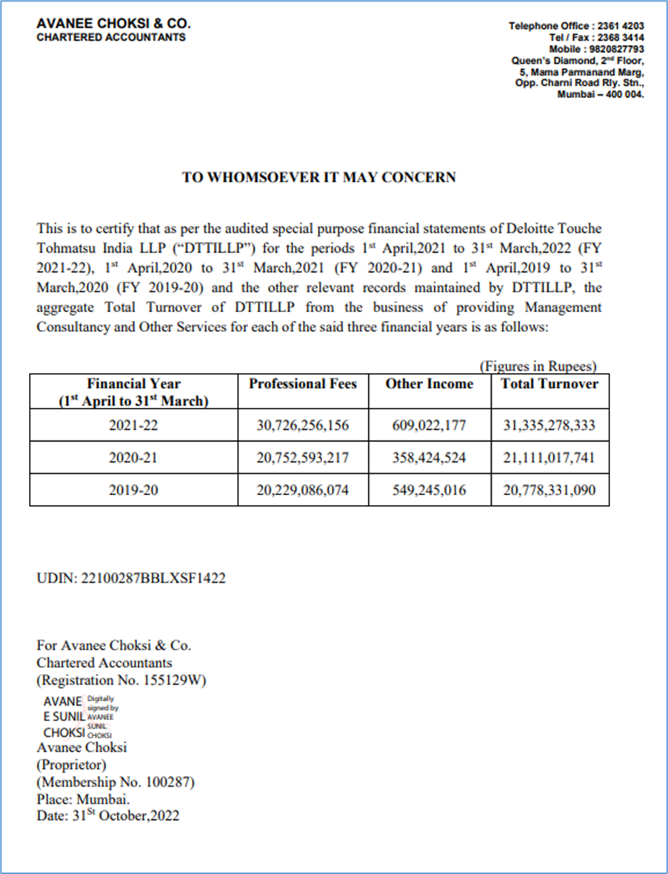
Financial Turnover

Slide 126
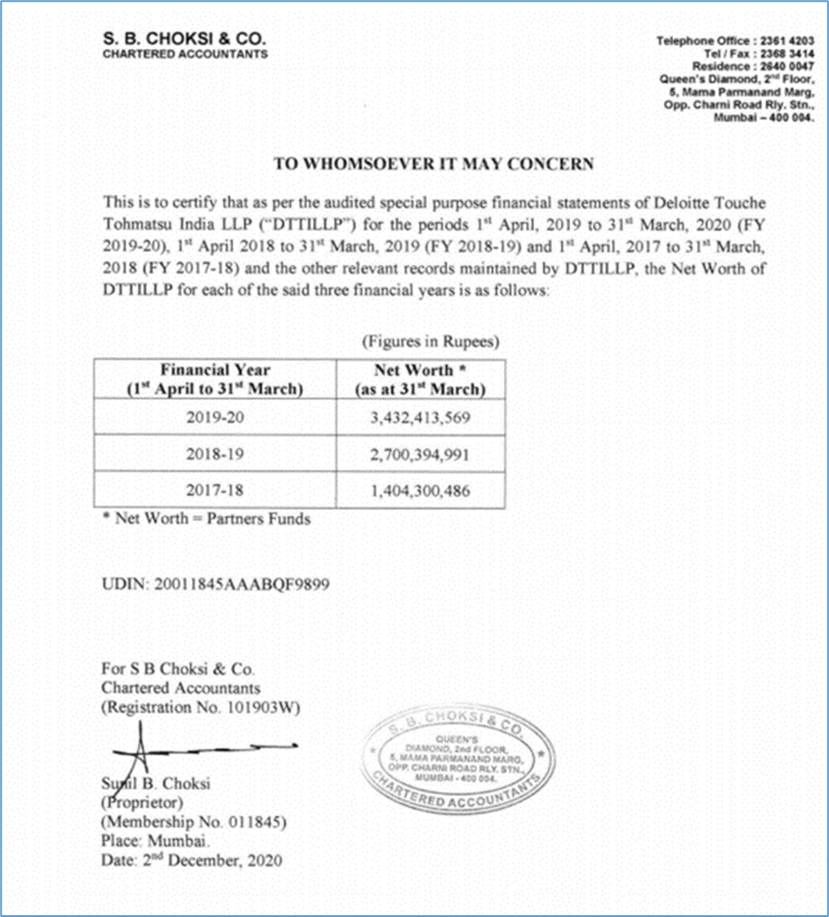
Financial Turnover

Slide 127
Relevant Documents

Slide 128
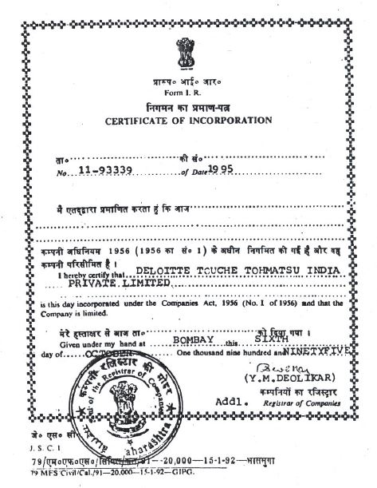
Certificate of Incorporation of Deloitte Touche Tohmatsu India Private Limited

Slide 129
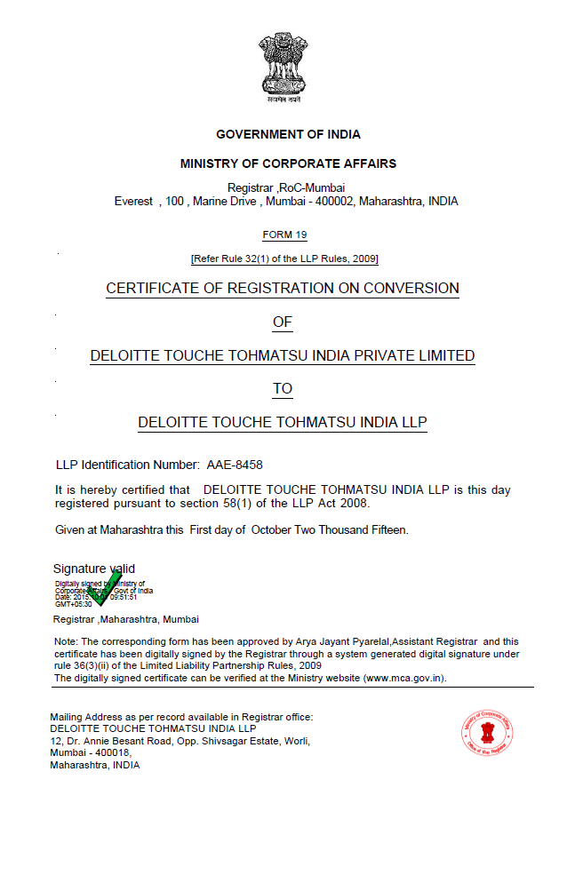
Certificate of Registration
Proof of name change from Deloitte Touche Tohmatsu India Private Limited (DTTIPL) to Deloitte Touche Tohmatsu India LLP (DTTILLP))

Slide 130
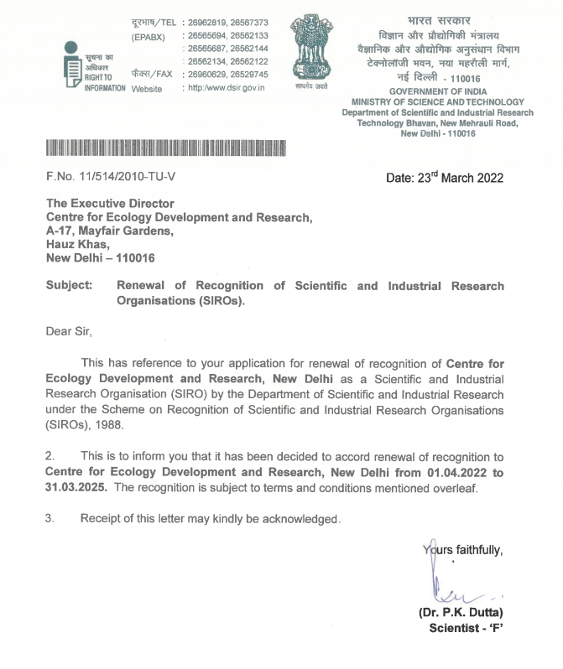
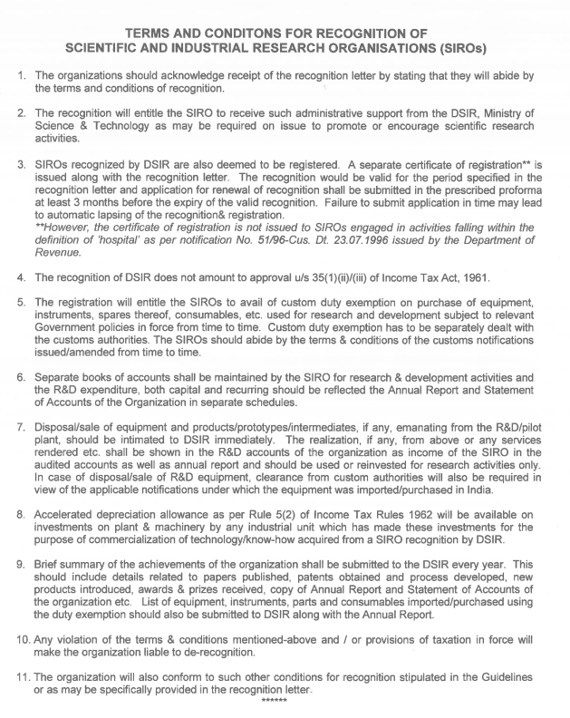
Scientific and Industrial Research Organisation recognition of CEDAR by the Department of Science and Technology, Govt. of India

Slide 131
Deloitte refers to one or more of Deloitte Touche Tohmatsu Limited, a UK private company limited by guarantee (“DTTL”), its network of member firms, and their related entities. DTTL and each of its member firms are legally separate and independent entities. DTTL (also referred to as “Deloitte Global”) does not provide services to clients. Please see www.deloitte.com/about to learn more about our global network of member firms.
Deloitte provides audit & assurance, consulting, financial advisory, risk advisory, tax and related services to public and private clients spanning multiple industries. Deloitte serves four out of five Fortune Global 500® companies through a globally connected network of member firms in more than 150 countries and territories bringing world-class capabilities, insights, and high-quality service to address clients’ most complex business challenges. To learn more about how Deloitte’s approximately 258,000 professionals make an impact that matters, please connect with us on Facebook, LinkedIn or Twitter.
This communication contains general information only, and none of Deloitte Touche Tohmatsu Limited, its member firms, or their related entities (collectively, the “Deloitte Network”) is, by means of this communication, rendering professional advice or services. Before making any decision or taking any action that may affect your finances or your business, you should consult a qualified professional adviser. No entity in the Deloitte Network shall be responsible for any loss whatsoever sustained by any person who relies on this communication.

